Slide 1
It’s my life
Samy poulin

Slide 2
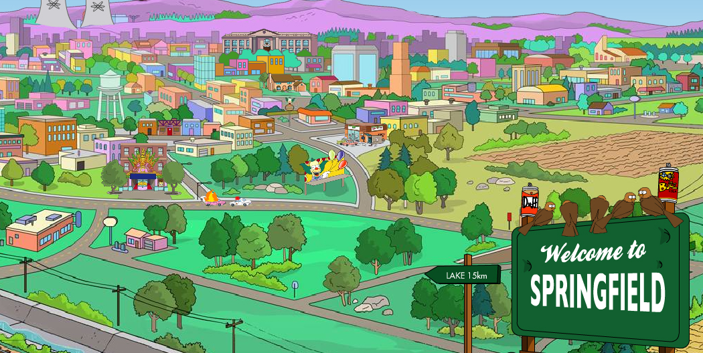
It's my life

Slide 3

It's now or never

Slide 4
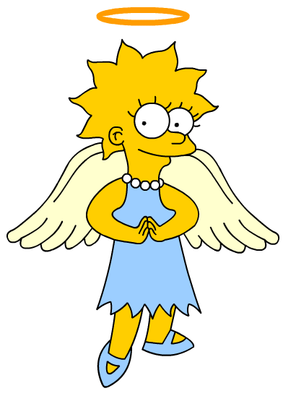
Cause I ain't gonna live forever

Slide 5
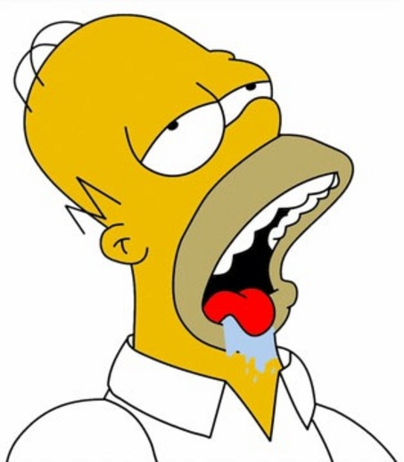
Luck ain't even lucky

Slide 6
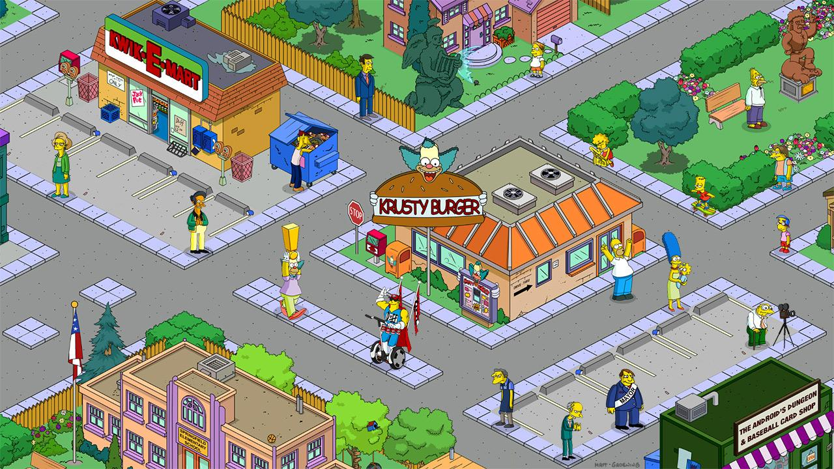
I just want to live while I'm alive

Slide 7
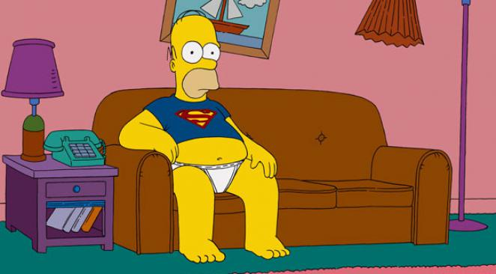
I did it my way

Slide 8

Don't bend, don't break, hell, don't back down

Slide 9
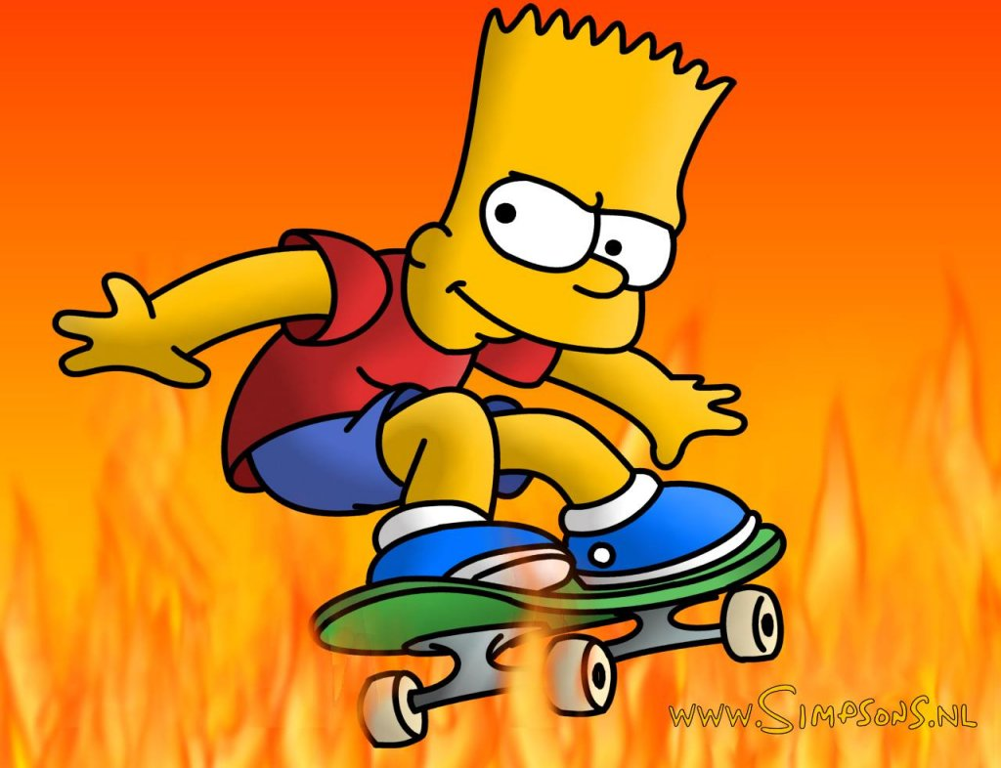
My heart is like an open highway

Slide 10

Got to make your own breaks

Slide 11
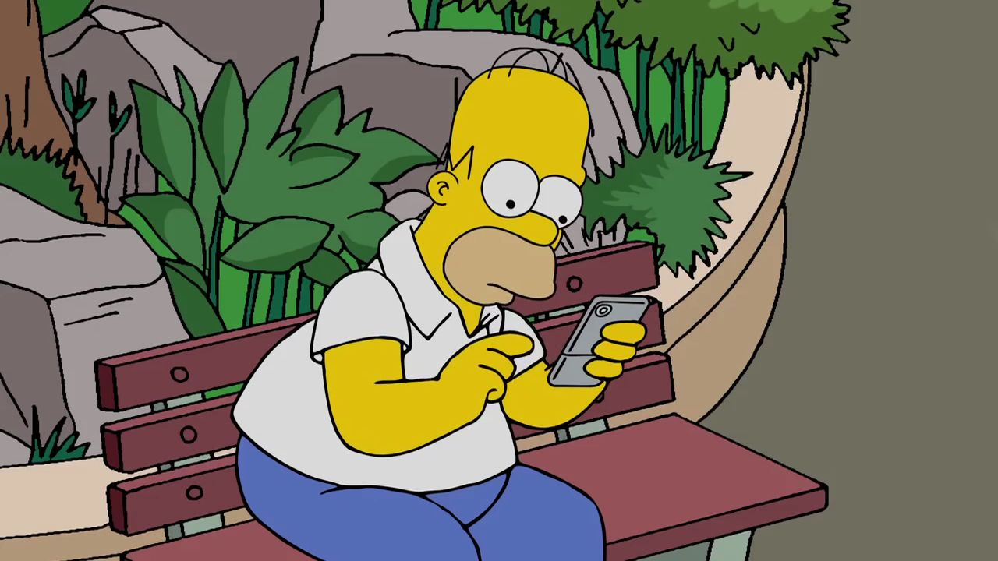
I ain't gonna be just a face in the crowd

Slide 12

You're gonna hear my voice

