Slide 1
We are the champions
Par : Hubert Lessard

Slide 2
No pleasure cruise

Slide 3
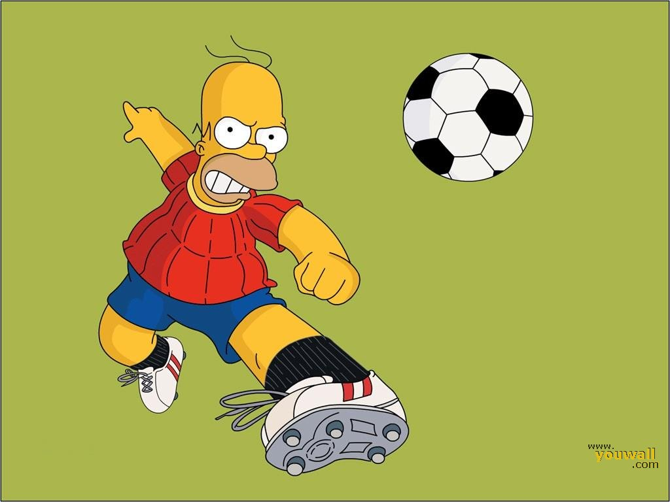
No pleasure cruise

Slide 4
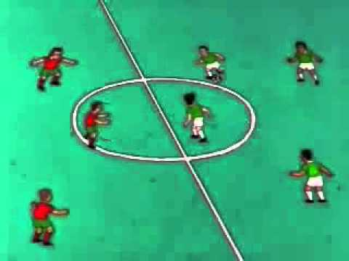
And we'll keep on fighting

Slide 5
I've made a few

Slide 6
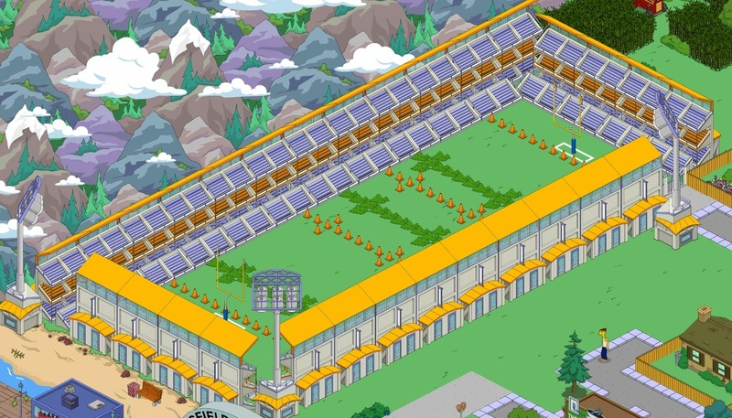
You brought me fame and fortuen and everything that goes with it

Slide 7
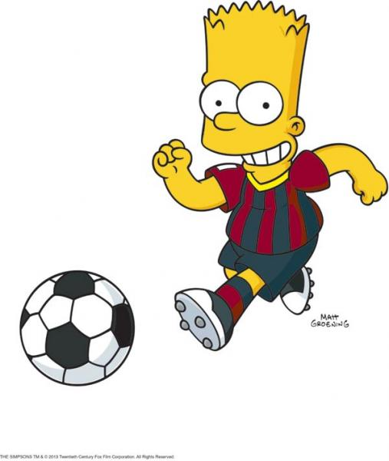
I've taken my bows

Slide 8
No time for losers

Slide 9
I've paid my dues

Slide 10
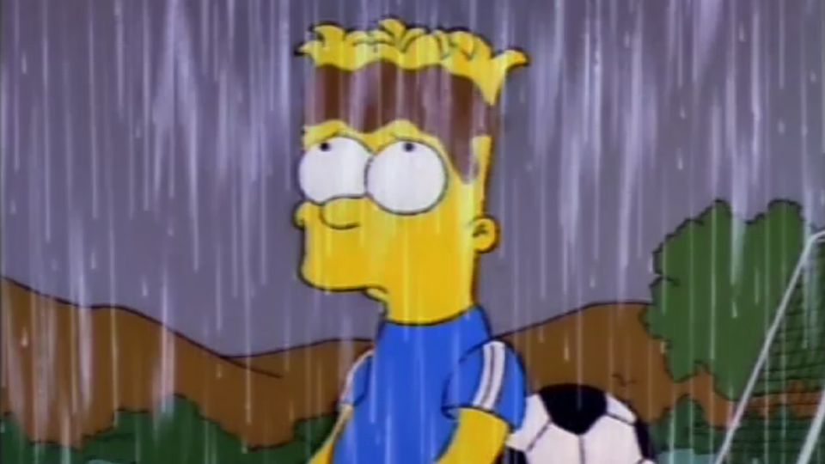
I've had my share of sand kicked in my face

Slide 11
We are the champions

