Slide 1
Storyboard fait par Samuel Giroux

Slide 2
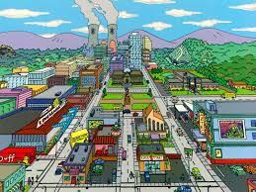
It's now or never

Slide 3

I ain't gonna live forever

Slide 4
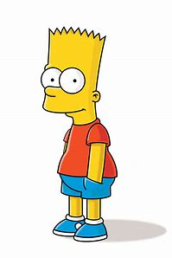
I did it my way

Slide 5
I just want to live while I'm alive

Slide 6


Tomorrow's getting harder make no mistake

Slide 7
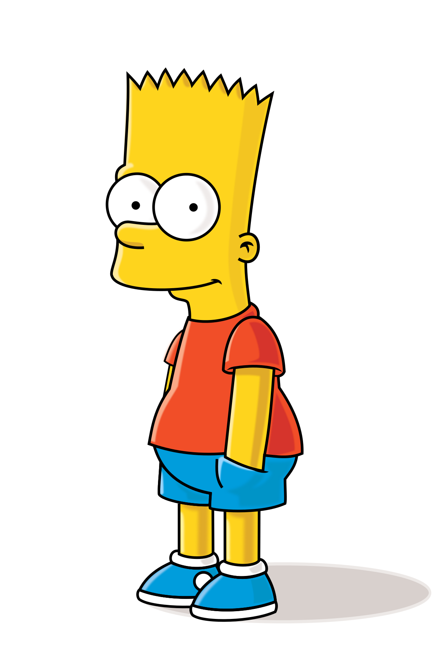


Cause I ain't gonna live forever

Slide 8
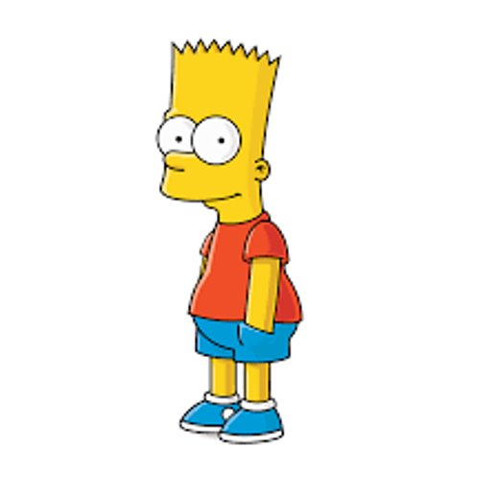
Luck ain't even lucky
Aidez moi

Slide 9


I just want to live while I'm alive

Slide 10

My heart is like an open highway

Slide 11
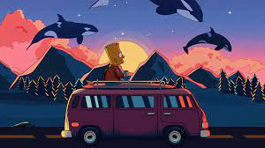
It's my life

