Slide 1
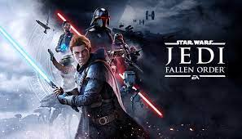

Slide 2
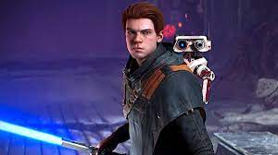
Jedi Fellen Order
It's the game of Star Wars. I can choose the color of my lightsaber, the paint for bd-1 and the cloth of Cal. I noticed that when you know the move of the enemies it very easy.

Slide 3
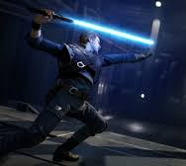

The fight
The difficulty is : story mode, Jedi knight, Jedi master and Jedi grand master, I chose Jedi knight. I love this game because there is a lot of capacity with the force, BD-1 and to fight

Slide 4
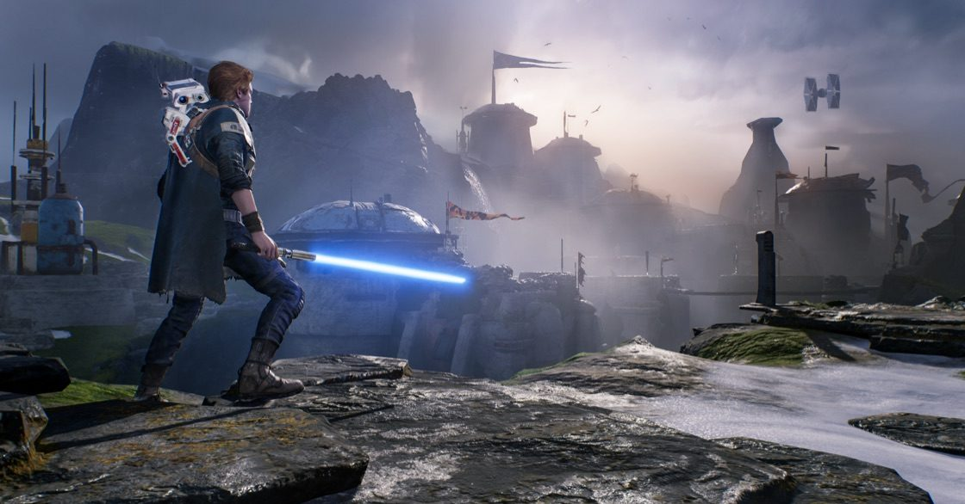
The story
the story is very long. The goal of Jedi Fallen Order is to find an Jedi holocron in an old Zeffo cilivisation to build a new Jedi order.

Slide 5
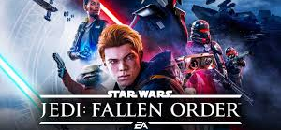
END

