Slide 1
Story Board
Fait par
Raphaël Tanguay

Slide 2
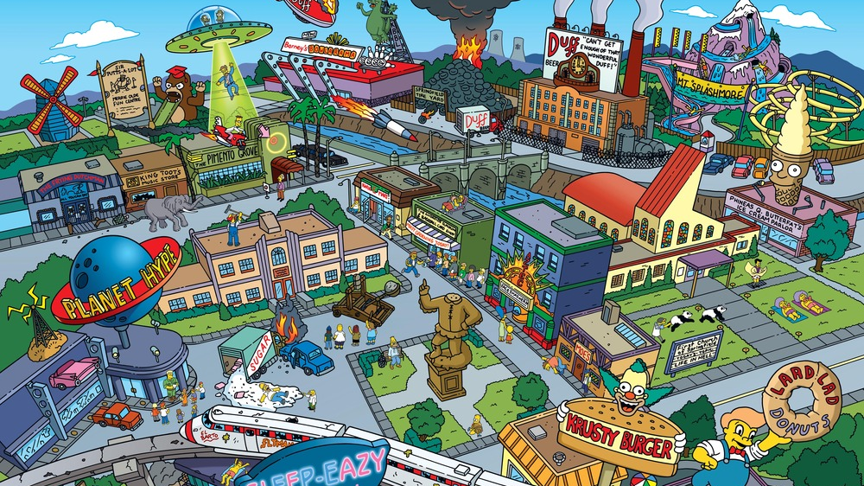
It's my life

Slide 3
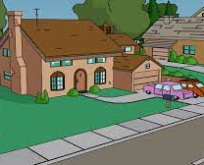
ow or never or never
Its now or never

Slide 4
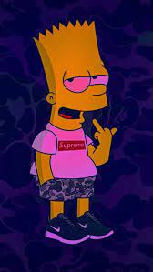
I ain't gonna live forever

Slide 5
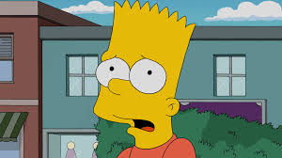
I just want to live while I'm alive

Slide 6
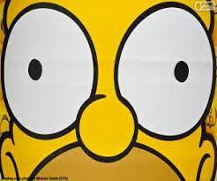



It's my life

Slide 7










My heart is like an open highway

Slide 8
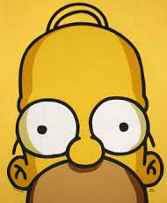
Like Frankie said

Slide 9
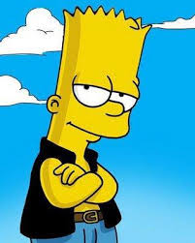
y
I did it my way

Slide 10
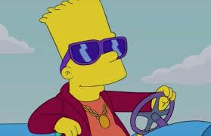
I just wanna live while I'm alive

Slide 11
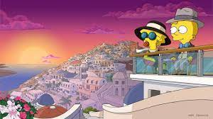
It's my life

