Slide 1
ITSS
Fait par Rosalie Boucher

Slide 2
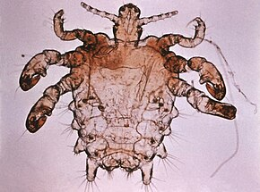
Morpions
Poux de pubis
Phtirus pubis
Transmission: relation sexuelle
Classification: parasite
Traitement: shampooing
This Photo by Unknown author is licensed under CC BY-SA.

Slide 3
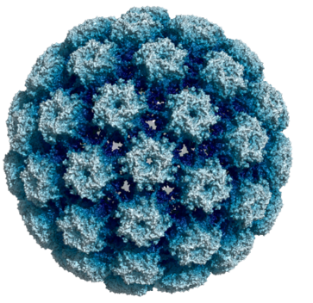
VHP
Virus papillome humain
Human papillomavirus
Transmission relation sexuelle
Classification: virus
Traitement: vaccin ou laser
This Photo by Unknown author is licensed under CC BY-SA.

Slide 4
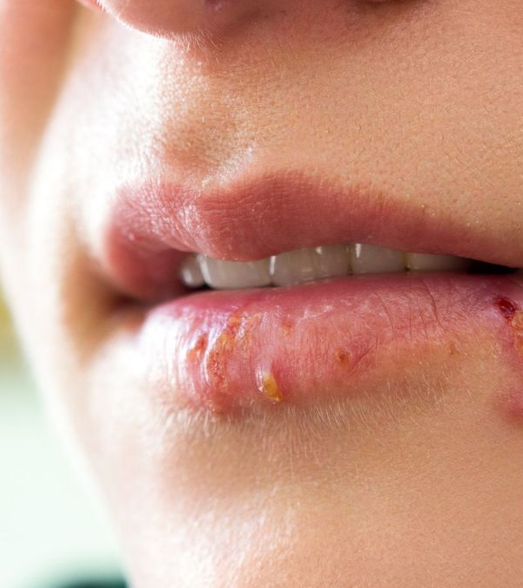
Herpèse
Feu sauvage
Herpes simplex
Transmission: relation sexuelle
Classification: virus
Traitement: crème

Slide 5
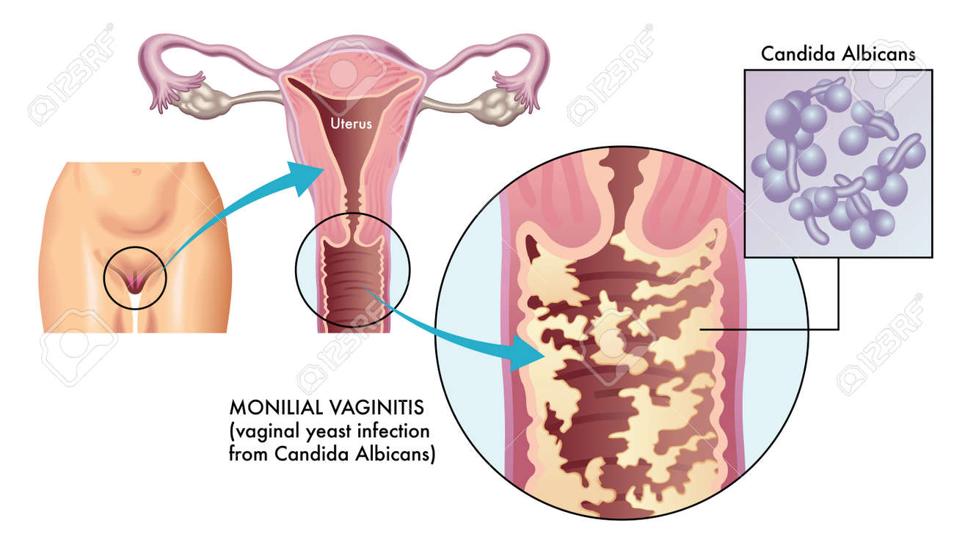
Vaginite à levure
Tricomonas vaginalls
Relation sexuelle
Classification: protiste
traitement: crème

Slide 6
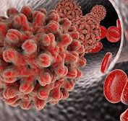
Hépatite B
Jaunisse
VhB
Transmission: relation sexuelle
Classification: virus
Traitement: vaccin

Slide 7
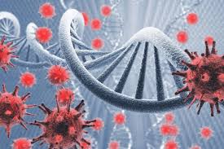
VIH
Sida
HIV
Transmission: relation sexuelle
Classification: virus
Traitement: 3 trithérapie

Slide 8
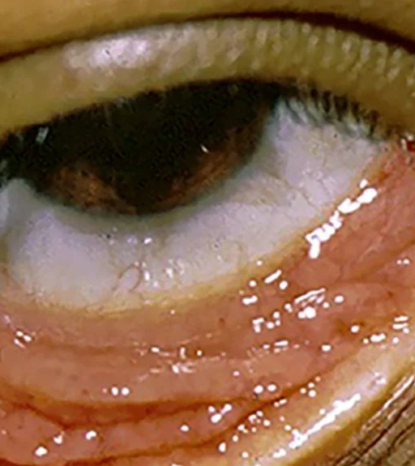
Chlamydia
Chlamydia trachomatis
Transmission: relation sexuelle
Classification: bactérie
Traitement: antibiotique

Slide 9
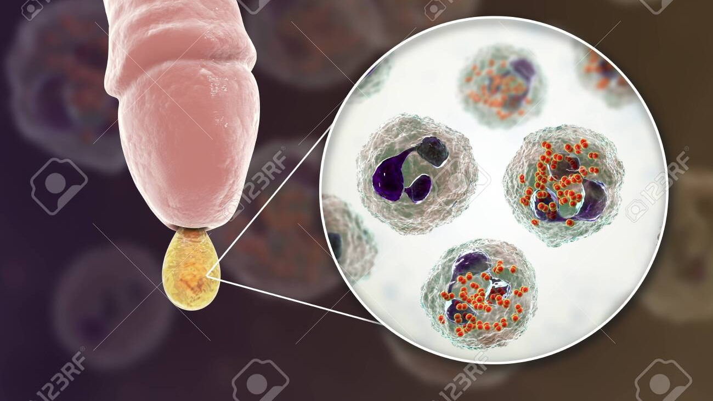
Gonornée
Chaude pisse
Neisseria gonorrhoeae
Transmission: relation
Classification: bactérie
Traitement: antibiotique

Slide 10
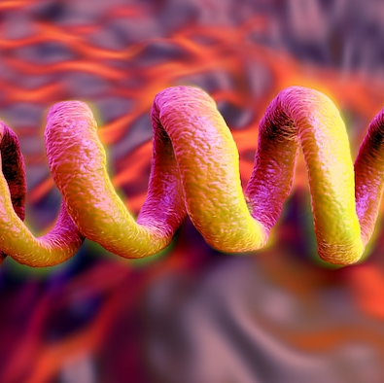
Syphilis
Treponema pallidum subsp pallidum
Transmission: relation sexuelle
Classification: bactérie

