Slide 1
Storyboard fait par Mavrik Poulin

Slide 2
Its my life

Slide 3
It's now or never

Slide 4
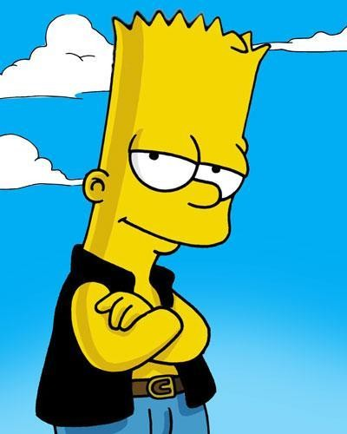
I ain't gonna live forever

Slide 5
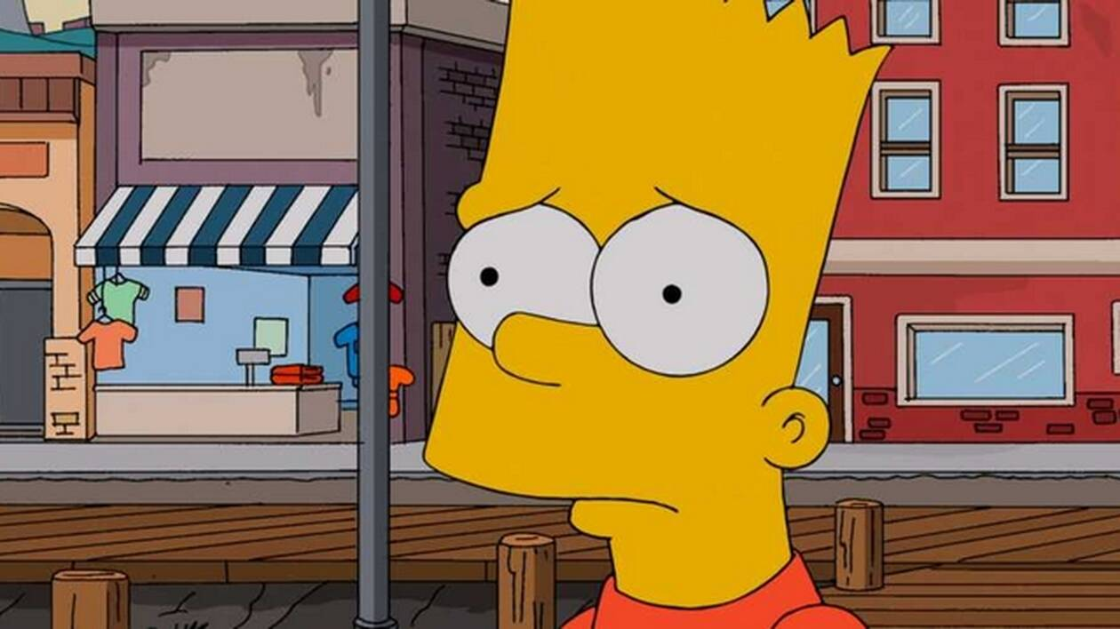
I just wanna live while I'm alive

Slide 6
My heart is like an open highway

Slide 7
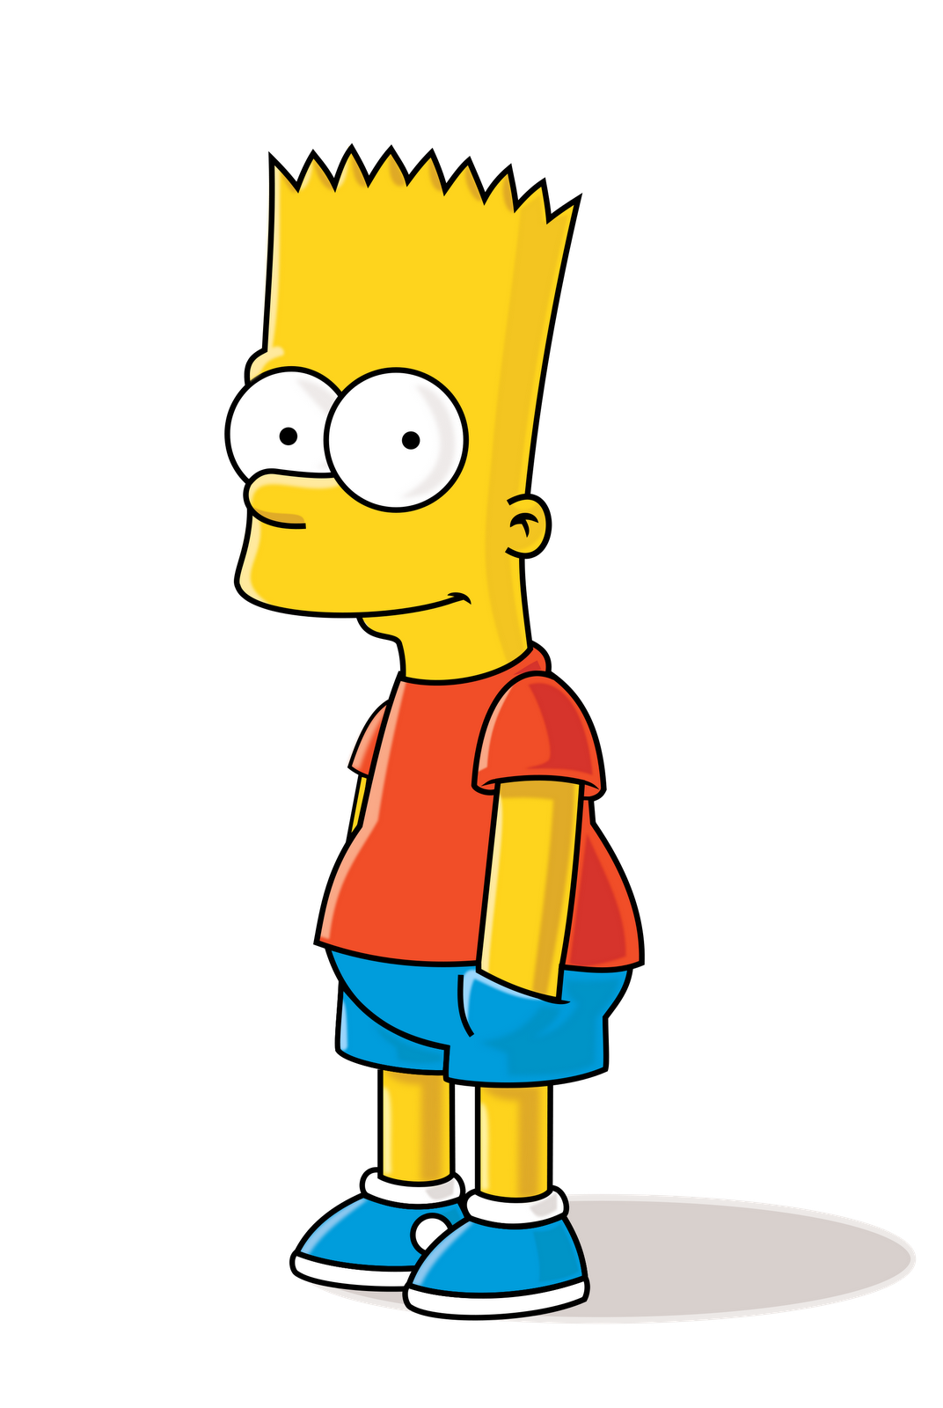
Don't bend, don't break, hell, don't back down

Slide 8
'Cause I ain't gonna live forever

Slide 9
Better stand tall when they're calling you out

Slide 10
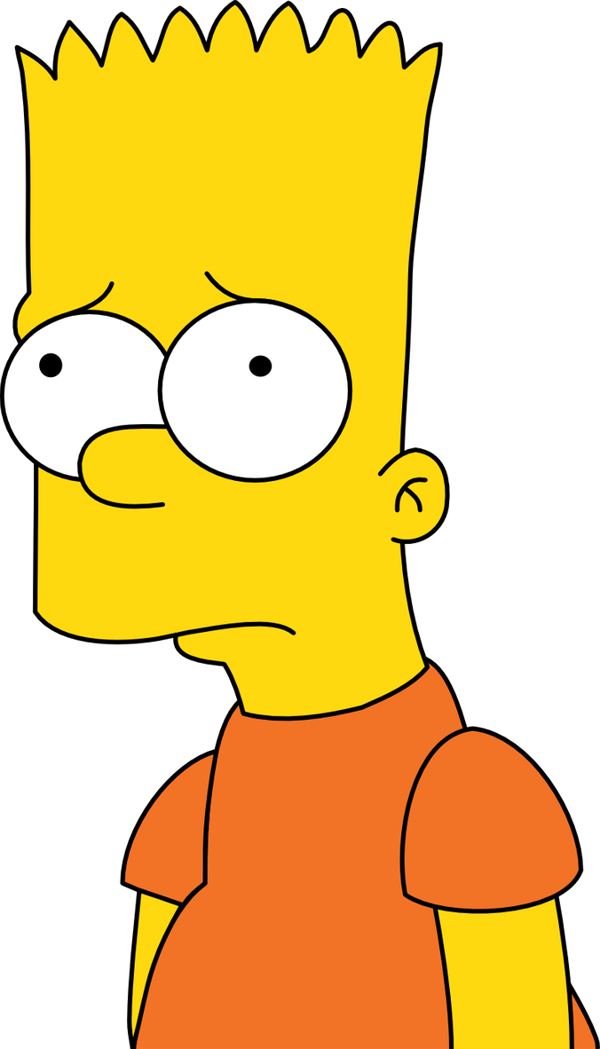

Slide 11
