Slide 1
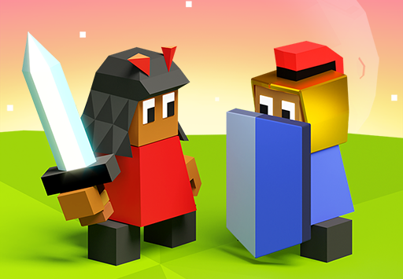
Polytopia

Slide 2
opinion
In my opinion, Polytopia is a game of strategy. To win the game, we must eliminate all the tribes. We need to choose how many tribes will play. It is a game where all tribes are adversaries. I like that I can play with my friends if they are there. In this game we should do alliance with other teams. I understand that when we break an alliance every soldiers that are in the city’s square dies and our other soldiers can’t move this turn. I find the fact that I may choose the number of tribes very interesting. I noticed that we can trick the number of robots by going to the multiplayer section. I must admit it make the game longer.

Slide 3
Start the game

Slide 4
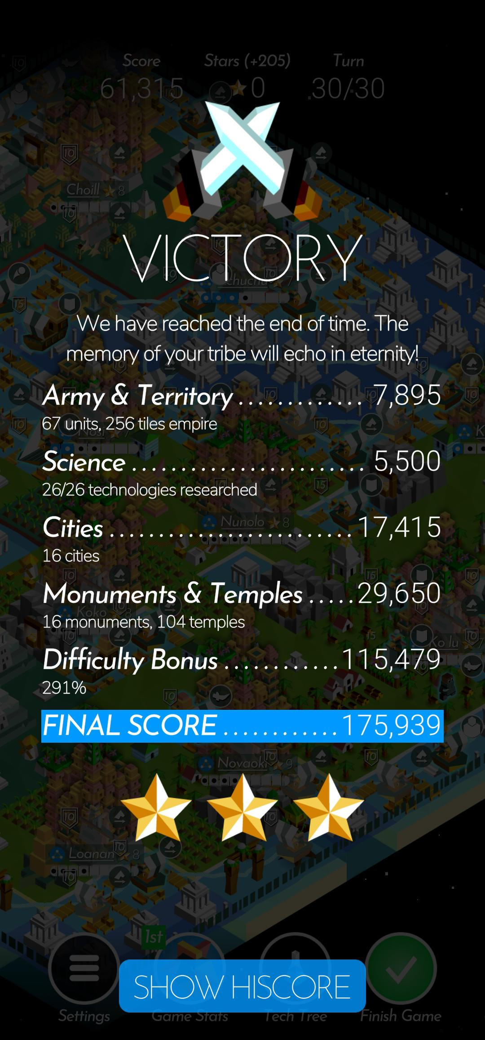
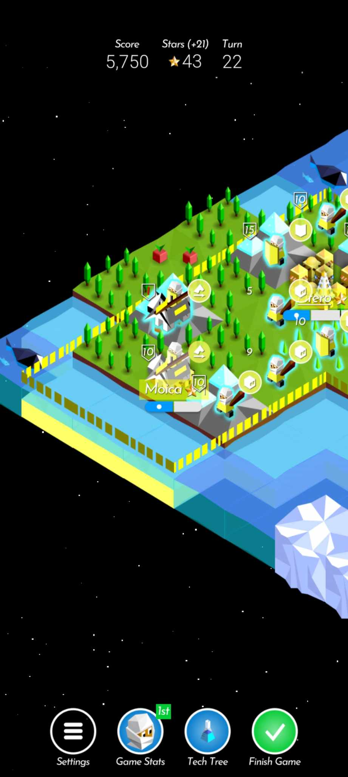
The goal of the game
Eliminate all tribes​

Slide 5
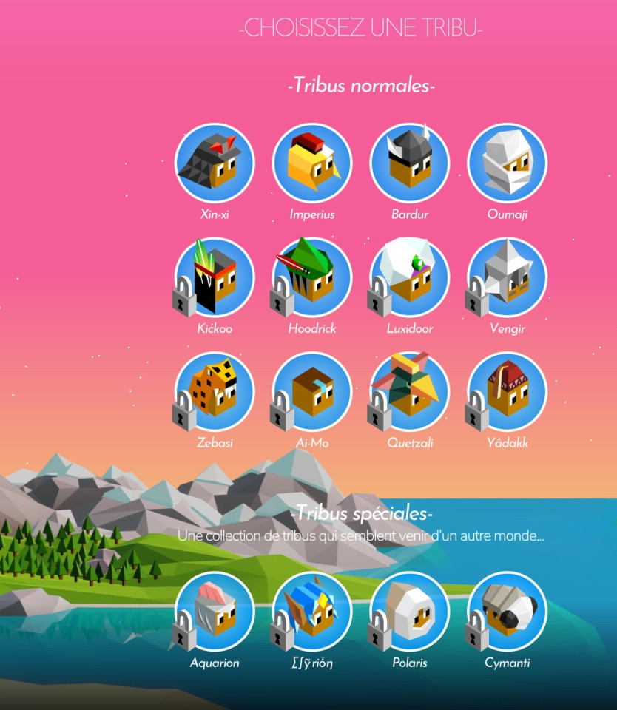
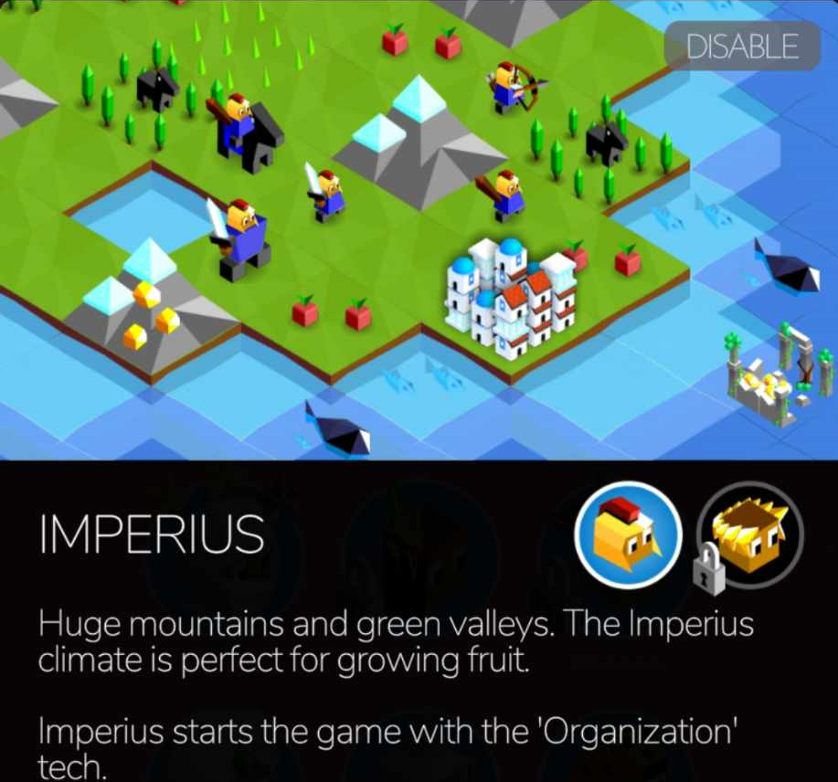
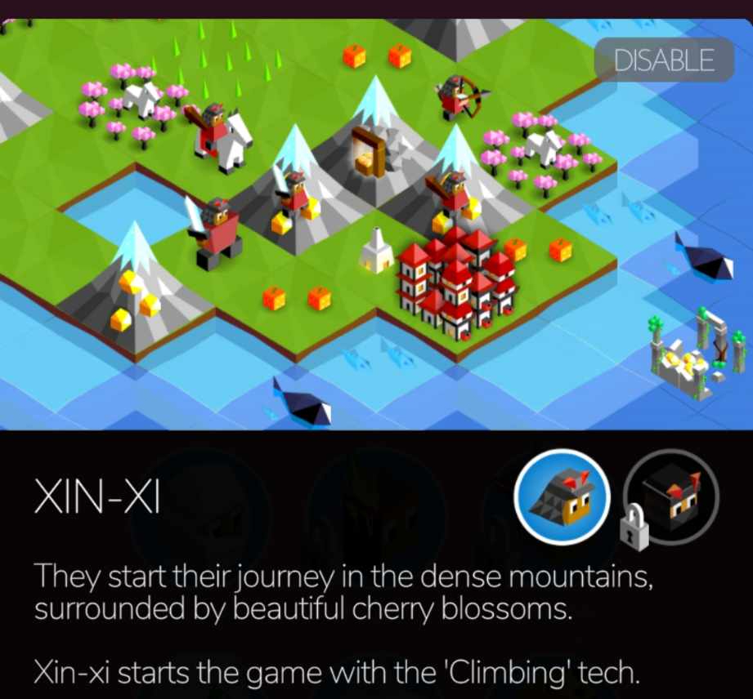
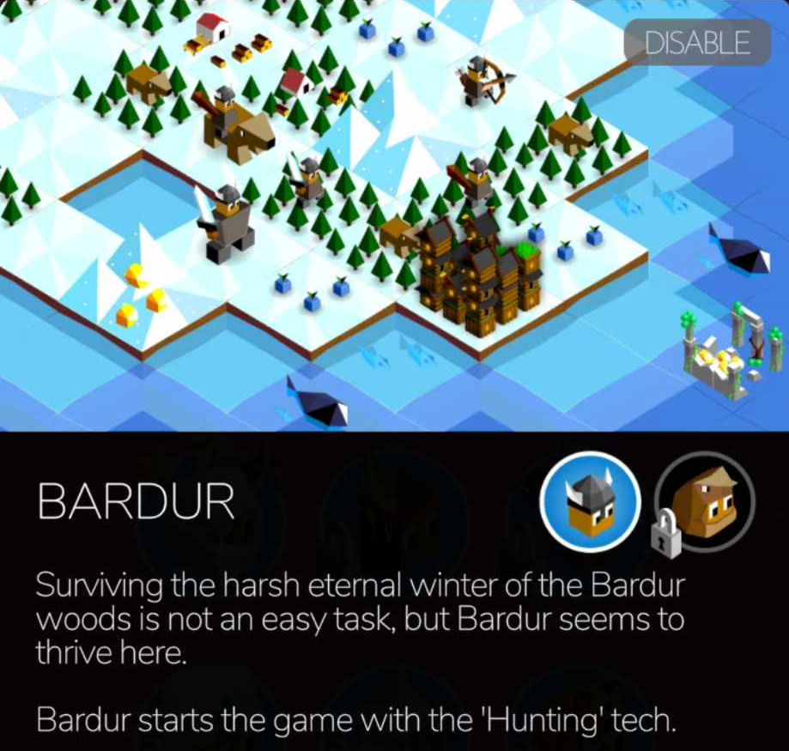
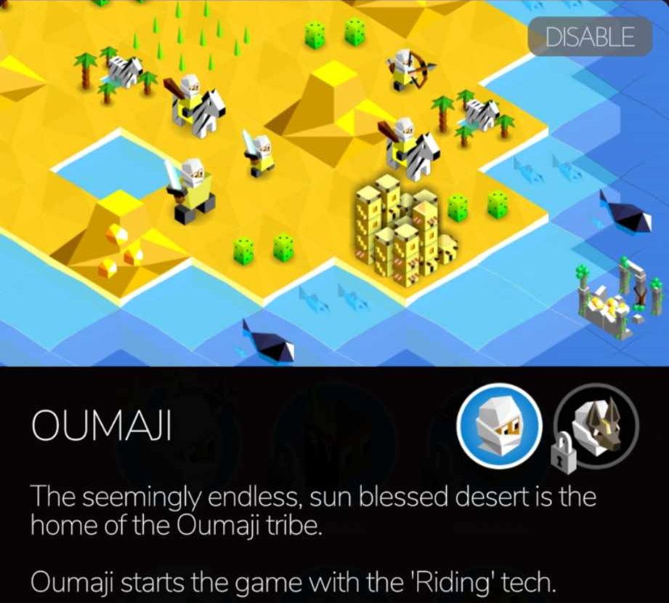
Tribes
When we start a game, we can choose a tribe
Every tribe starts with a capacity
The Oumaji tribe starts with capacity of riding
The Bardur's capacity is hunting
The Xin-xi's capacity is climbing
The Imperius' capacity is organization
Etc.

Slide 6
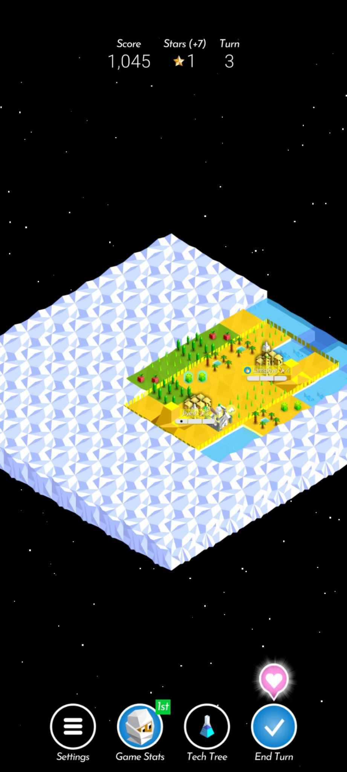
Money

Slide 7
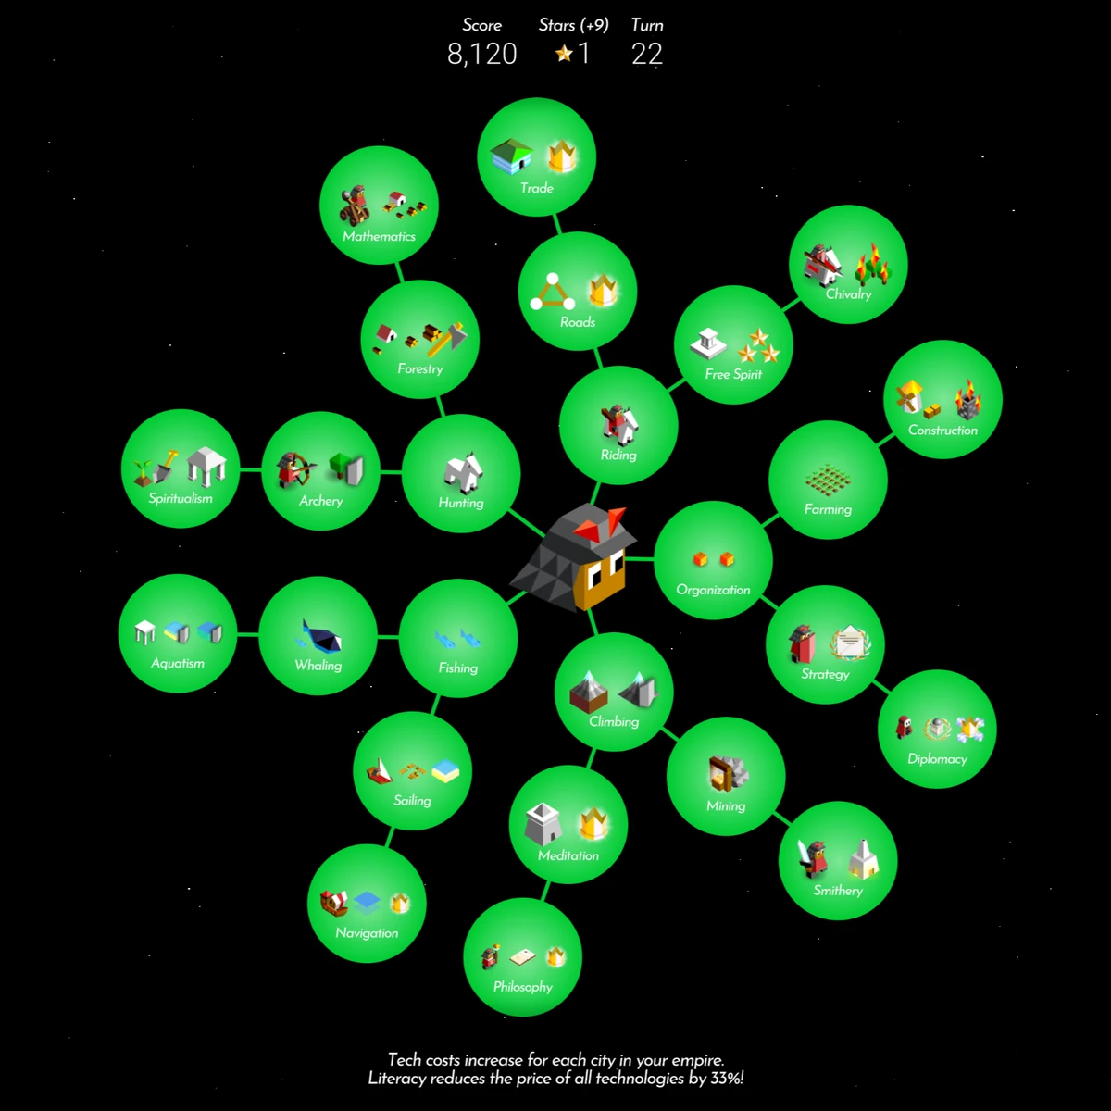
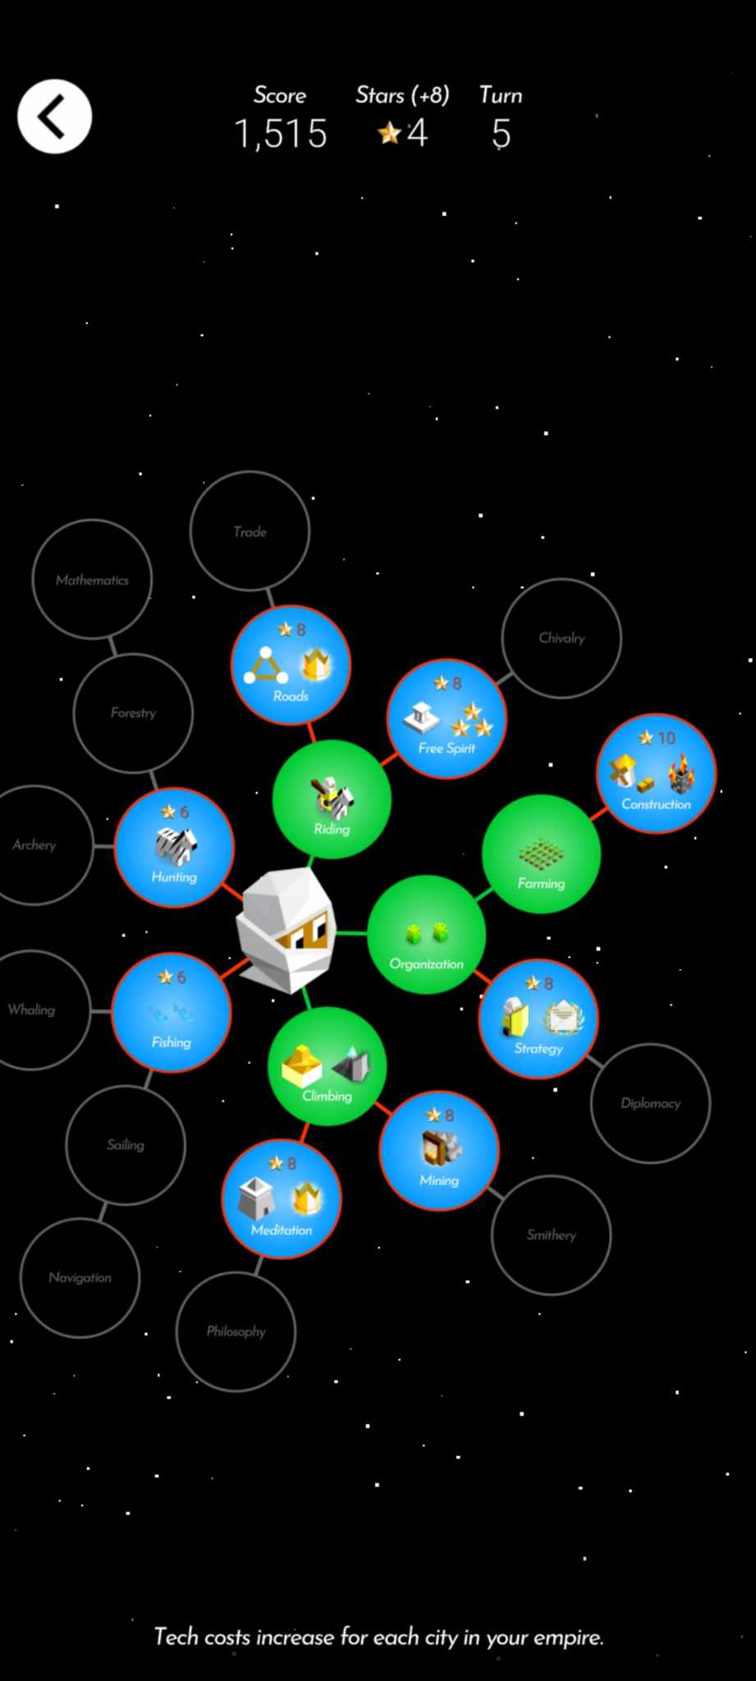
Capacity

Slide 8
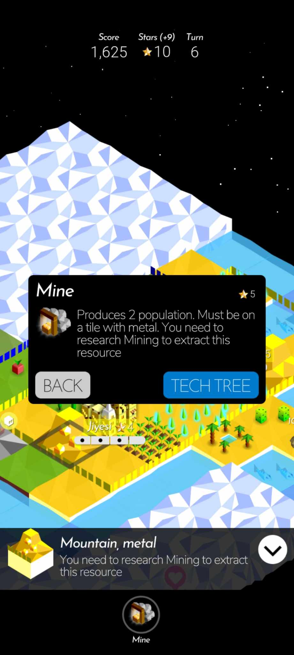
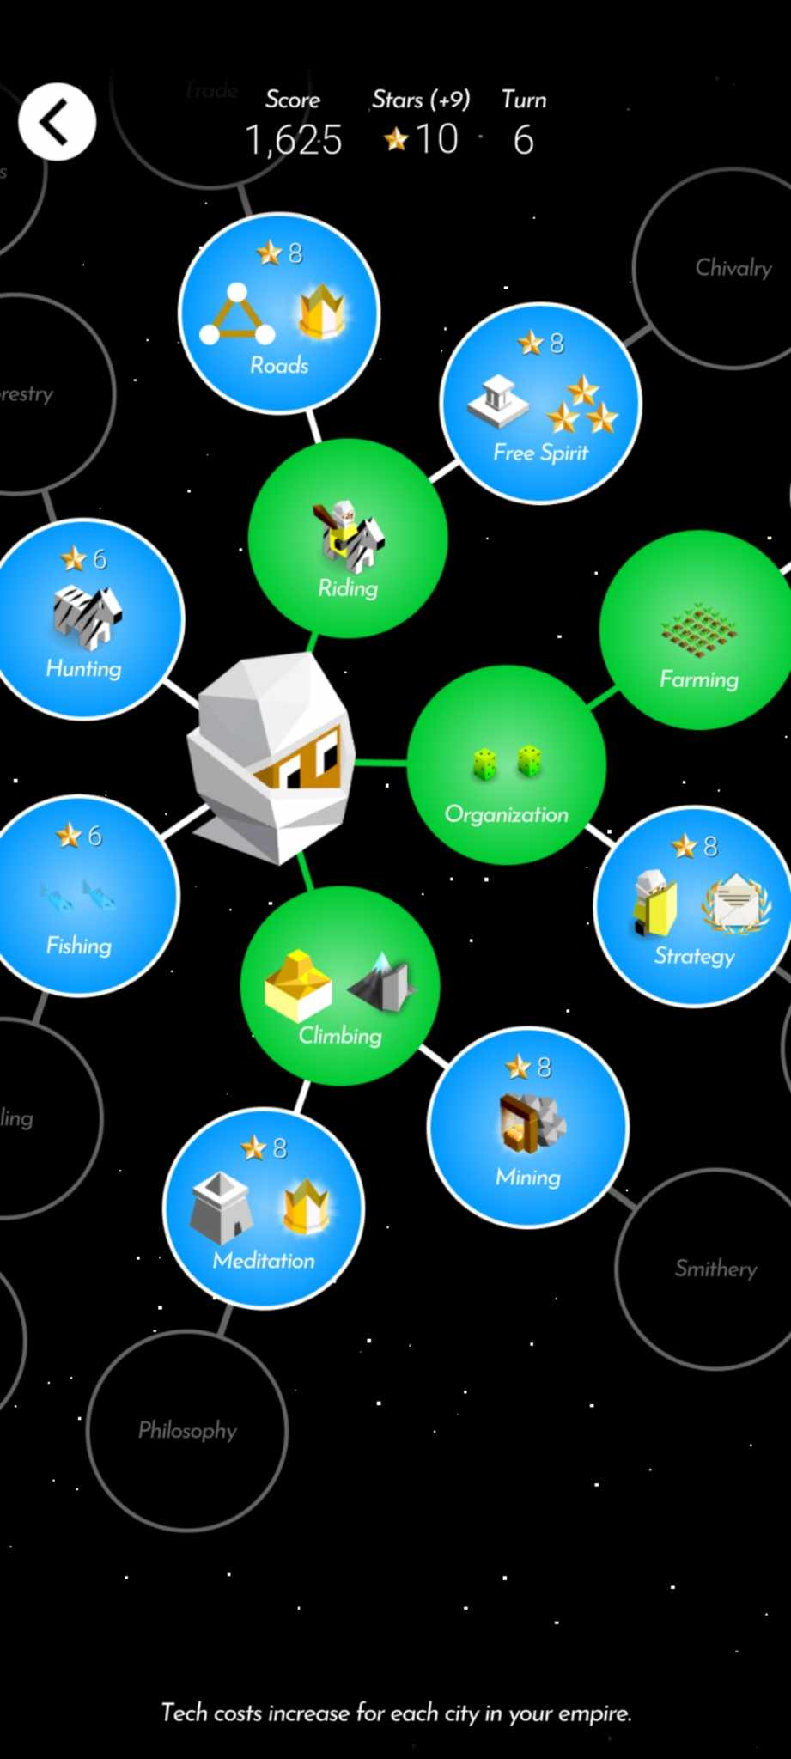
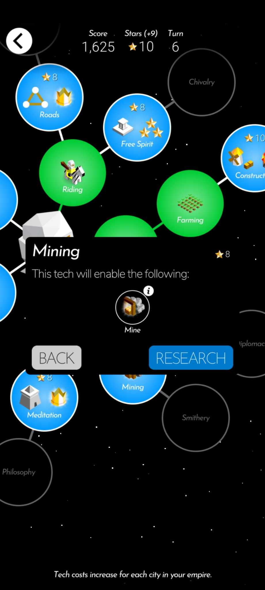
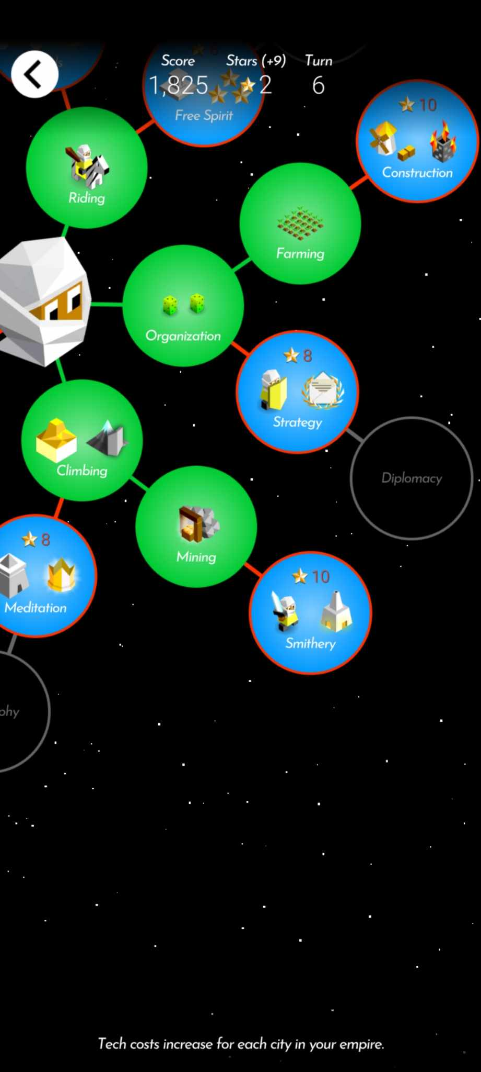
Capacity
1
2
3
4
5

Slide 9
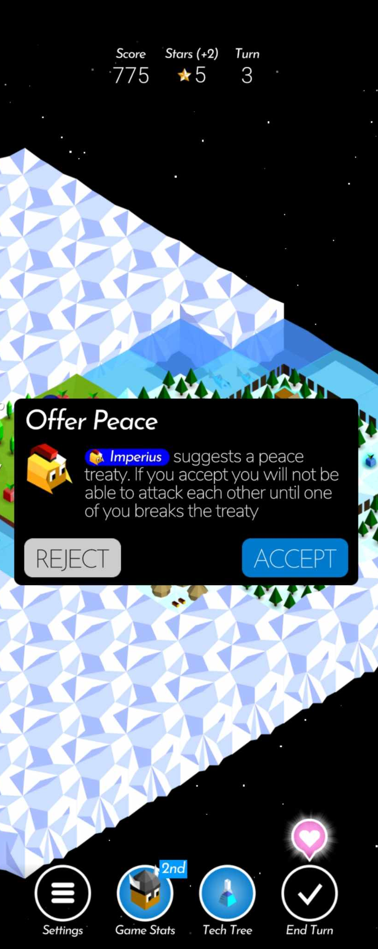
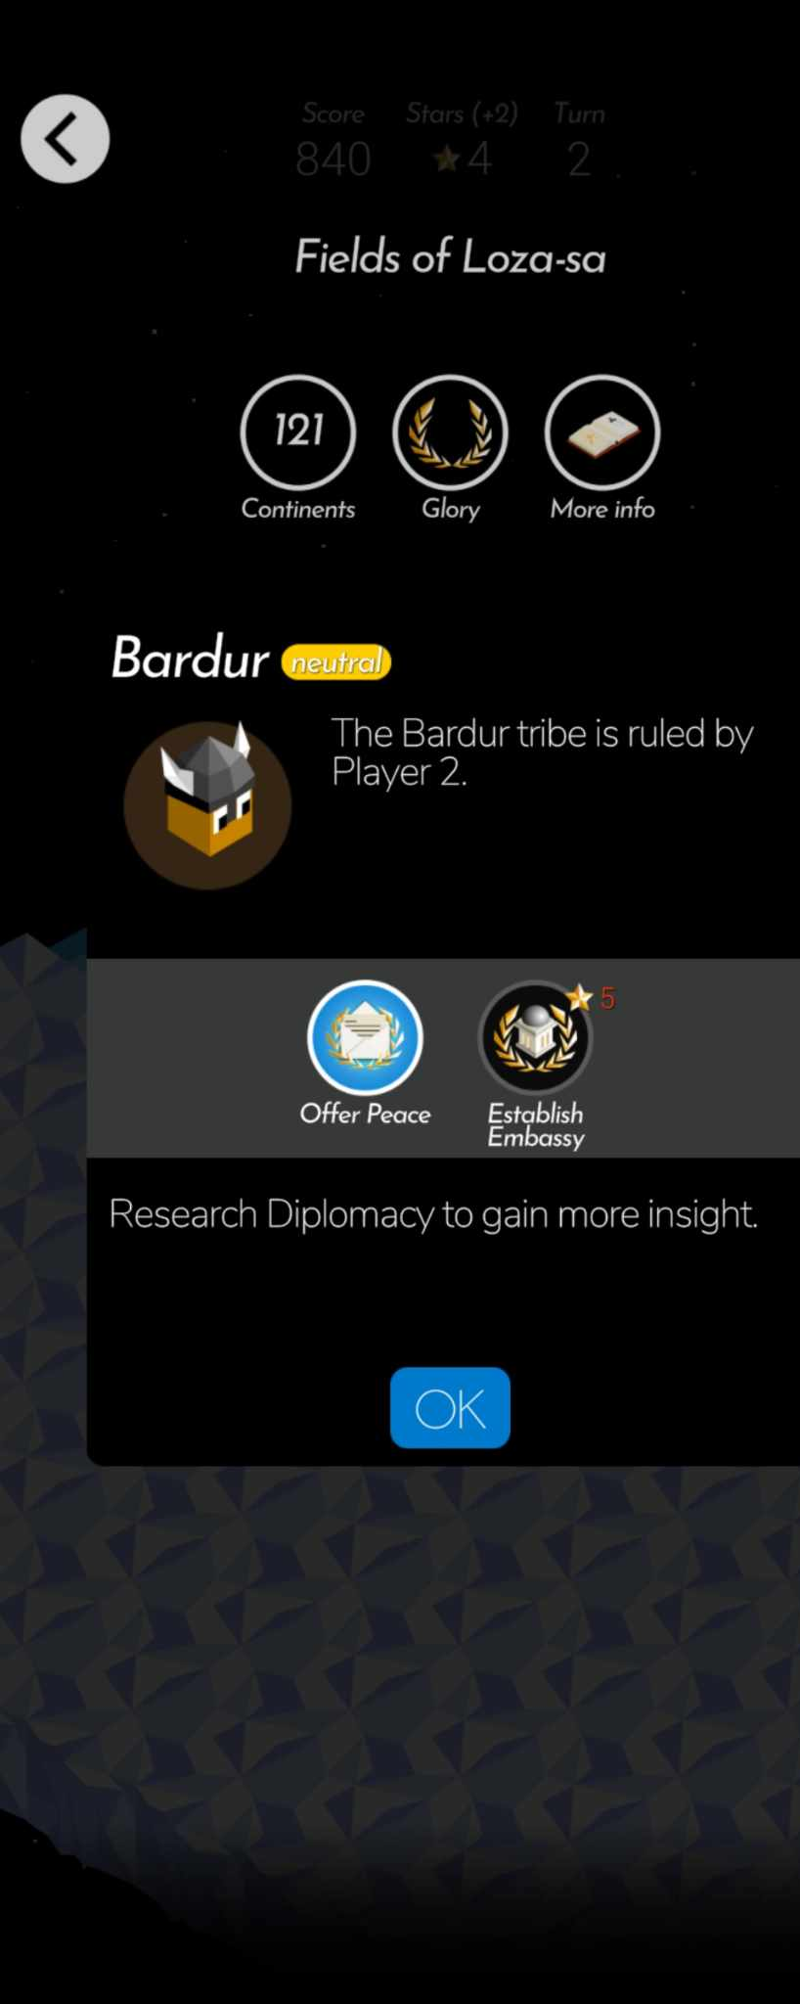
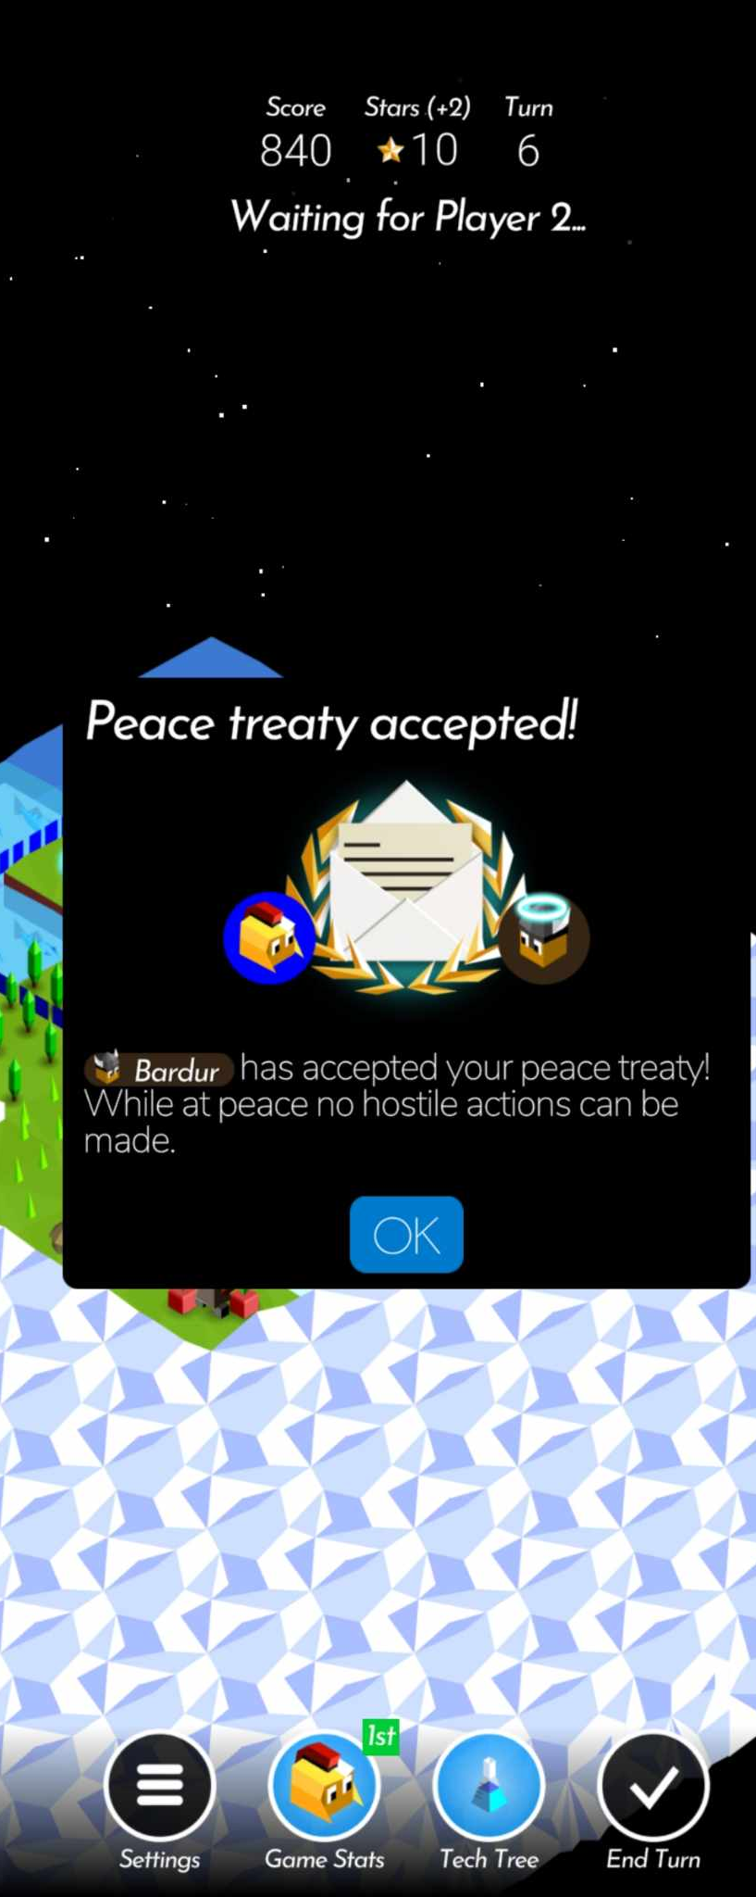
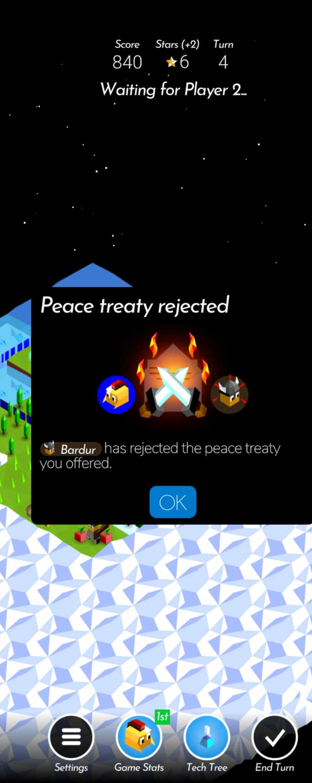
Strategy
make an alliance with another tribe until only one remains

Slide 10
We can play that on a cell

