Slide 1
Storyboard
Fait par Elizabeth Vachon

Slide 2
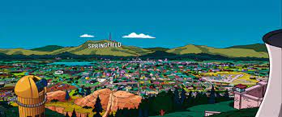
Once upon a time

Slide 3
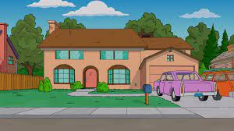
Gina works the diner all day

Slide 4
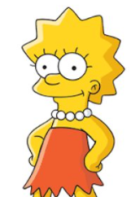
She says: We've got to hold on to what we've got

Slide 5
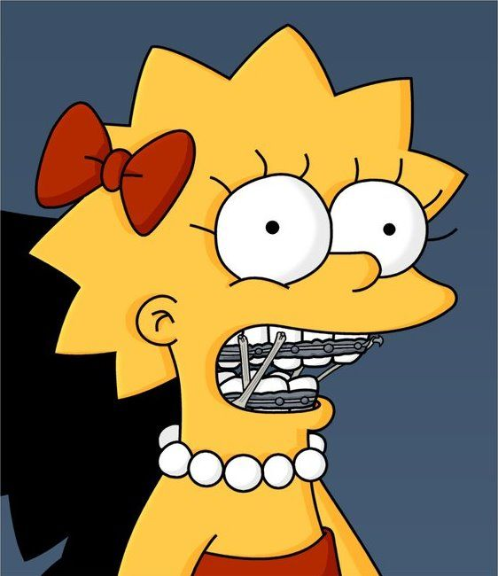
We're half way there

Slide 6
Tommy got his six string in hock

Slide 7
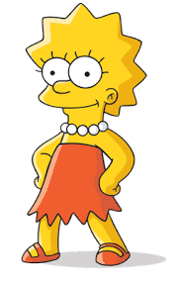
Gina dreams of running away

Slide 8
For love - we'll give it a shot

Slide 9
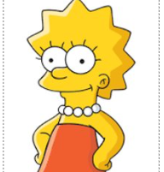
Livin' on a prayer

Slide 10
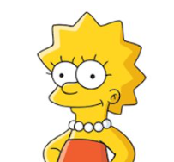
Take my hand and we'll make it - I swear

Slide 11
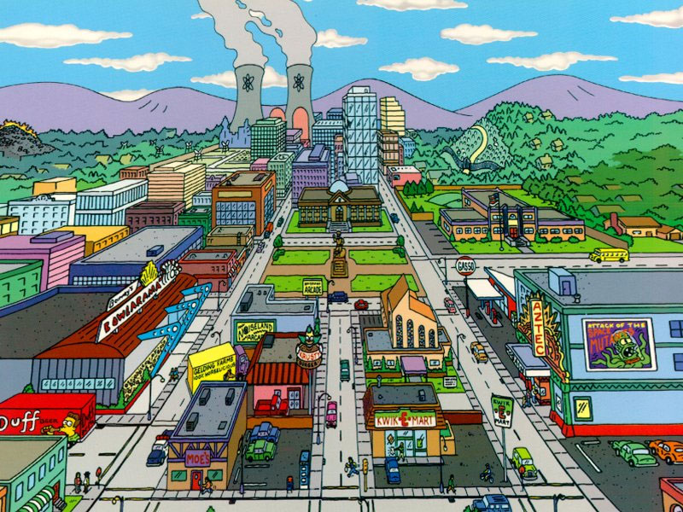
You live for the fight when it's all that you've got

