Slide 1
Itss fait par Edouard Lambert

Slide 2
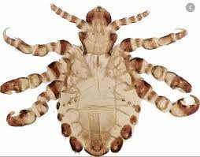
Morpions
Poux de pubis
Phtirus pubis
Transmission: Relation sexuelle
Classification: parasite
Traitement: Shampoing

Slide 3
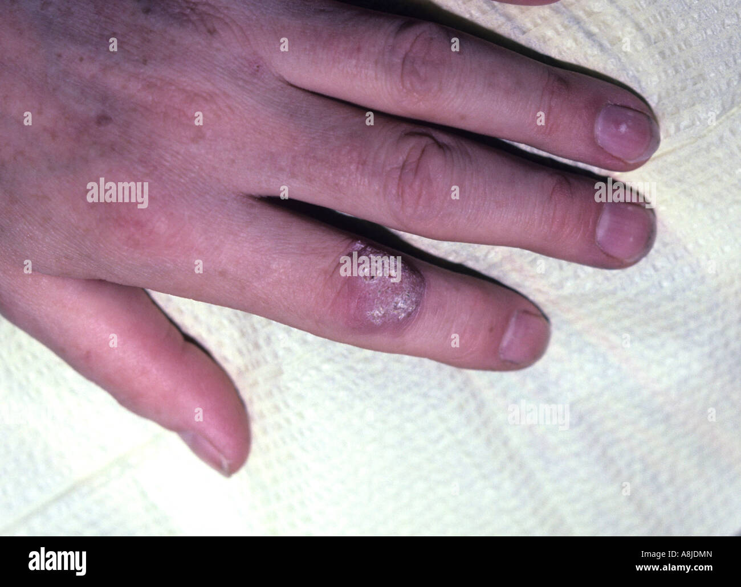
Vph
Virus papillone humain
Human papionavirus
Transmission: Relation sexuelle
Classification: virus
Traitement: vaccin,laser,azote liquide

Slide 4
Herpès feux sauvages
Herpes simplex
Transmission: relation sexuelle
Classification: Virus
Traitement: crème

Slide 5
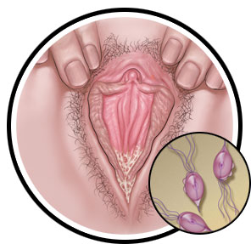
Vaginite à levure
Tricomonas vaginalis
Transmition: Relation sexuelle
Classification: protiste
Traitement: crème

Slide 6
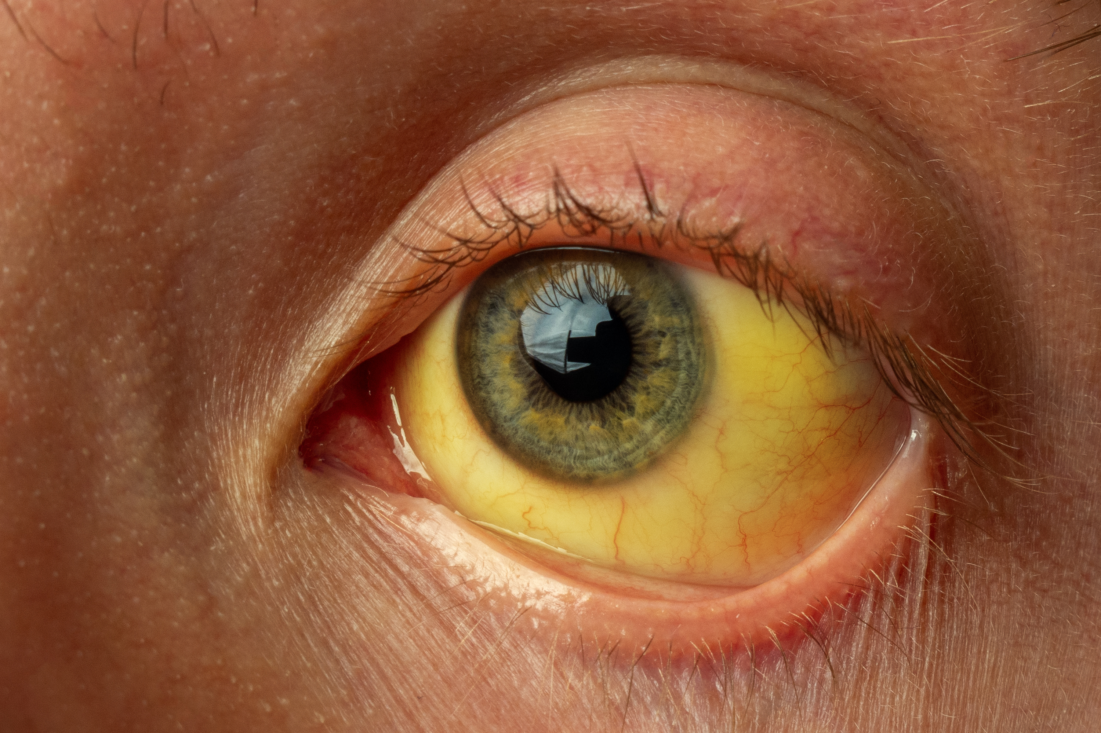
Hépatite B Jaunisse
VHB
Transmission: Relation sexuelle
Classification: virus
Traitement: vaccin

Slide 7
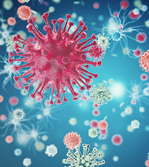
VIH sida
HIV
Transmission: relation sexuelle
Classification: virus
Traitement:Trithérapie

Slide 8
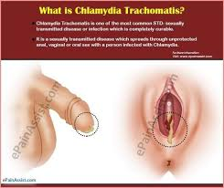
chlamydia
Chlamydia trachomatis
Transmission: Relation sexuelle
Classification: bactérie
Traitement:antibiotique

Slide 9
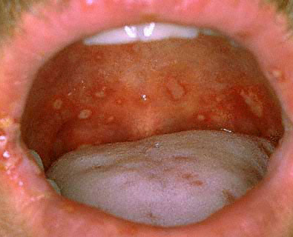
Gonorhée
Neisseria gonorrhoeae
Transmission: Relations sexuele
Classification: bactérie
Traitement: antibiotique

Slide 10
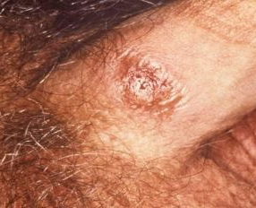
syphilis
Treponema pallidum subsp pallidum
Transmission: relation sexuelle
Classification:
Traitement:

