Slide 1
Projet g
Dylan Lessard Labbé

Slide 2

So come an take your time

Slide 3

can I take you home where we can be alone

Slide 4


asked for his name

Slide 5


Slide 6


Slide 7

.
.

Slide 8
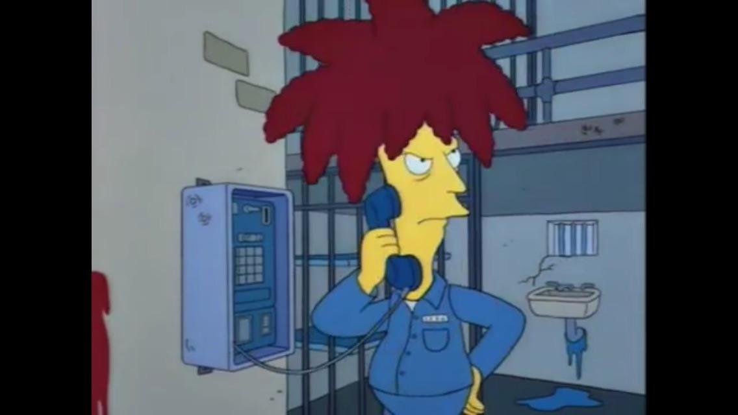

Slide 9
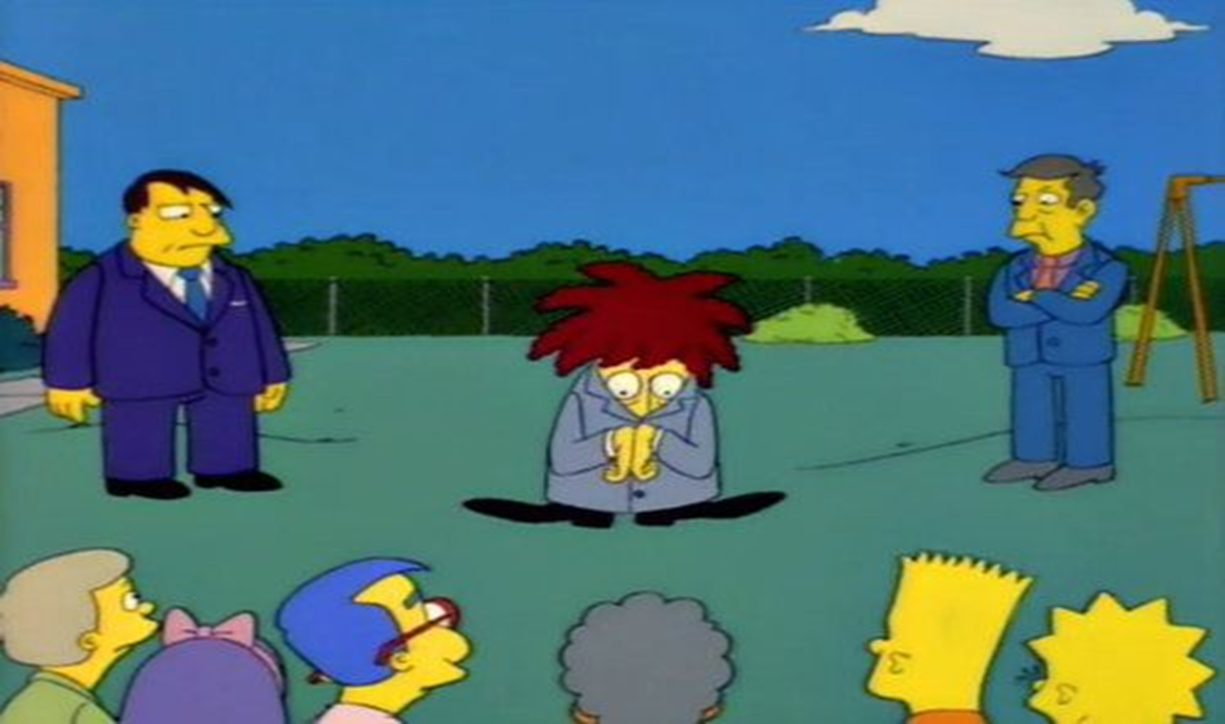

Slide 10
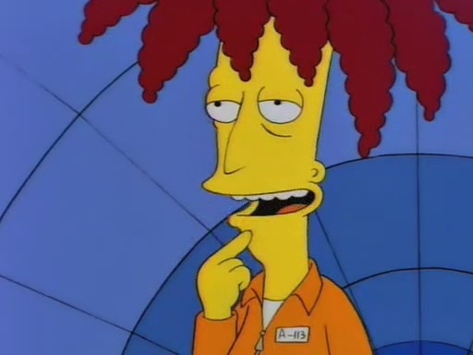

Slide 11
