Slide 1
Storyboard
Fait par Charles-Antoine

Slide 2
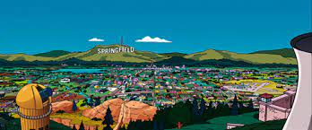
I did it my way

Slide 3
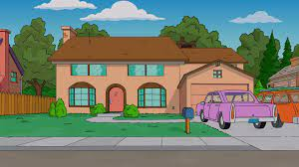
Like Frankie said

Slide 4
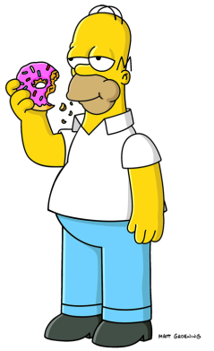
Don't bend, don't break, hell, don't back down

Slide 5

And it's now or never

Slide 6
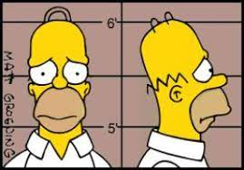
It's my life

Slide 7
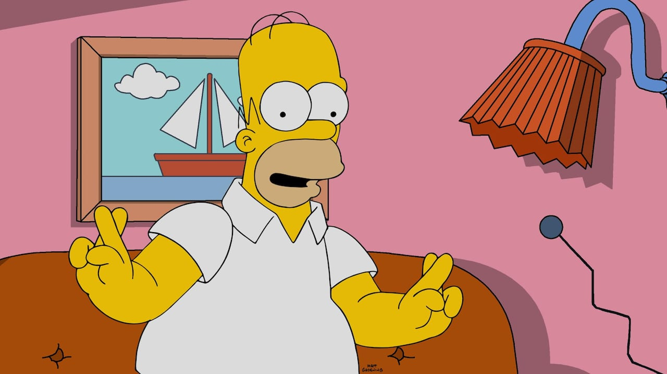
I just wanna live while I'm alive

