Slide 1
My video game project
Made by Alexis Berthiaume

Slide 2
God of war
Gods of wars
Greek mythology
God of war 3
God of war 1
Nordic mythology
God of war 2
God of war 4
God of war 5

Slide 3
God of war
There is many creature and many weapon.
The graphics are very realistic.
If you play the first God of war and you play the third God of war, you won't know what Kratos does in the second God of war

Slide 4
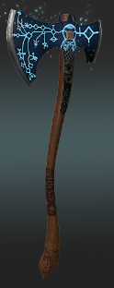
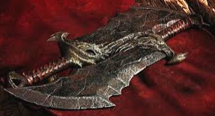
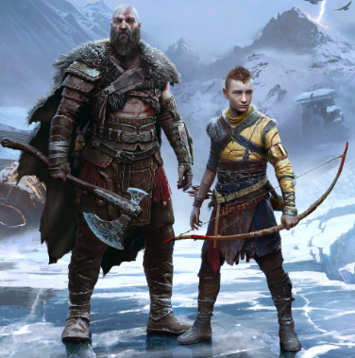
The main character and weapon
Leviathan axe
Kratos
The blade of chaos
and Atreus

Slide 5
Who is Kratos?
Kratos is a spartan
After accidentally killed his family
He is known as the ghost of Sparta
He was manipulated by the ancient war god, Ares
He avenge their death later
He became the new war god after killed Ares
Athena reveal him that Zeus is his father
Kratos swear that he will kill all the god

Slide 6
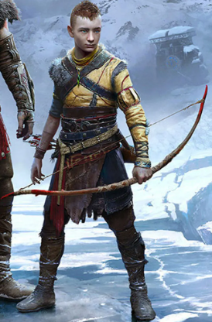
Who is Atreus?
Atreus is the son of Kratos and the ice giant Laufey
Atreus is sick a lot
We don't know a lot of thing on Atreus
In the giant prophesy Atreus is called Loki (Loki is the god of mischief and illusion)
The long bow

Slide 7
The game
The tree first god of war, Kratos try to killed all the god of the Greek mythology (Zeus, Poseidon, …).
The god of war 4, Kratos and Atreus do a lot of mission to put the ash of Laufey in the highest mountain.
The last god of war, Kratos and Atreus must stop the Ragnarök.
The Ragnarök is the end of the world.
The Ragnarök will arrive when the giant wolf will catch the moon and the sun (when they will eat the sun and the moon).

Slide 8
The end.

