Slide 1
Storyboard
Fait par Samuel Turmel

Slide 2
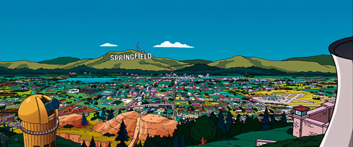
Grand plan d’ensemble
Ricky was a young boy

Slide 3
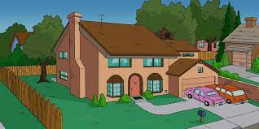
He had a heart of stone

Slide 4
Lived 9 to 5 and he worked

Slide 5
His fingers to the bone

Slide 6
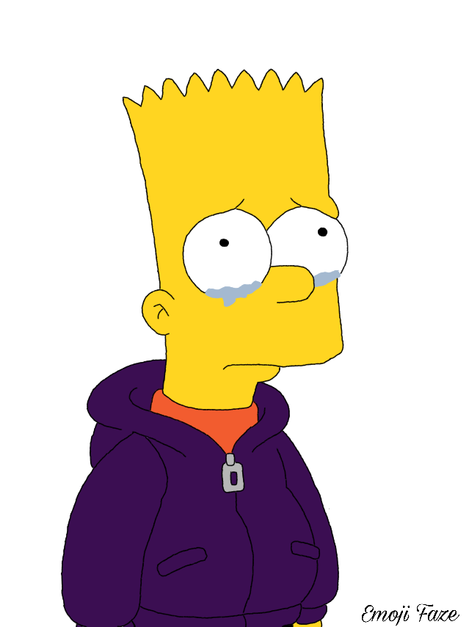
Just barely out of school

Slide 7
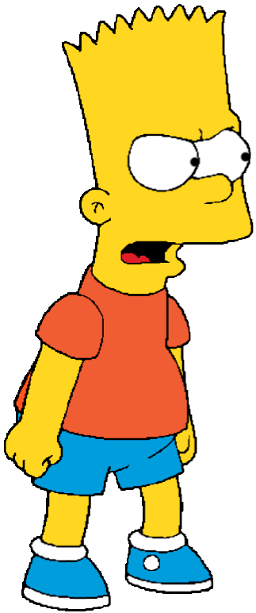
He came from the edge of town

Slide 8
He had no money

Slide 9
He walked the streets a soldier

Slide 10
18 and life (music)

