Slide 1
Motocrosse Nathan Turcotte
Gaming

Slide 2
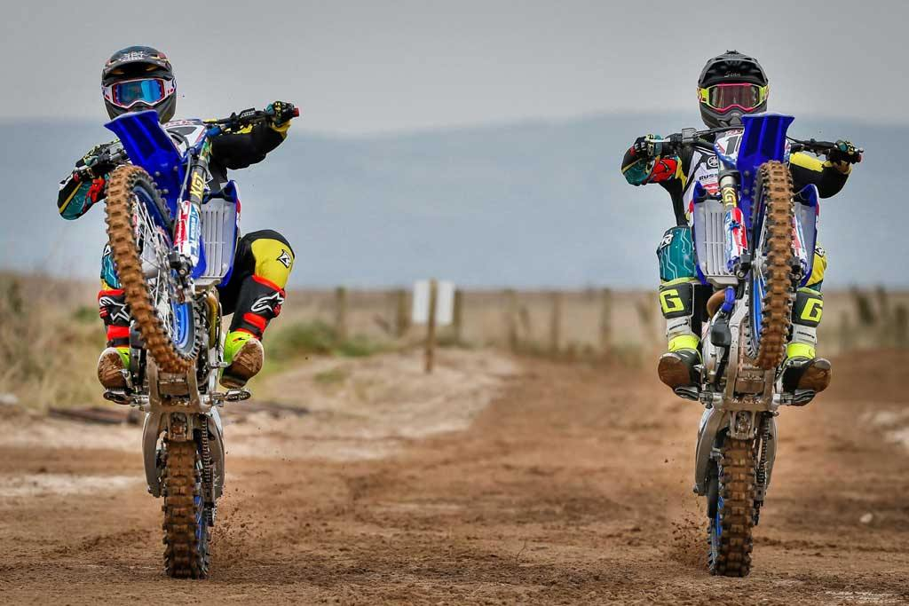

Slide 3
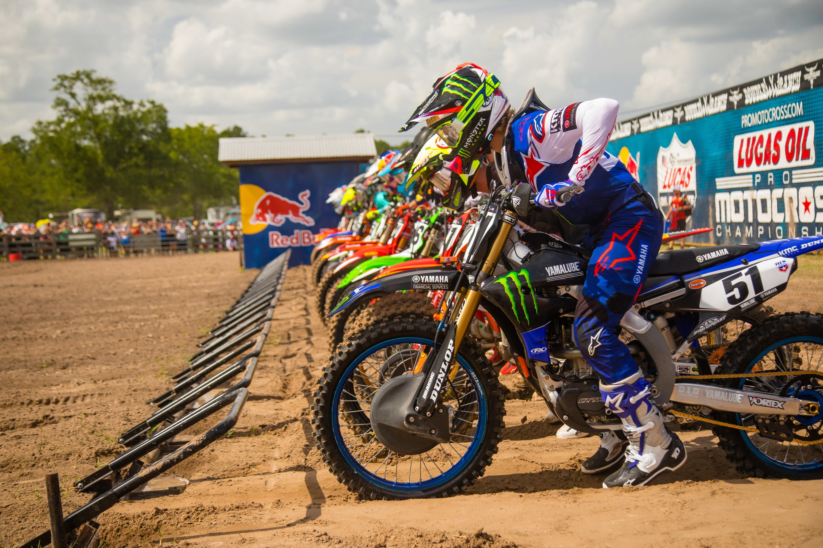

Slide 4
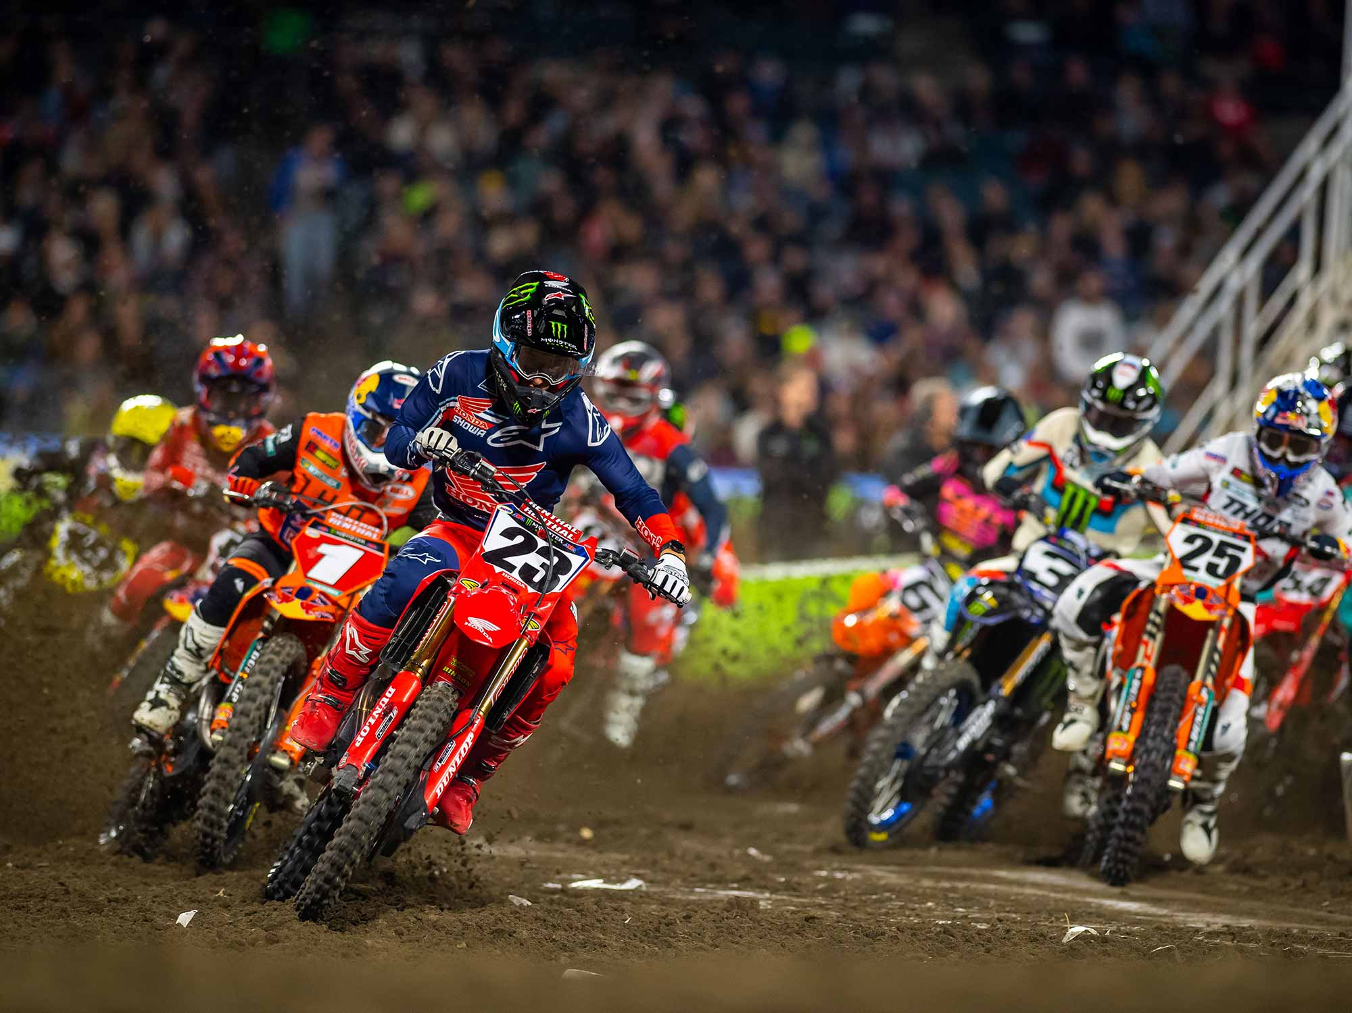

Slide 5
