Slide 1



Storyboard
Fait par Jakob Toulouse

Slide 2
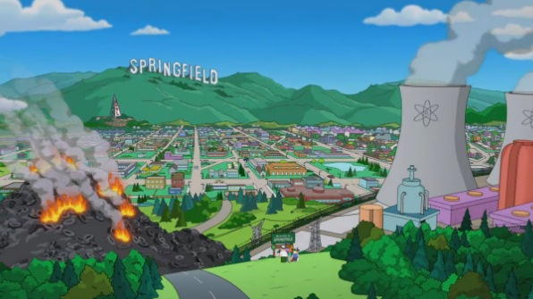
Grand plan d’ensemble
Don't want to close my eyes
I don't want to fall asleep
'Cause I'd miss you baby

Slide 3
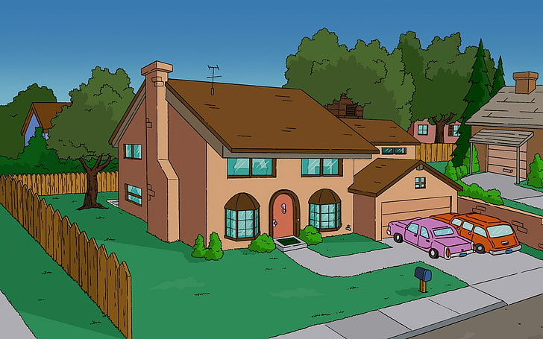
Plan général
I could stay awake just to hear you breathing

Slide 4
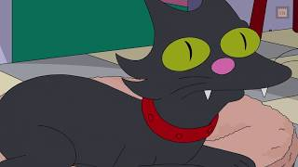
Plan américain
I don't want to miss one smile

Slide 5

Plan épaule
Forever and ever

Slide 6
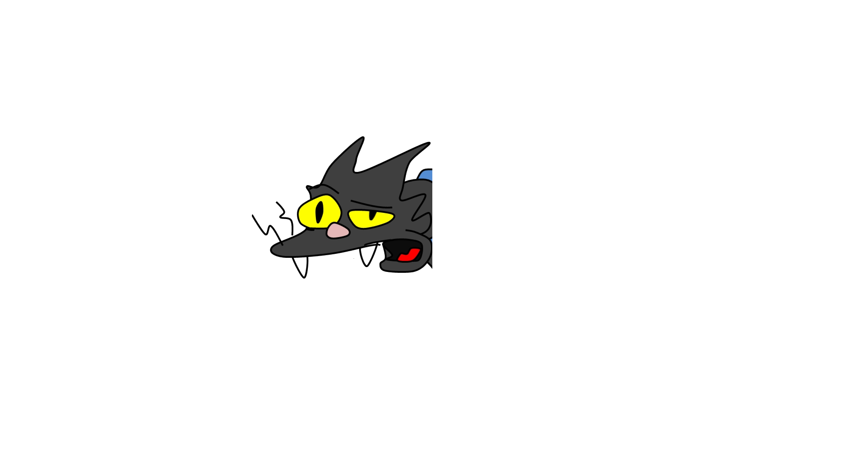
Extreme gros plan

Slide 7
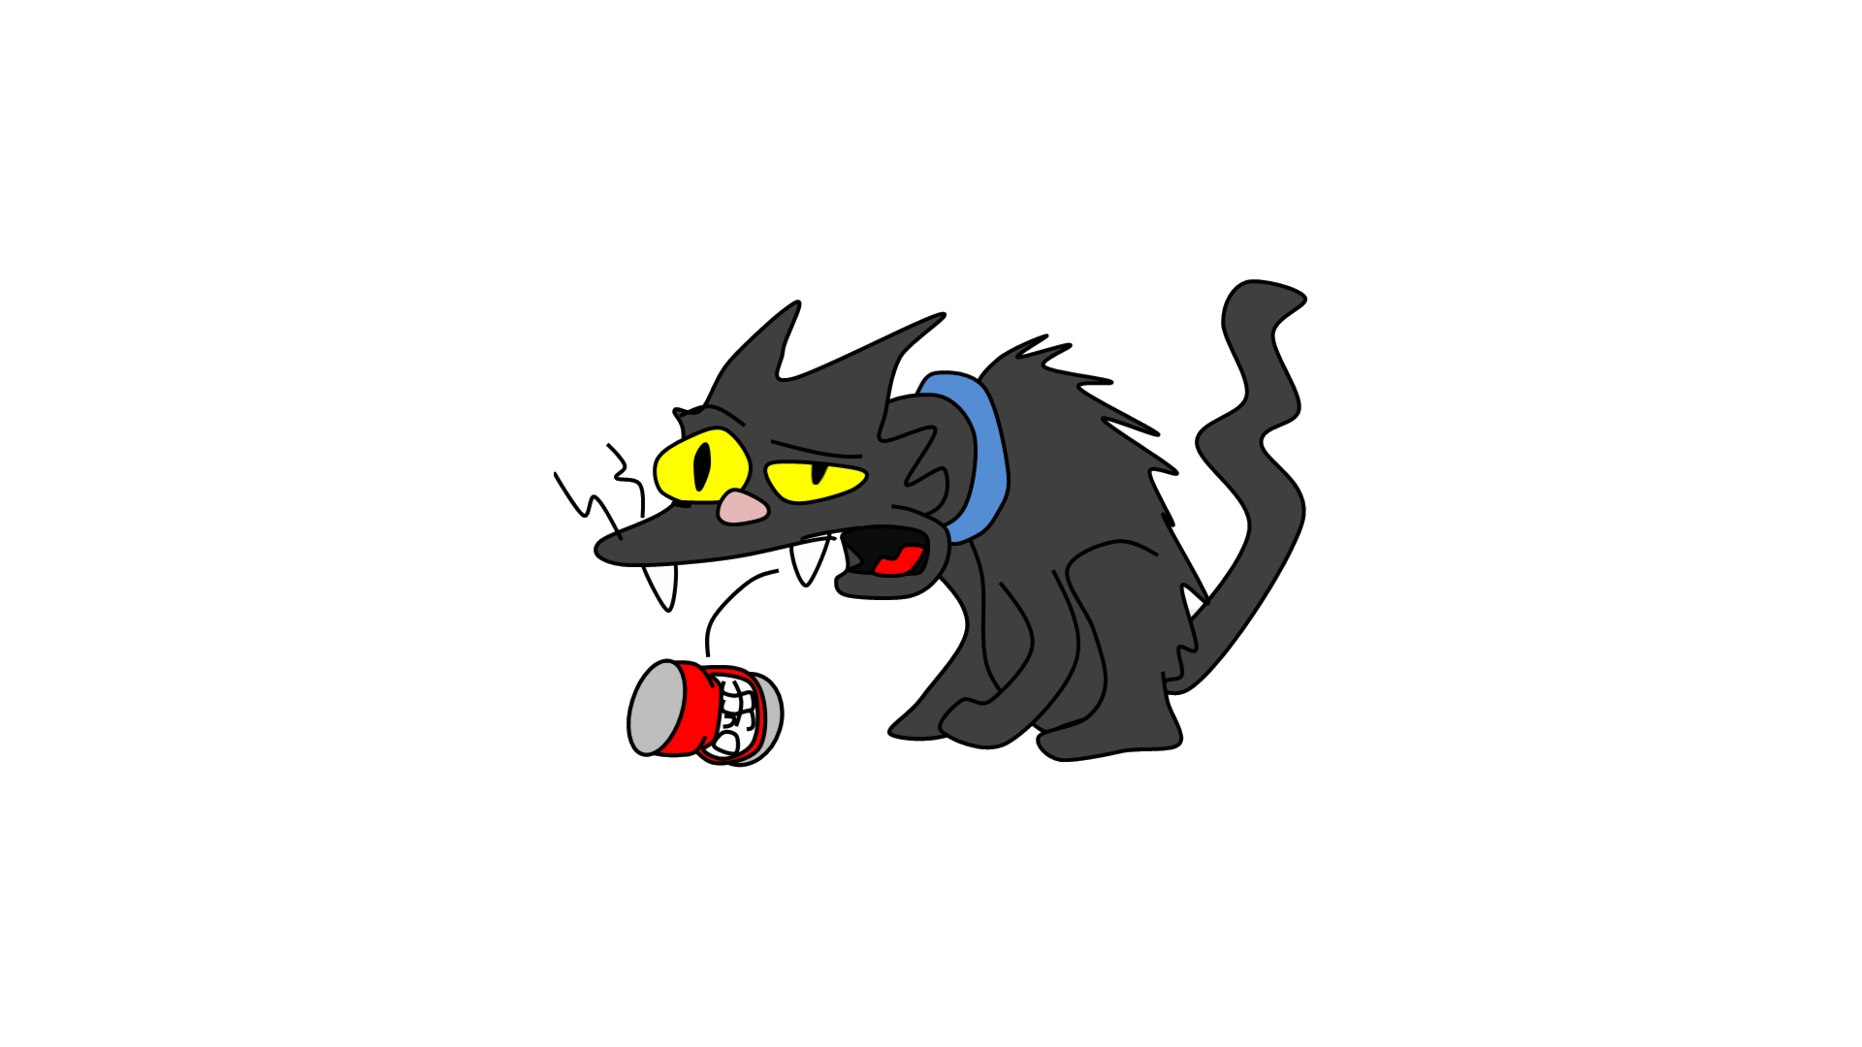

Slide 8
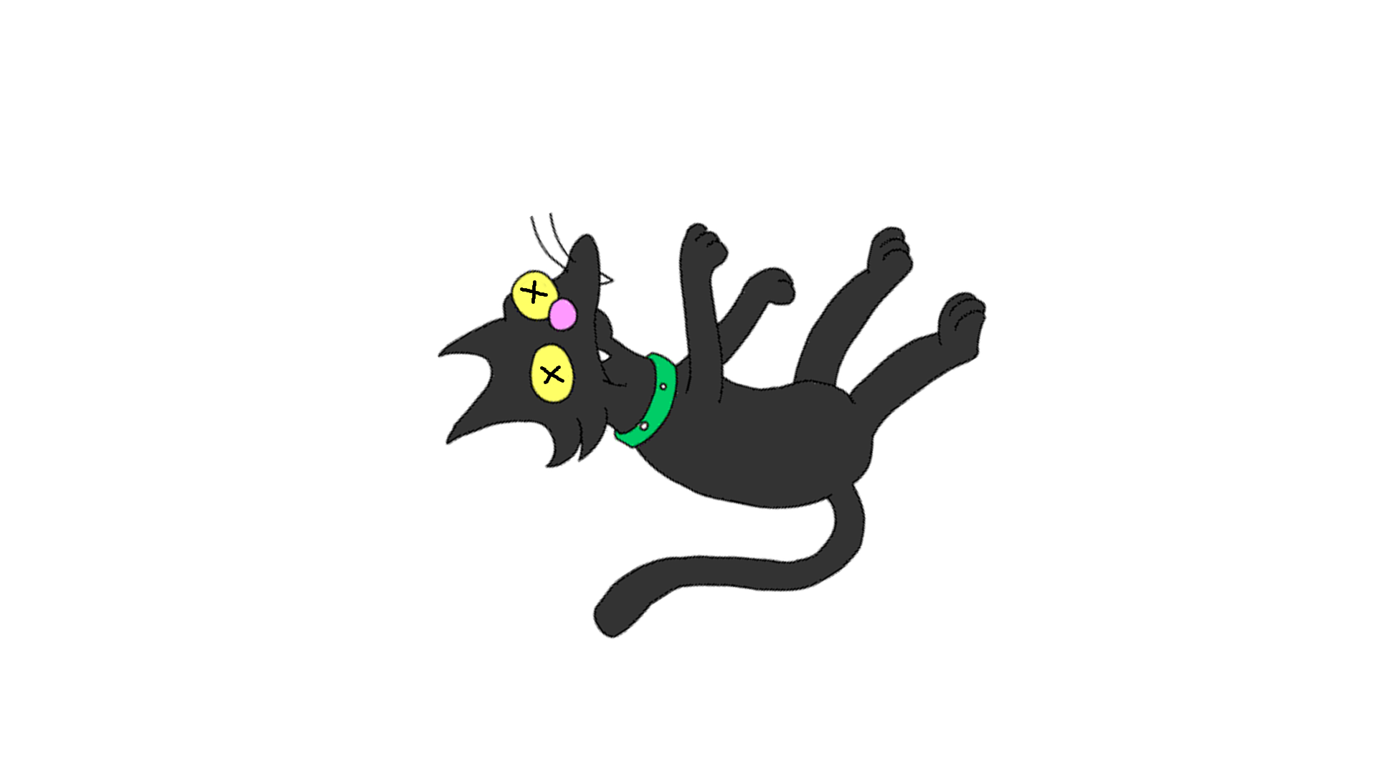

Slide 9
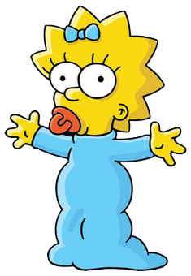

Slide 10
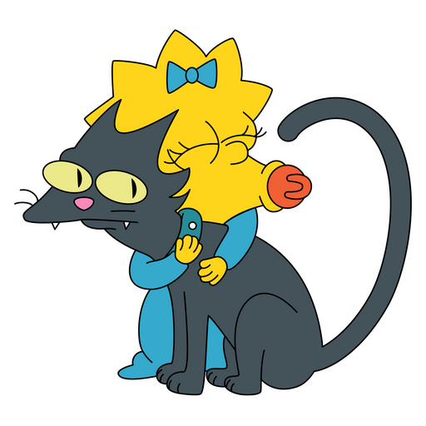

Slide 11
