Slide 1
Storyboard
Fait par Justin Roy
simpson

Slide 2
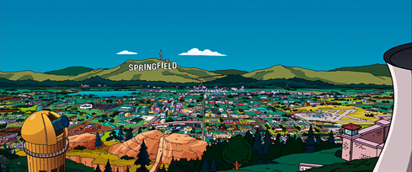
Right here with you, just like this

Slide 3
For all the rest of time

Slide 4
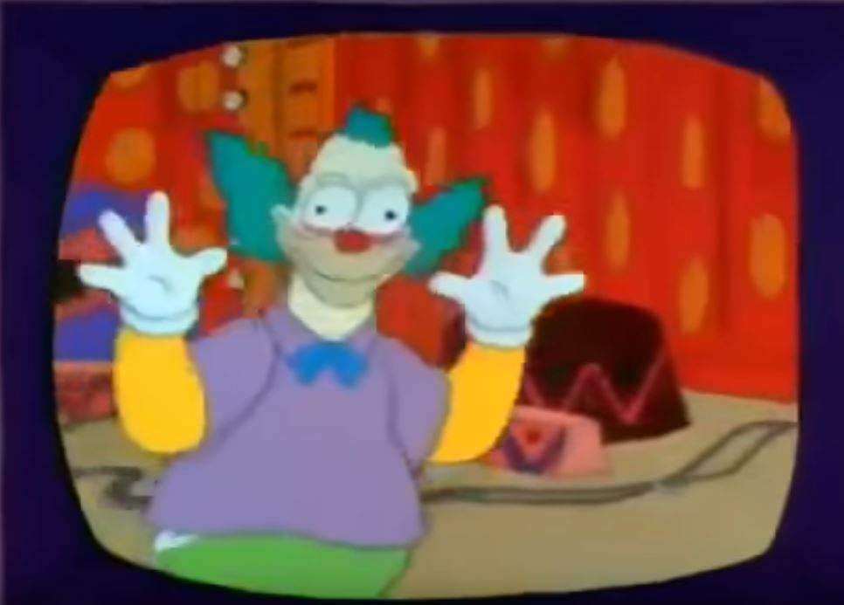
Watch you smile while you are sleeping

Slide 5
Wondering if it's me you're seeing

Slide 6
Don't want to close my eyes

Slide 7
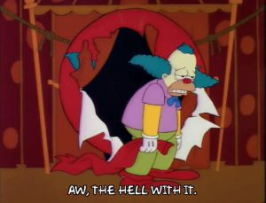
Forever and ever

Slide 8
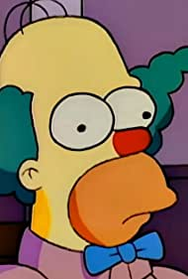
I could stay awake just to hear you breathing

Slide 9
I'd still miss you baby

Slide 10
Lying close to you, feeling your heart beating

Slide 11
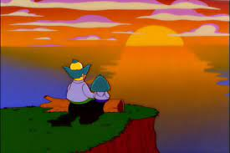
Then I kiss your eyes

