Slide 1
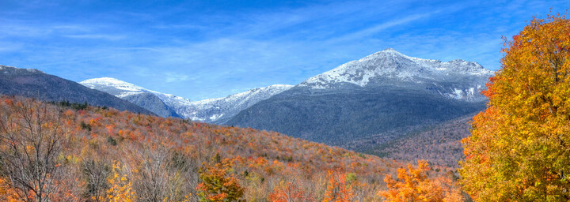
Hiking
By Justin Roy

