Slide 1
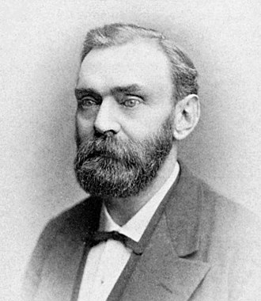
Alfred Nobel
 | Check Point Threat Extraction Secured This Document |  | Get Original

Slide 2

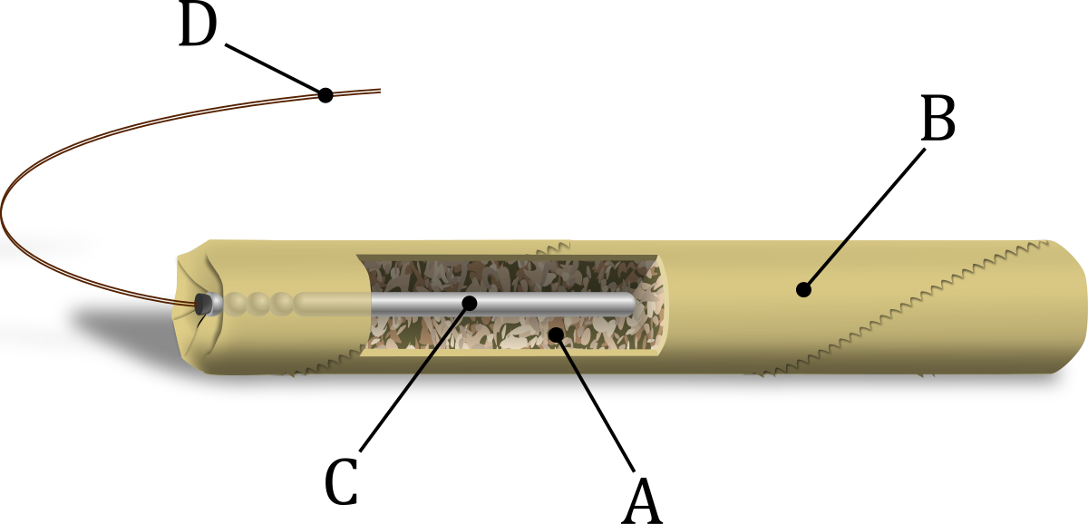
Suédois
1833-1896
Dynamite
Prix nobel

