Slide 1
Story board
Fait par Jason Quigley

Slide 2
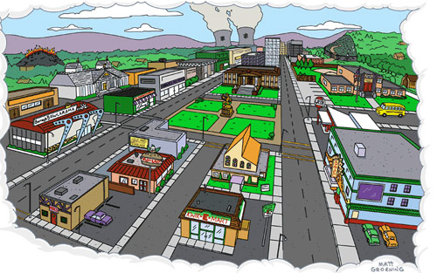
One life, with each other

Slide 3
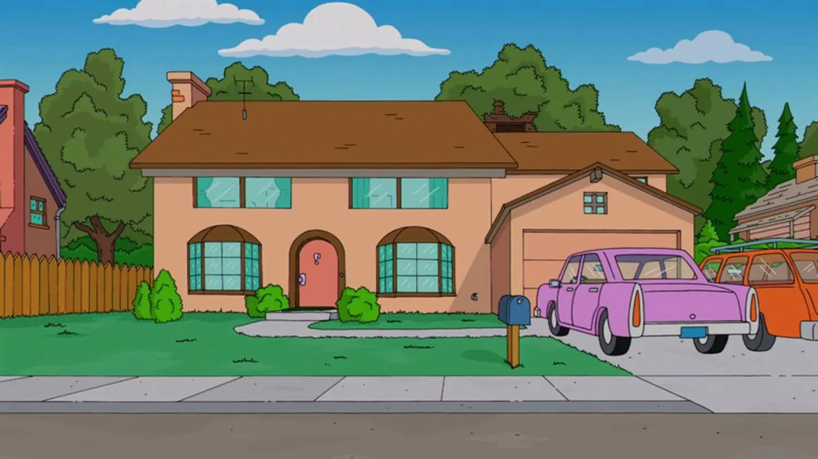
When it's one need in the night

Slide 4
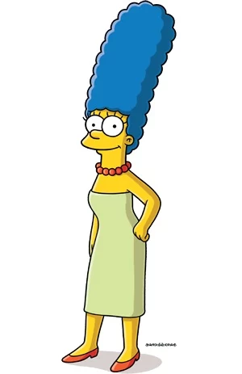
One!

Slide 5
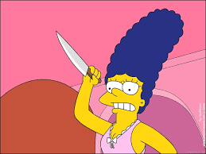
One life, you got to do what you should

Slide 6
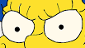
When all you got is hurt

Slide 7
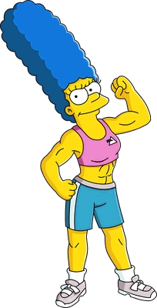
You act like you never had love

Slide 8
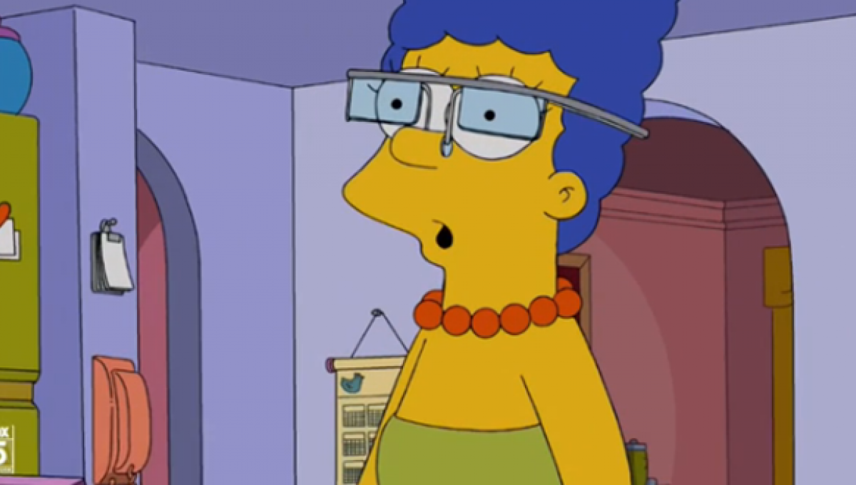
You got someone to blame

Slide 9
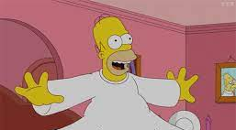
Is it getting better?

Slide 10
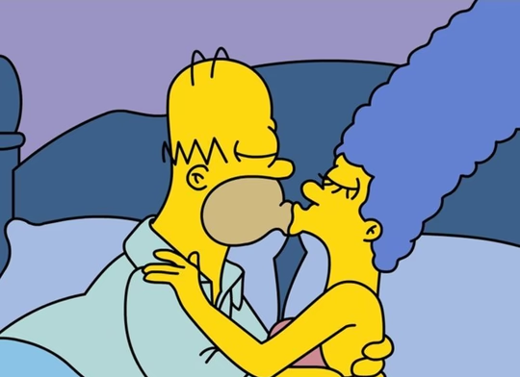
Or do you feel the same?

Slide 11
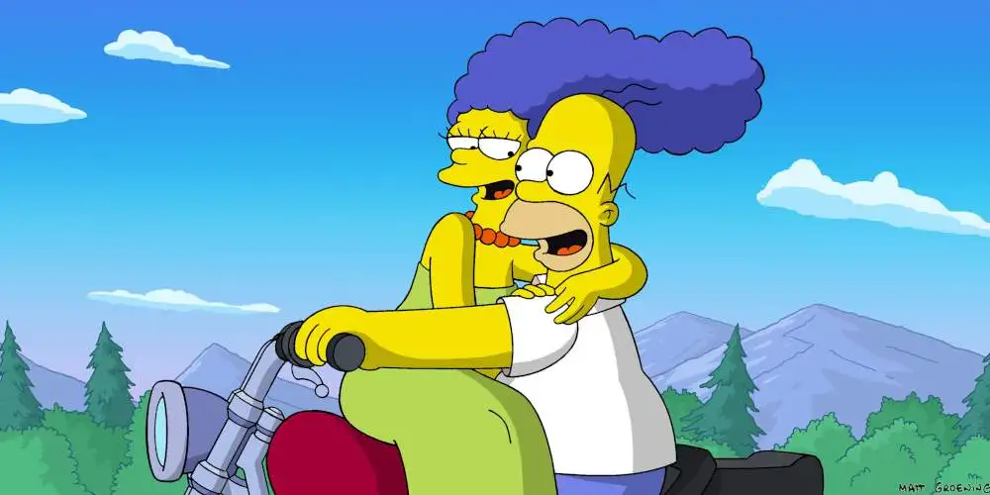
You say, one love, one life

