Slide 1
Storyboard
Fait par Charli Poulin

Slide 2
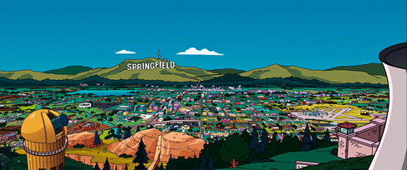
Grand plan d’ensemble
Better stand tall when they're calling you out

Slide 3
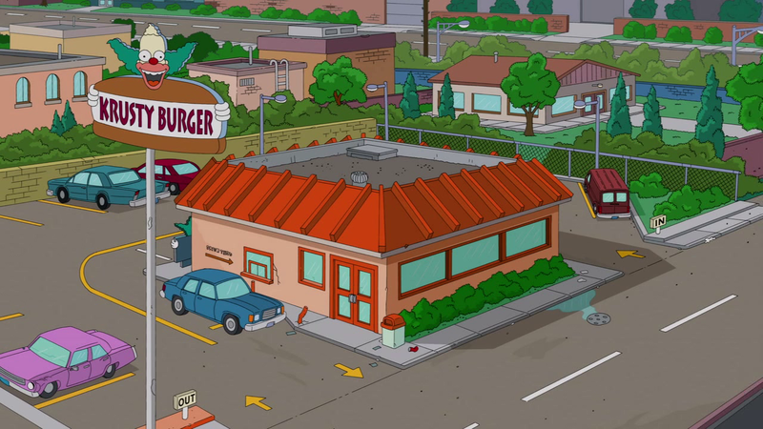
Plan d’ensemble
Don't bend, don't break, baby, don't back down

Slide 4
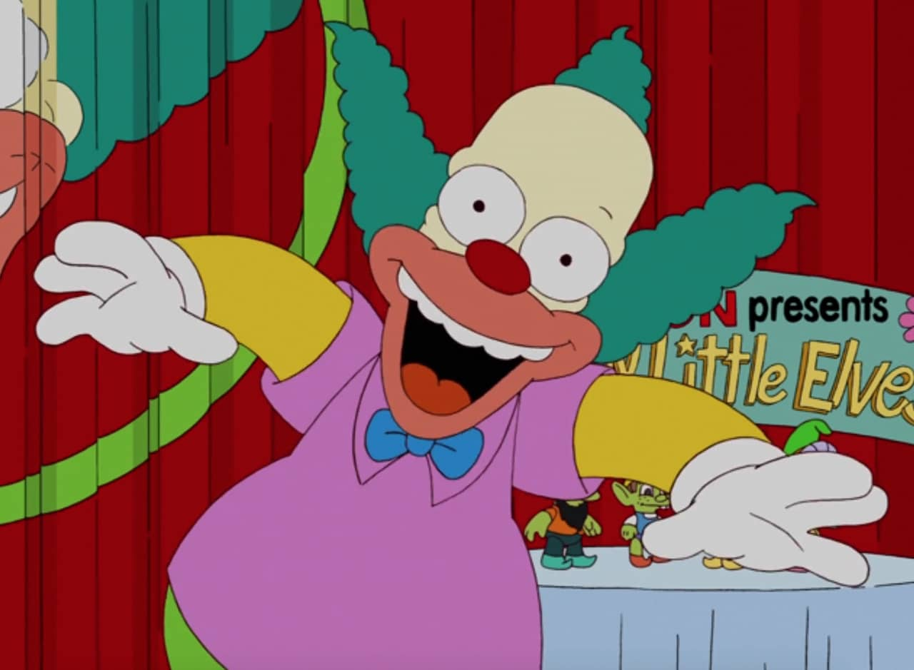
Plan général
'Cause it's my life

Slide 5
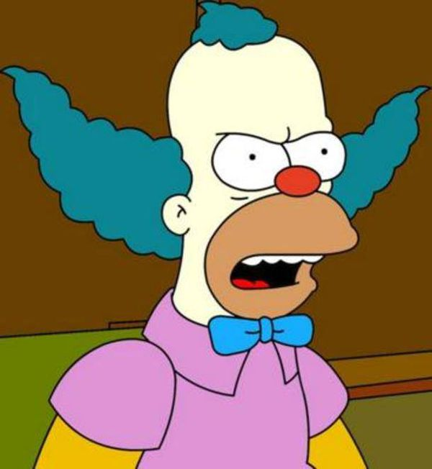
Plan moyen
This ain't a song for the broken-hearted

Slide 6
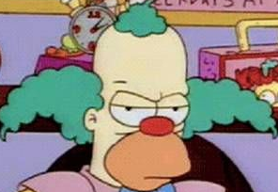
Êctreme gros plan
No silent prayer for faith-departed

Slide 7
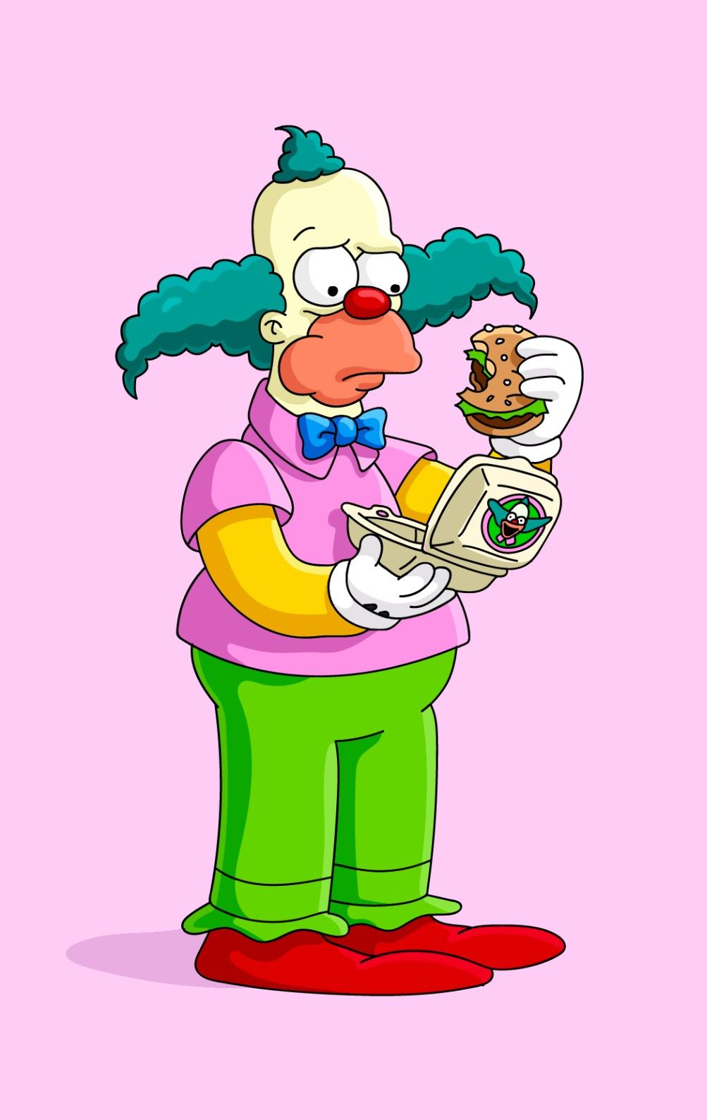
Plan pied
I just want to live while I'm alive

Slide 8

Plan tête
It's now or never
HELP!

Slide 9
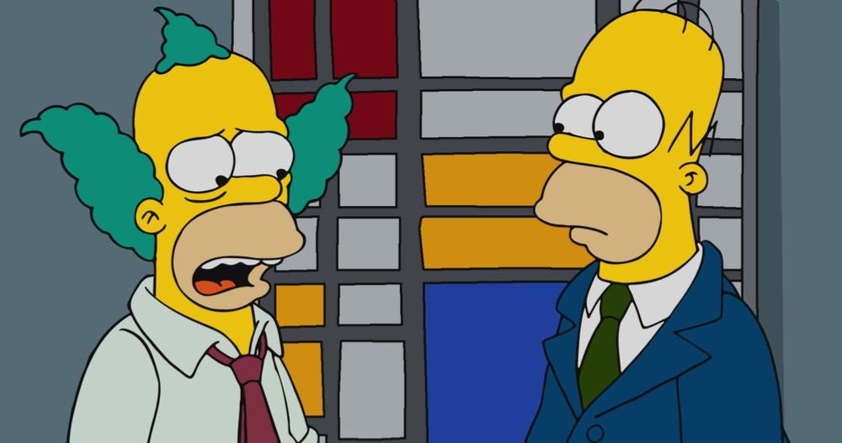
Plan ceinture
I ain't gonna live forever

Slide 10

Plan buste
It's my life

Slide 11
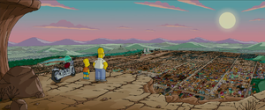
Plan d’ensemble
You're gonna hear my voice when I shout it out loud

