Slide 1
Storyboard
Par Antoine

Slide 2
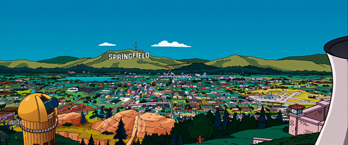
Well, East Coast girls are hip

Slide 3
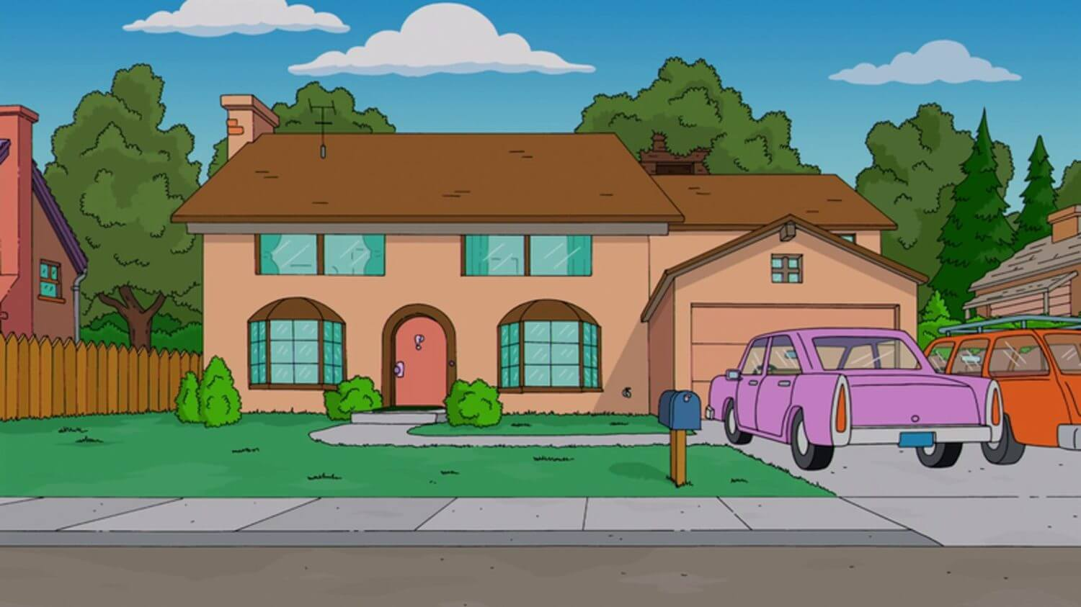
I really dig those styles they wear

Slide 4
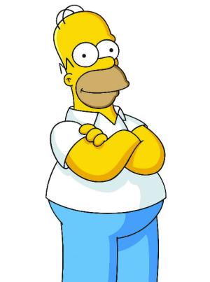
And the Southern girls with the way they talk

Slide 5
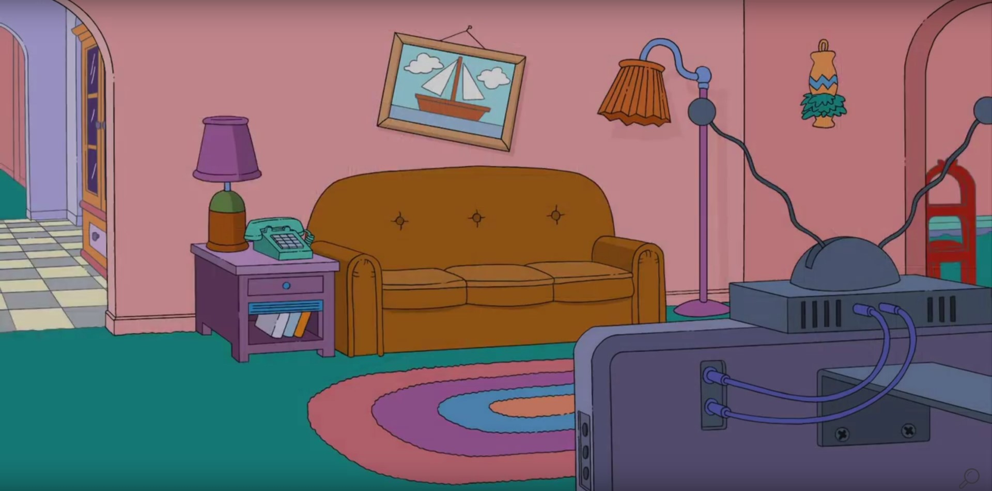
They knock me out when I'm down there

Slide 6
The Midwest farmer's daughters really make you feel alright

Slide 7
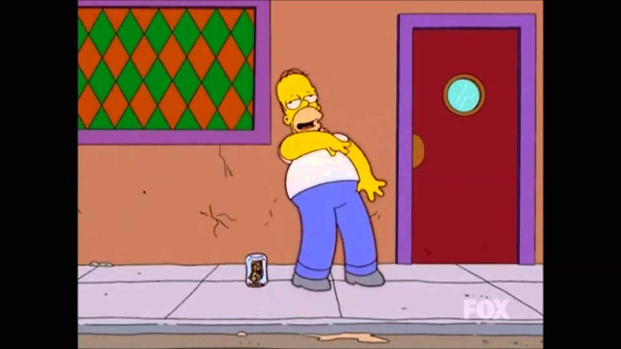
And the Northern girls with the way they kiss

Slide 8
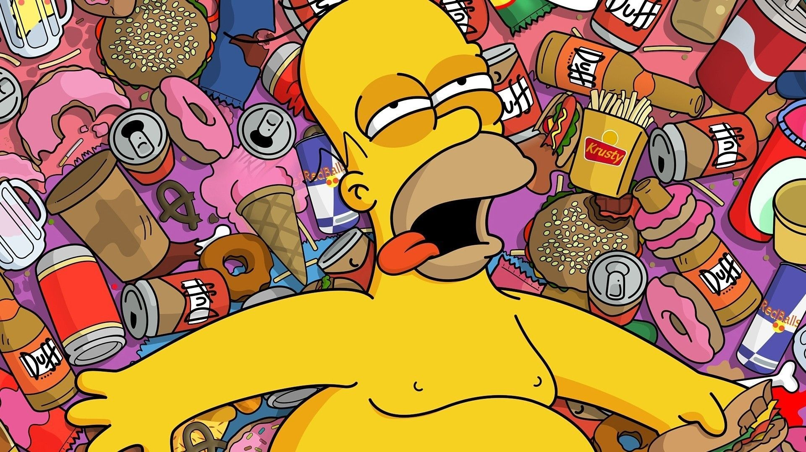
They keep their boyfriends warm at night

Slide 9
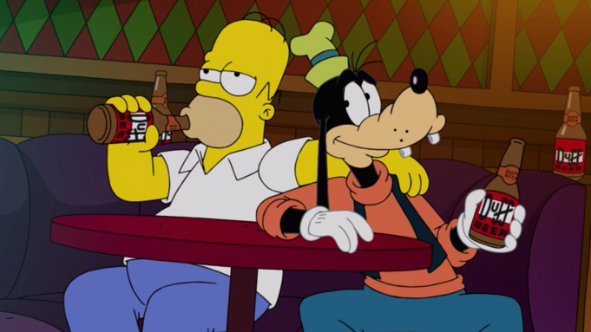
I wish they all could be California girls

Slide 10
I wish they all could be California

Slide 11
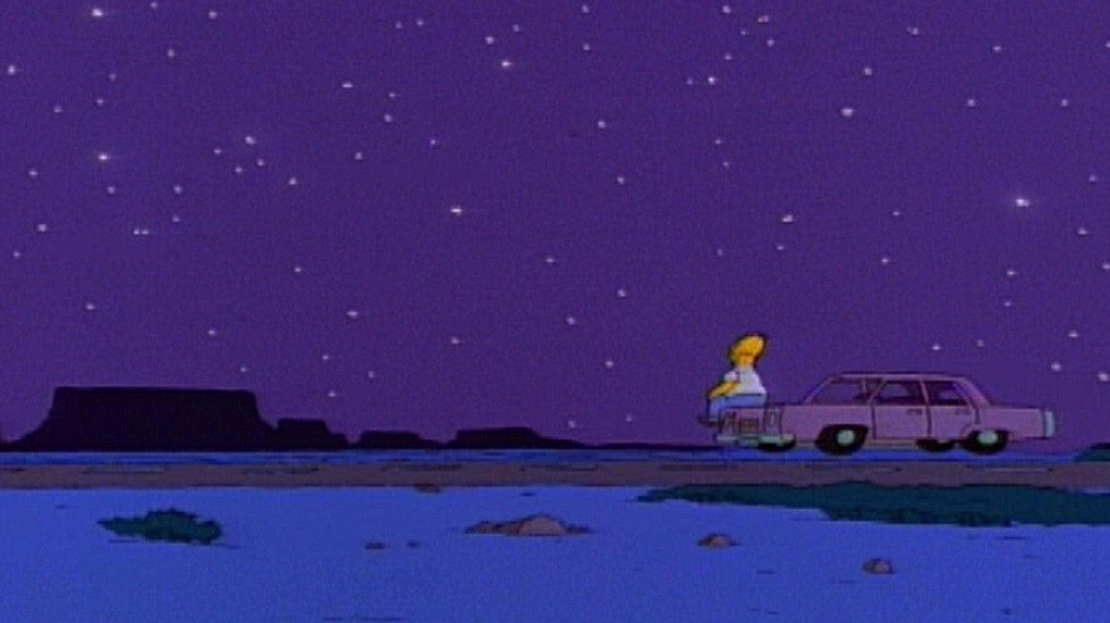
I wish they all could be California girls

