Slide 1
Minecraft Bedwars
Gaming par Antoine

Slide 2
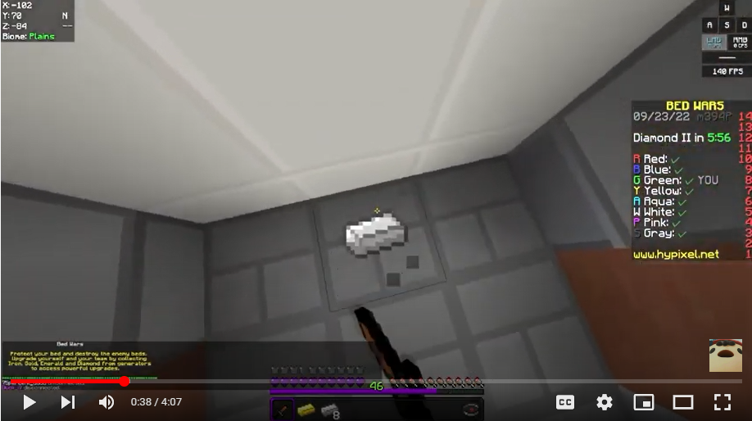
Take Ingots

Slide 3
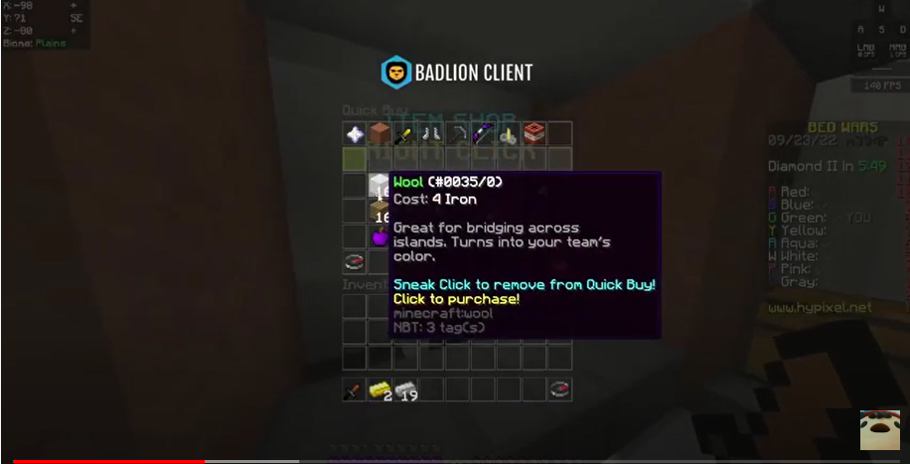
Buy Blocks

Slide 4
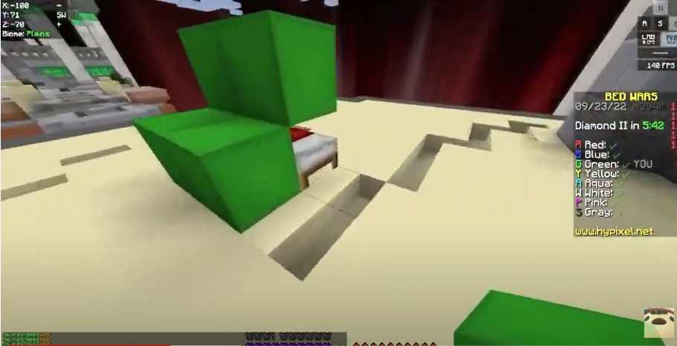
Protect Base

Slide 5
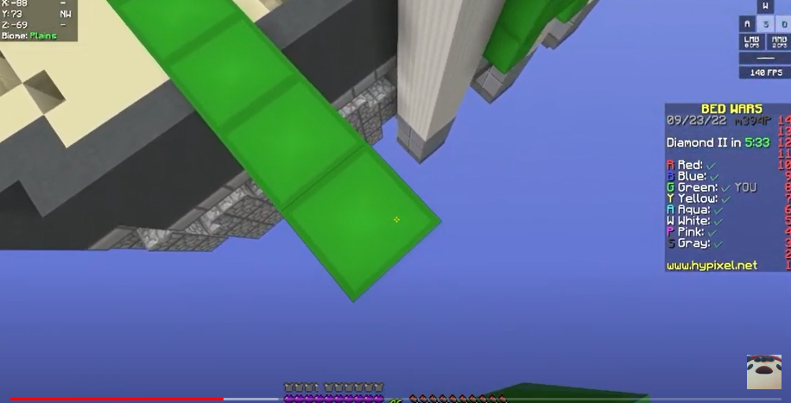
Build Bridges

Slide 6
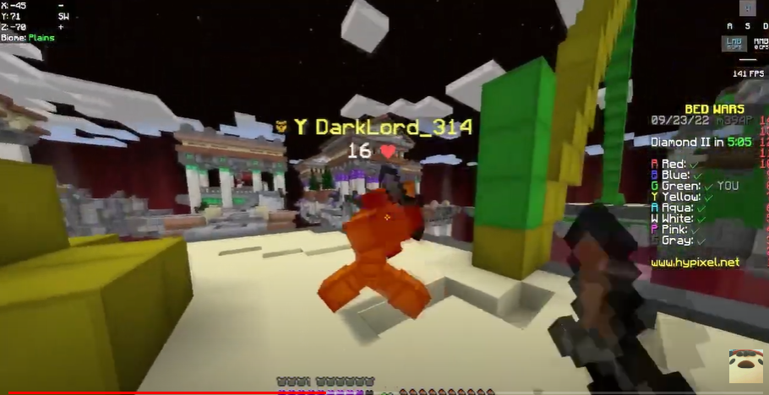
Kill enemie

