Slide 1
Story board
Fait par Samuel Landry

Slide 2
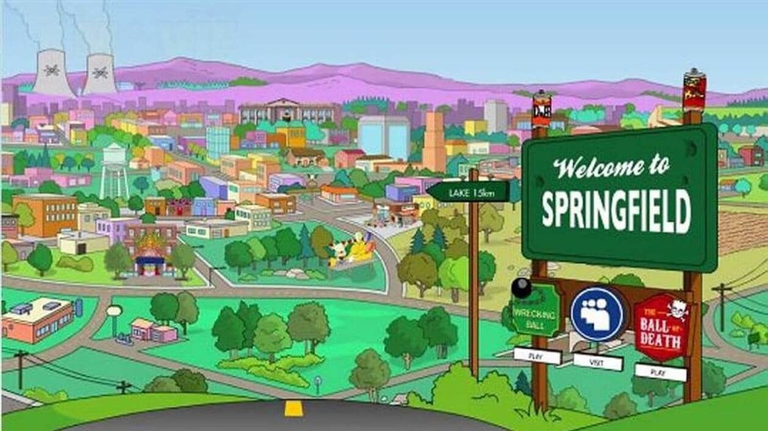
It's my life

Slide 3
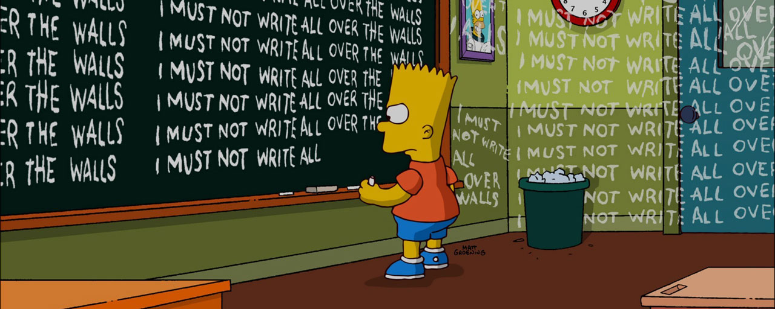
But I ain't gonna live forever

Slide 4

And it's now or never

Slide 5

'Cause I ain't gonna live forever

Slide 6

No silent prayer for faith-departed

Slide 7
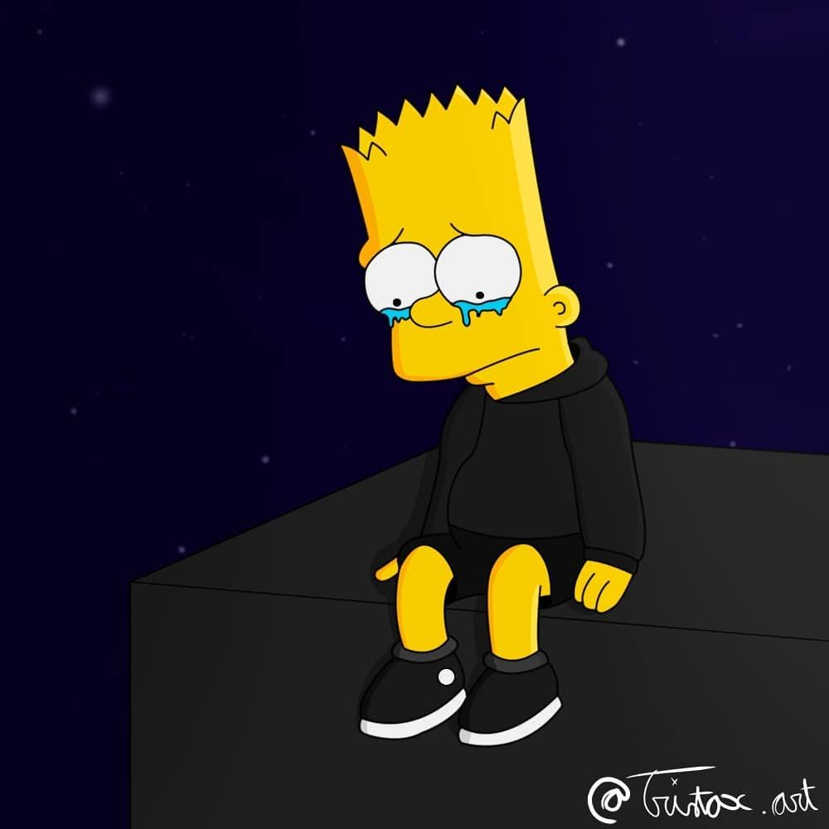
It's now or never

Slide 8
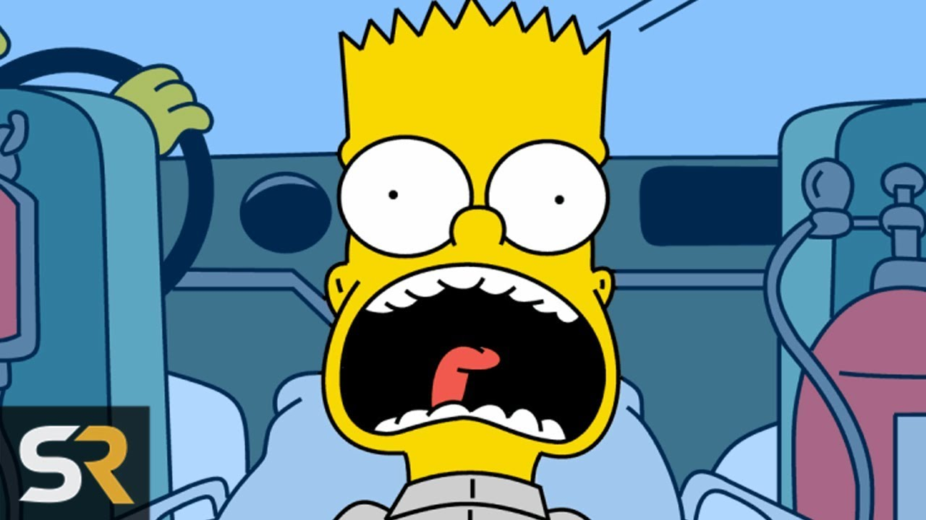
It's my life

Slide 9
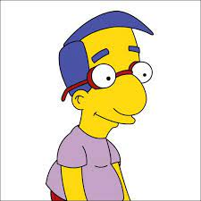
You're gonna hear my voice when I shout it out loud

Slide 10

Tomorrow's getting harder, make no mistake

Slide 11

I just want to live while I'm alive

