Slide 1
Storyboard
Par Anne Laliberté

Slide 2
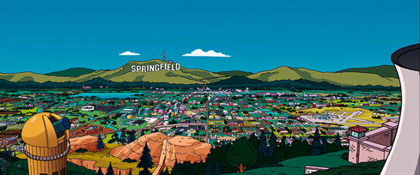
Cause to lose all my senses

Slide 3
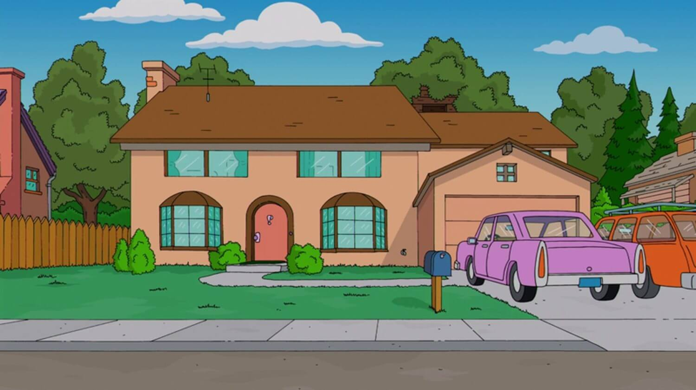
That is just so typically me

Slide 4
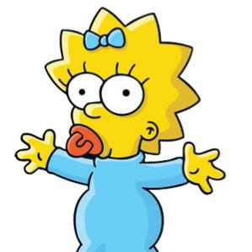
Oh baby, baby

Slide 5
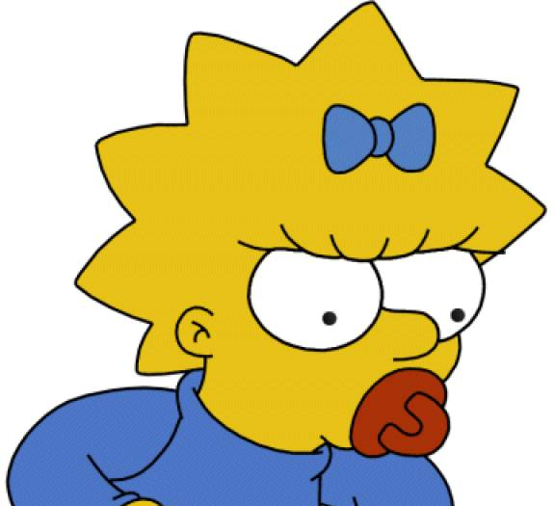
Oops, I did it again

Slide 6
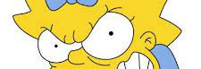
I played with your heart, got lost in the game

Slide 7
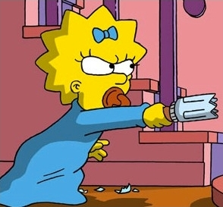
Oh baby, baby

Slide 8
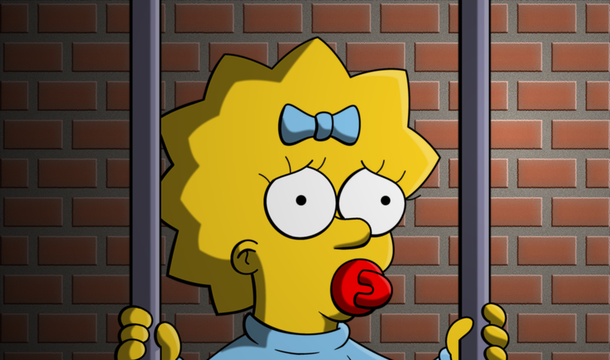
Oops, you think I'm in love

Slide 9
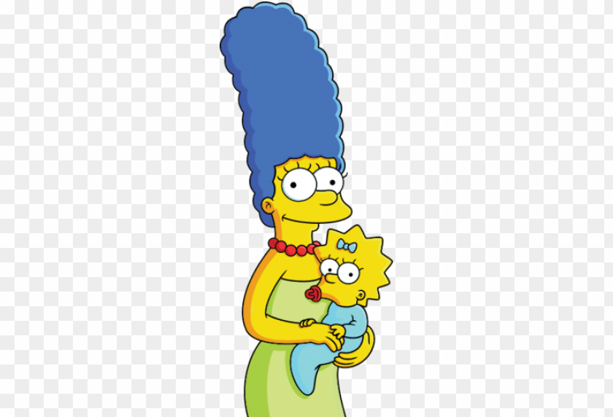
That I'm sent from above

Slide 10
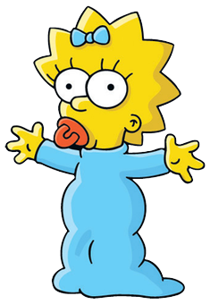
I'm not that innocent

Slide 11
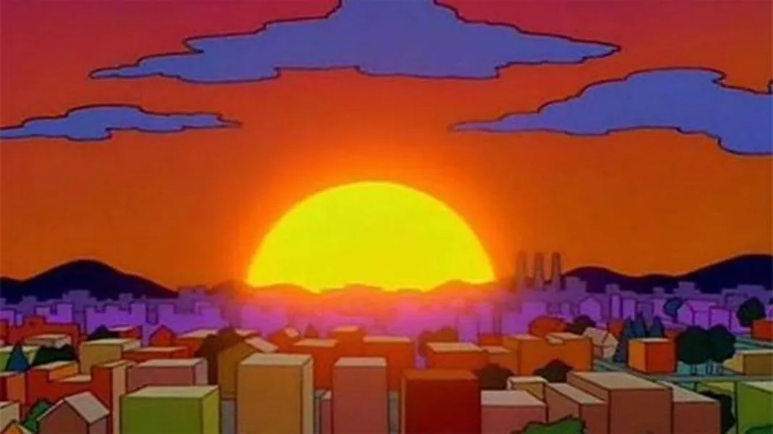
You see my problem is this

