Slide 1
Story board
Par Maxim

Slide 2
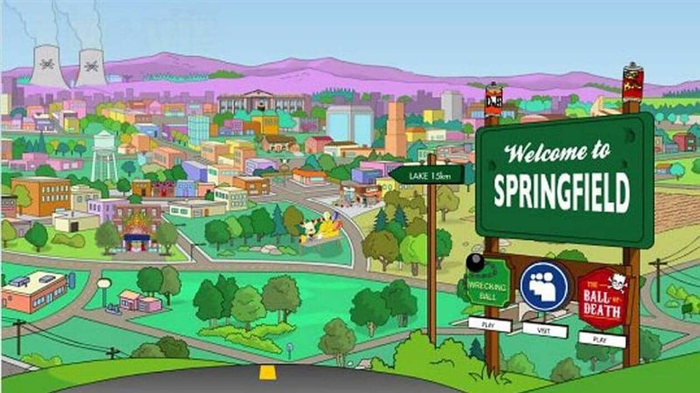
Simpson
I saw him dancin' there by the record machine

Slide 3
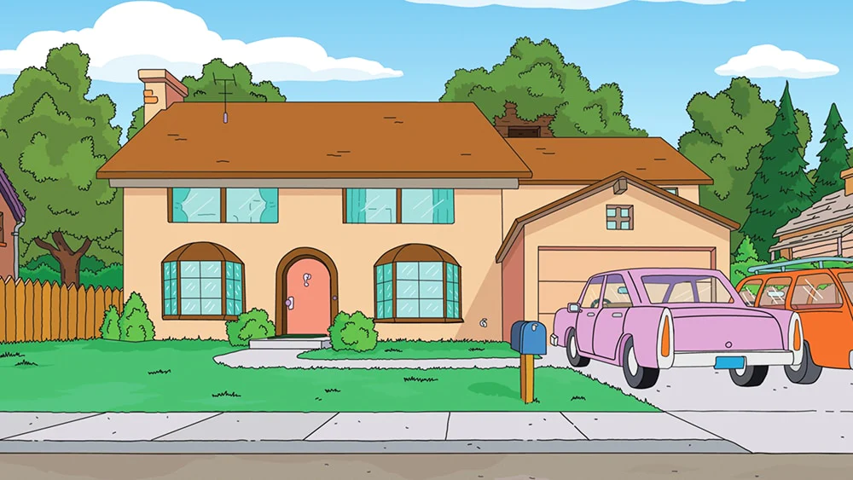
I knew he must a been about seventeen

Slide 4
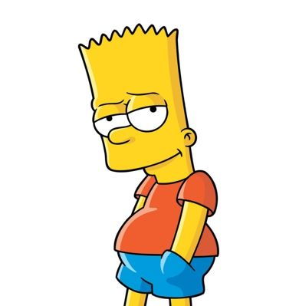
The beat was goin' strong

Slide 5
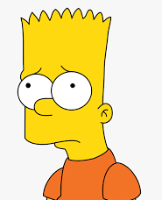
Playin' my favorite song

Slide 6
And I could tell it wouldn't be long

Slide 7
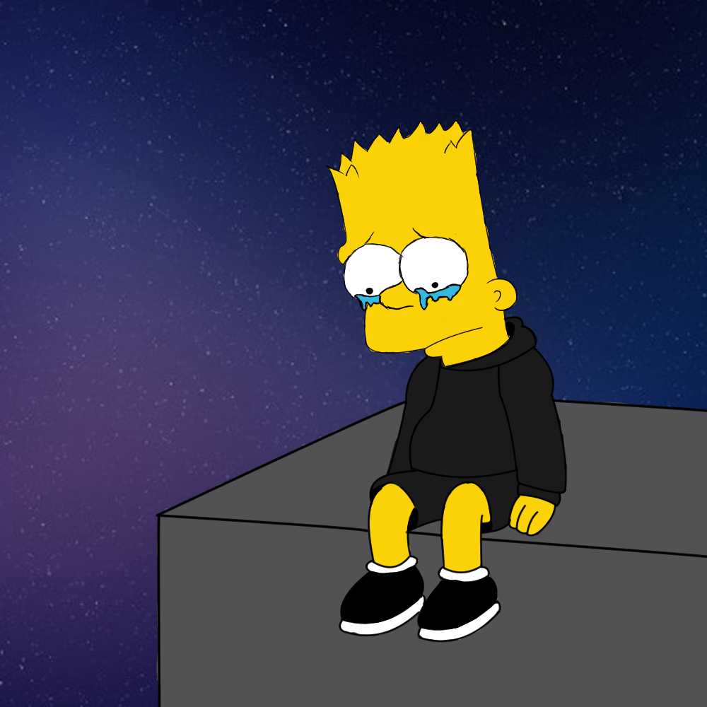
'Til he was with me, yeah, me

Slide 8
And I could tell it wouldn't be long
Help !

Slide 9
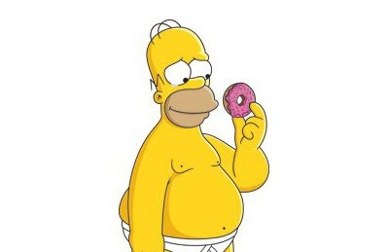
Til he was with me, yeah, me, singin'

Slide 10
I love rock n' roll

Slide 11
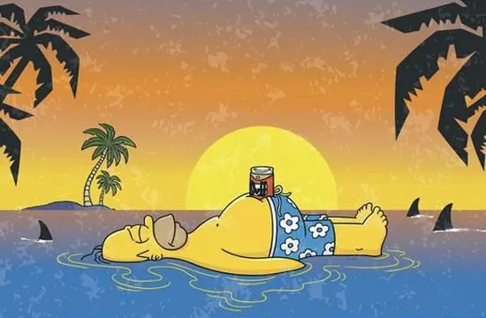
So put another dime in the jukebox, baby

Slide 12
I love rock n role
I saw him dancin' there by the record machine
I knew he must a been about seventeen
The beat was goin' strong
Playin' my favorite song
And I could tell it wouldn't be long
'Til he was with me, yeah, me
And I could tell it wouldn't be long
'Til he was with me, yeah, me, singin'
I love rock n' roll
So put another dime in the jukebox, baby
I love rock n' roll
So come and take your time and dance with me
Ow
He smiled, so I got up and asked for his name
"That don't matter", he said, "'cause it's all the same"
I said, "Can I take you home where we can be alone?"
And next we were movin' on
He was with me, yeah, me
Next we were movin' on
He was with me, yeah, me singin'

