Slide 1
Storyboard
Fait par Sarah-Maud Gosselin

Slide 2
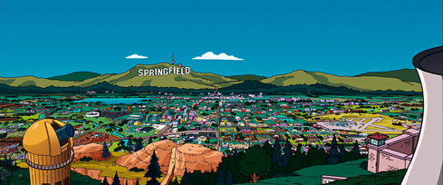
You could travel the world

Slide 3
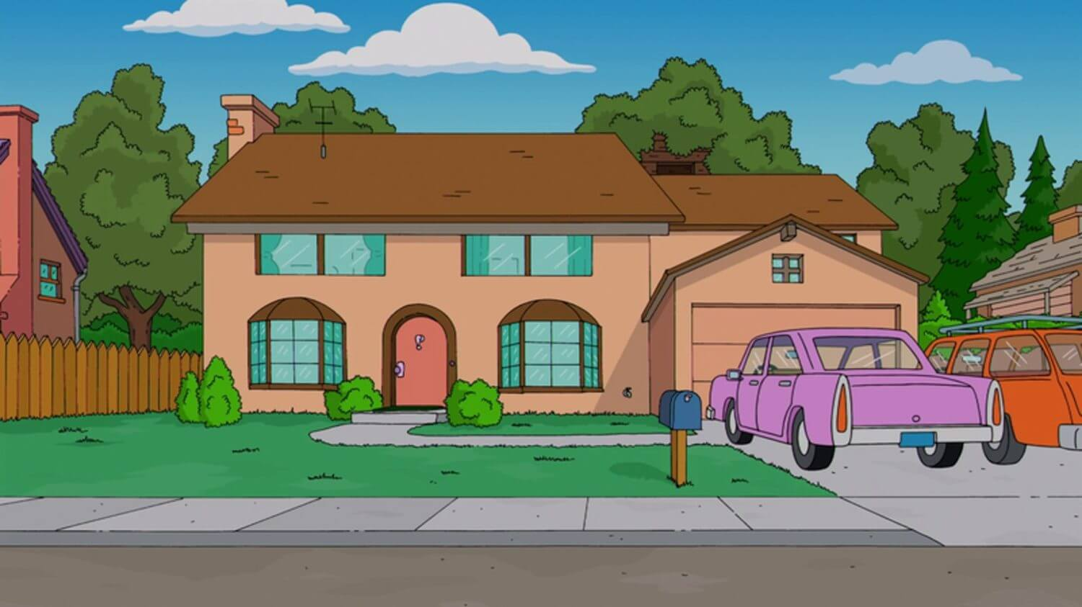
To the golden coast

Slide 4
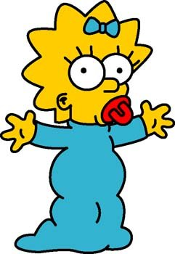
California girls

Slide 5
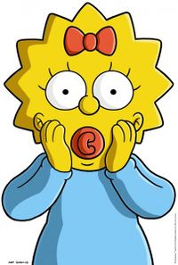
Once you party with us

Slide 6
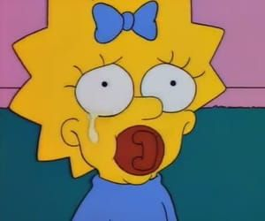
We're unforgettable

Slide 7
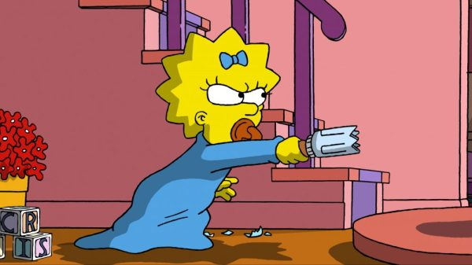
We're undeniable

Slide 8
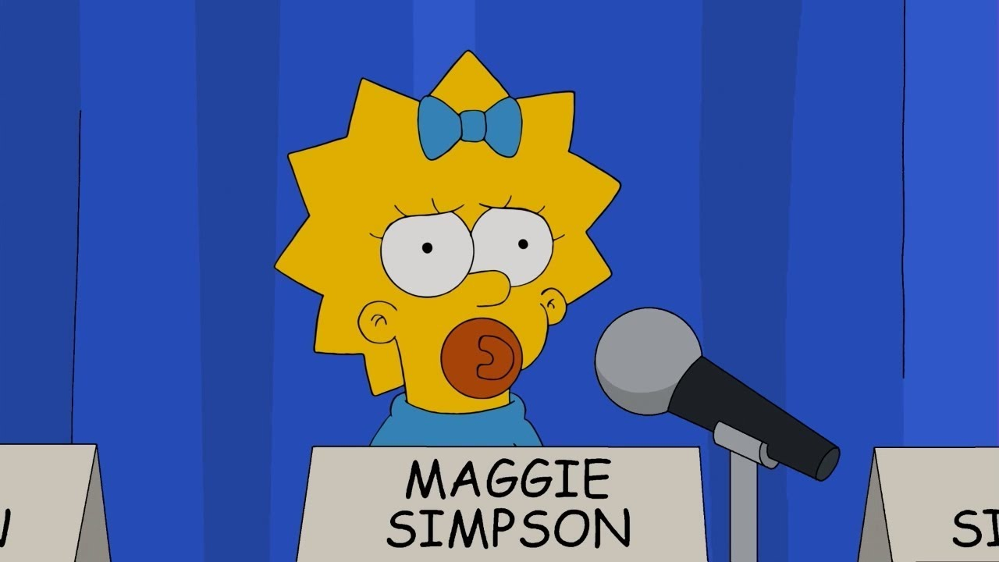
Help
You'll be falling in love

Slide 9
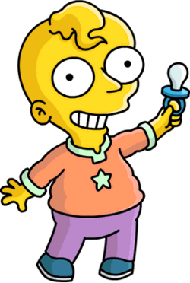
Now put your hands up

Slide 10
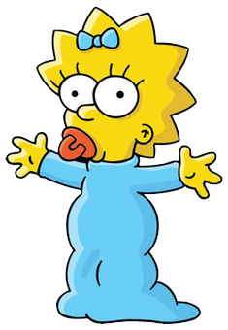
The girl's a freak

Slide 11
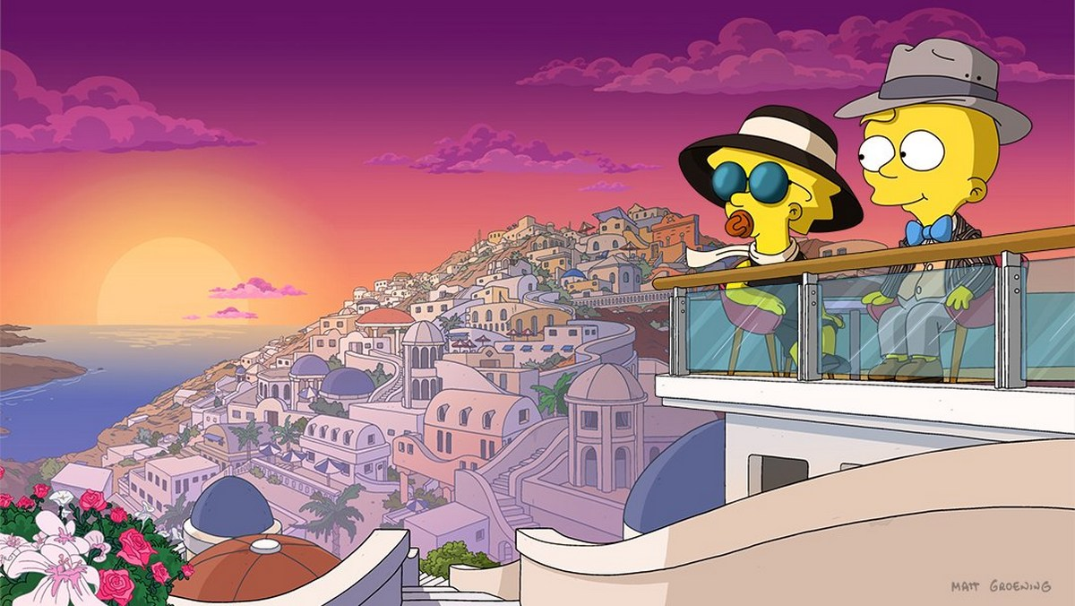
Bikinis, zucchinis, martinis

