Slide 1
Storyboard fait par Vincent Fecteau

Slide 2
Oh, oh, oh, oh, oh

Slide 3
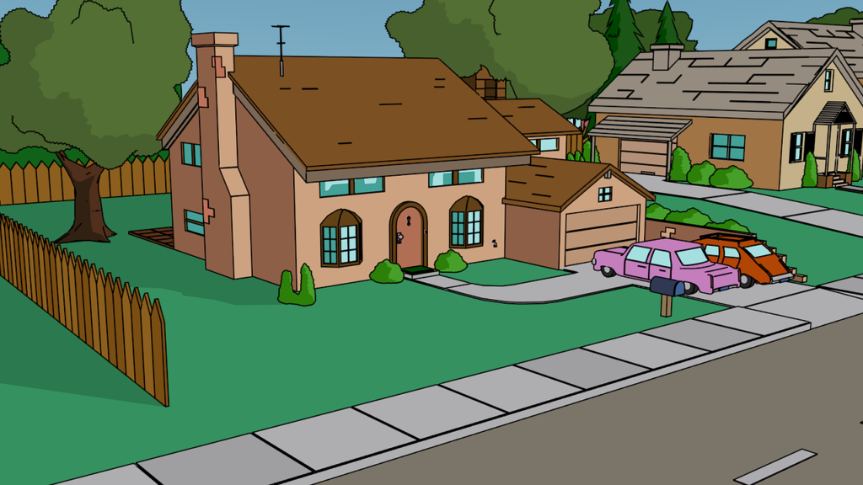
Oh, oh ooh oh, oh

Slide 4
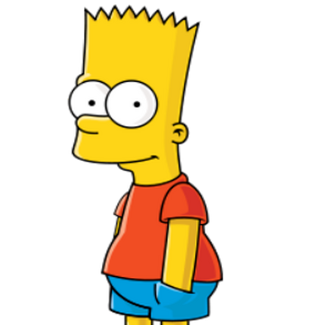
You run, run, run away

Slide 5
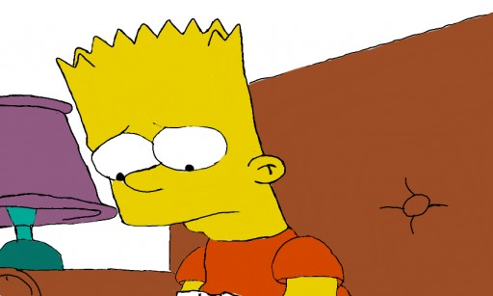
It's your heart that you betray

Slide 6
Feeding on your hungry eyes

Slide 7
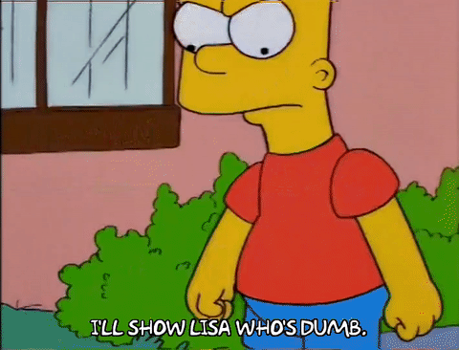
I bet you're not so civilized

Slide 8
Well isn't love primitive

Slide 9
A wild gift that you wanna give

Slide 10
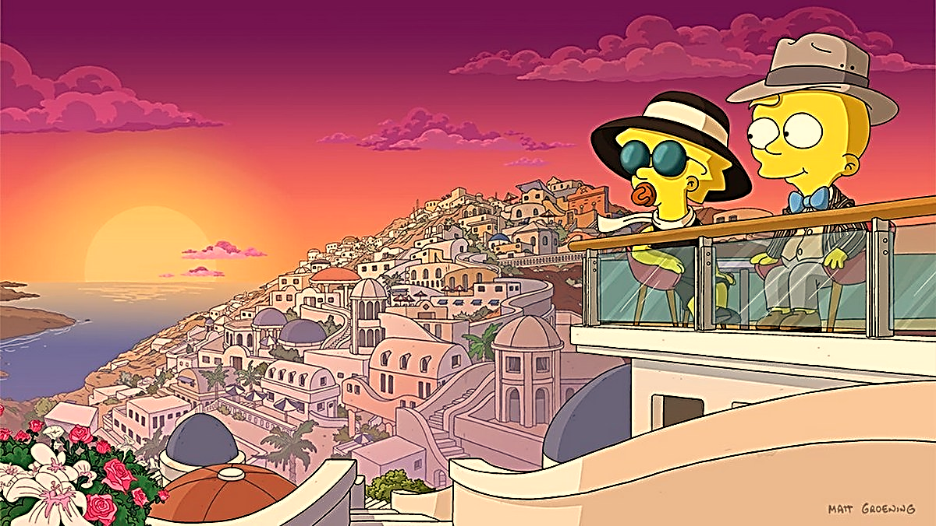
Break out of captivity

