Slide 1
Storie board fait par justin carbonneau

Slide 2
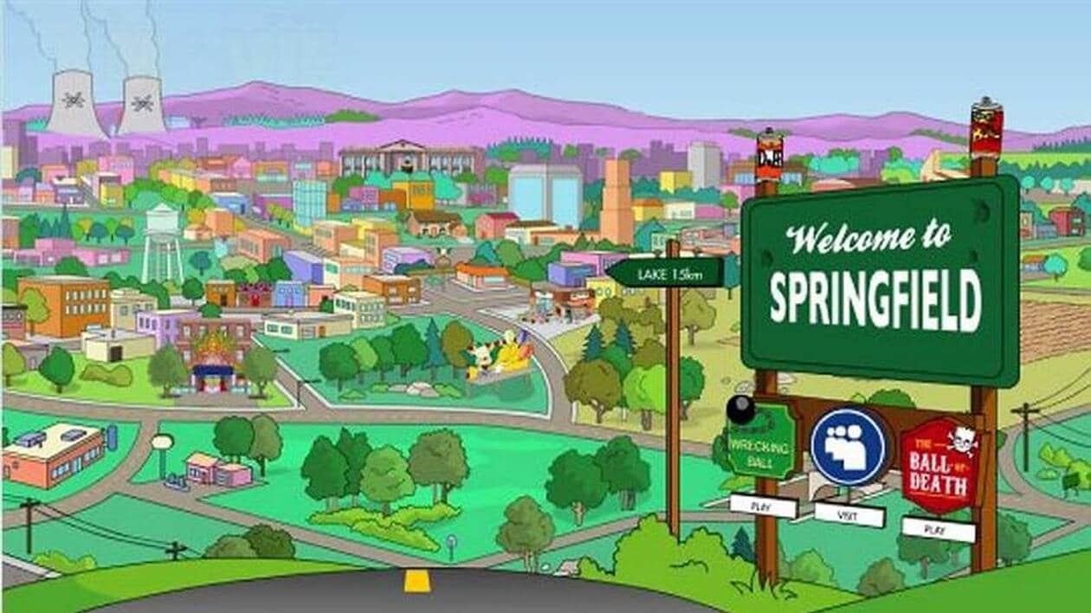
simson
Woah, we're half way there

Slide 3
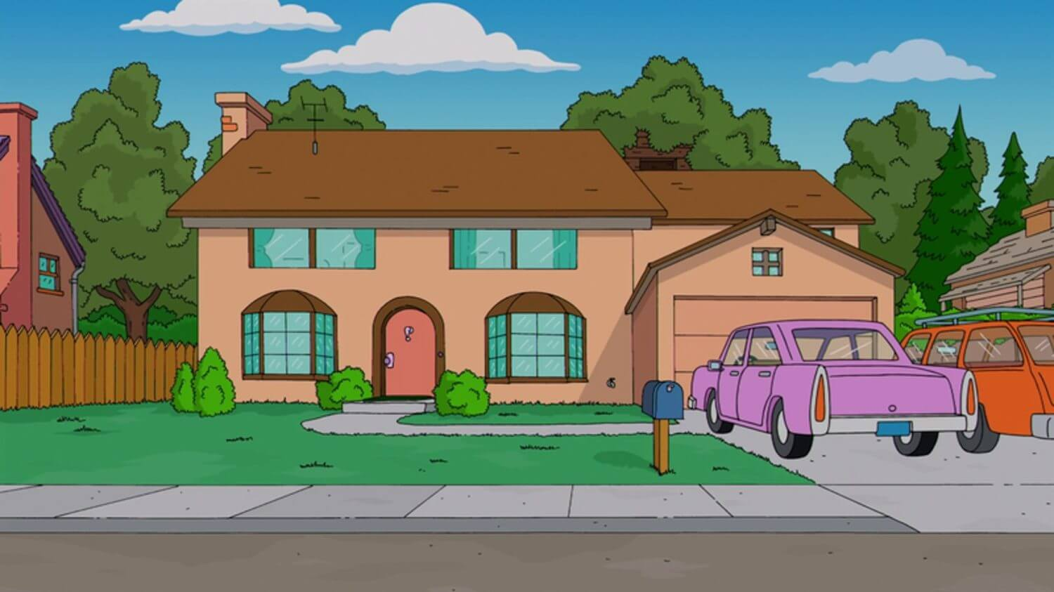
Take my hand, we'll make it I swear

Slide 4
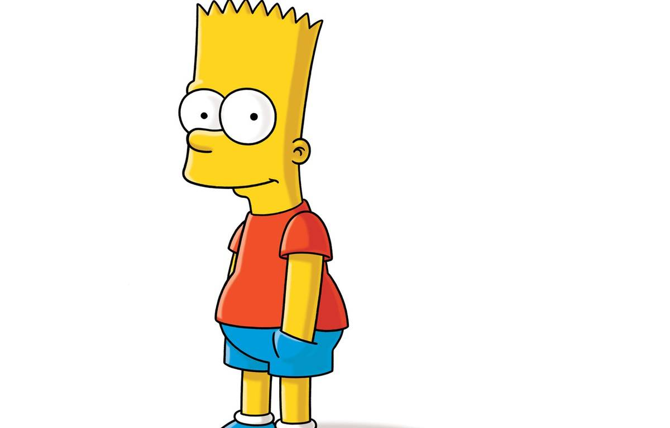
We've got to hold on to what we've got

Slide 5
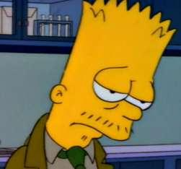
Woah, livin' on a prayer

Slide 6
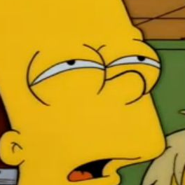
It doesn't make a difference if we make it or not

Slide 7
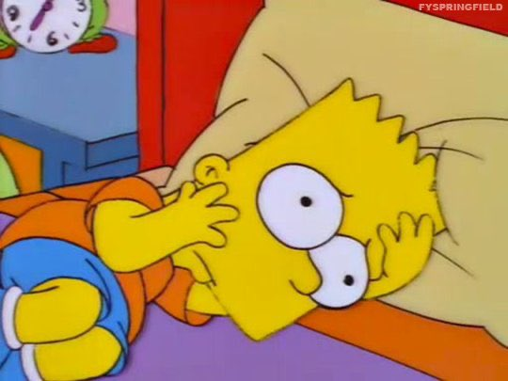
Baby, it's okay, someday

Slide 8
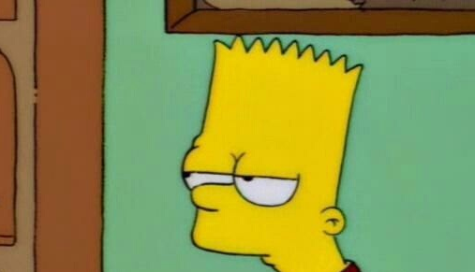
help
Tommy used to work on the docks, union's been on strike

Slide 9
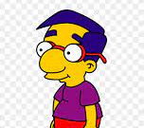
Gina works the diner all day working for her man

Slide 10
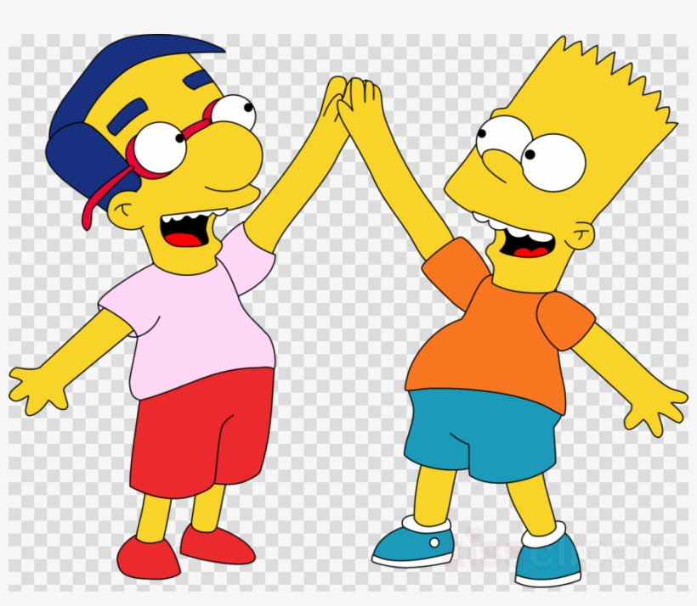
We've got each other and that's a lot for love

Slide 11
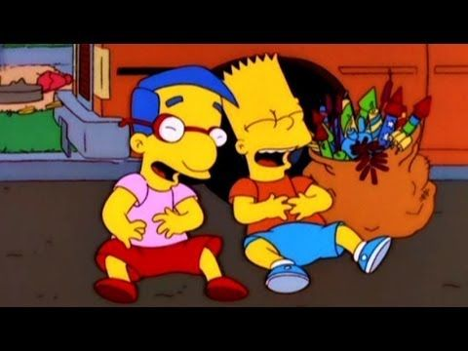
Tommy's got his six-string in hock

Slide 12
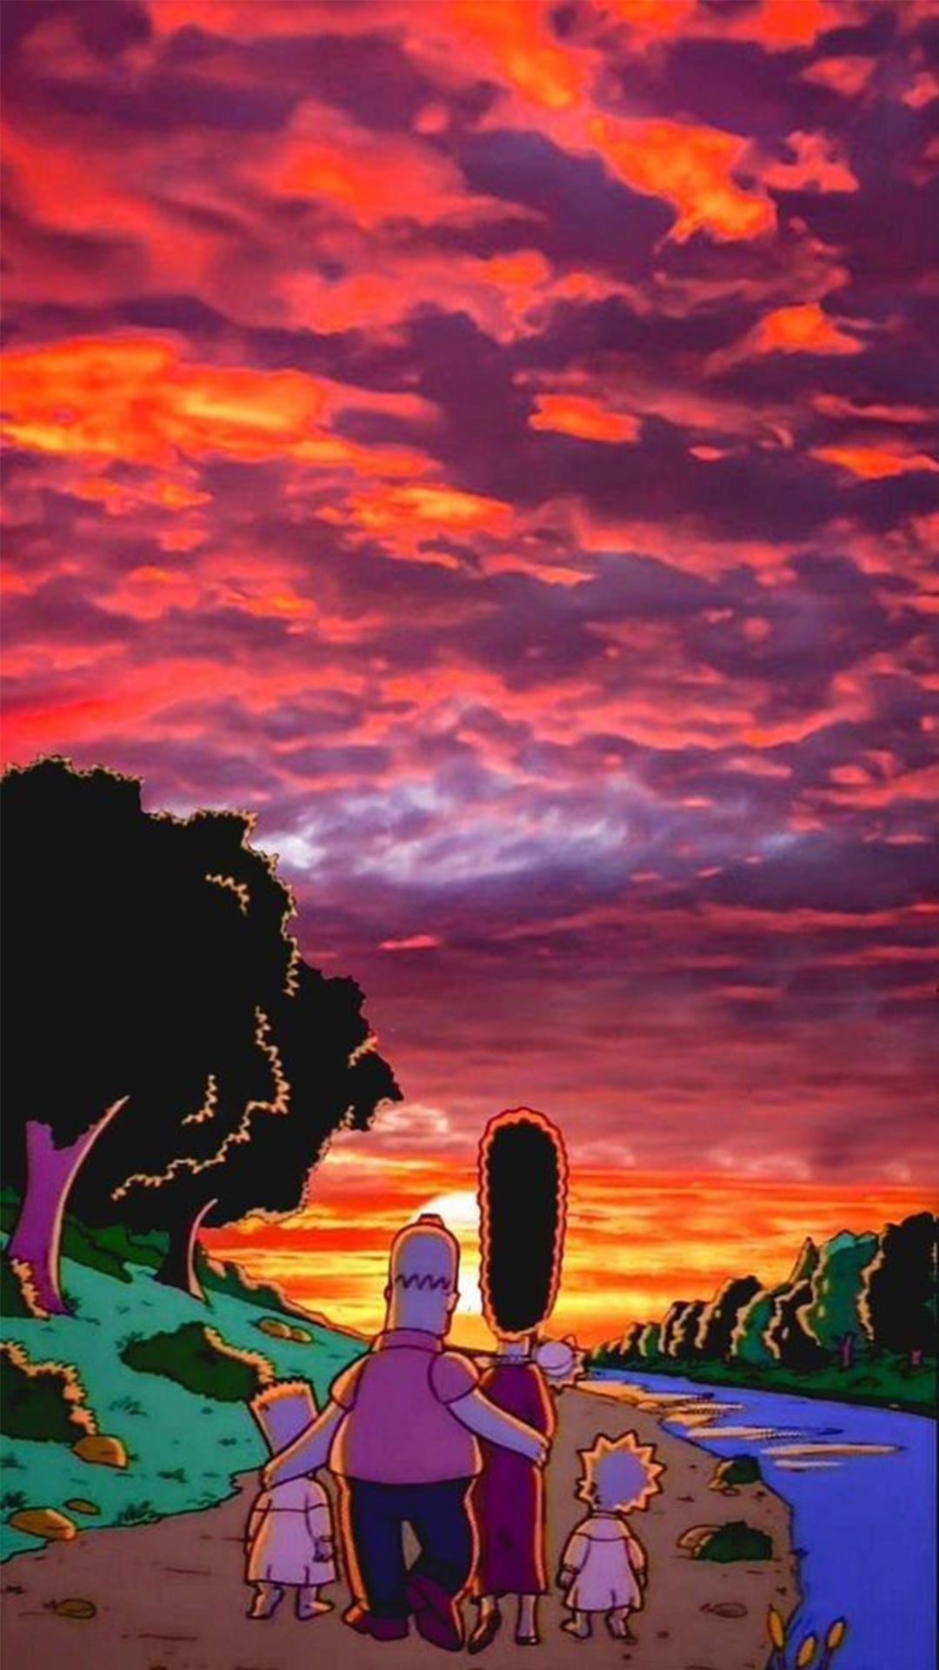
Gina dreams of running away

