Slide 1
Storyboard
Fait par Beverly

Slide 2
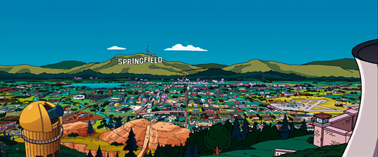
You could travel the world

Slide 3
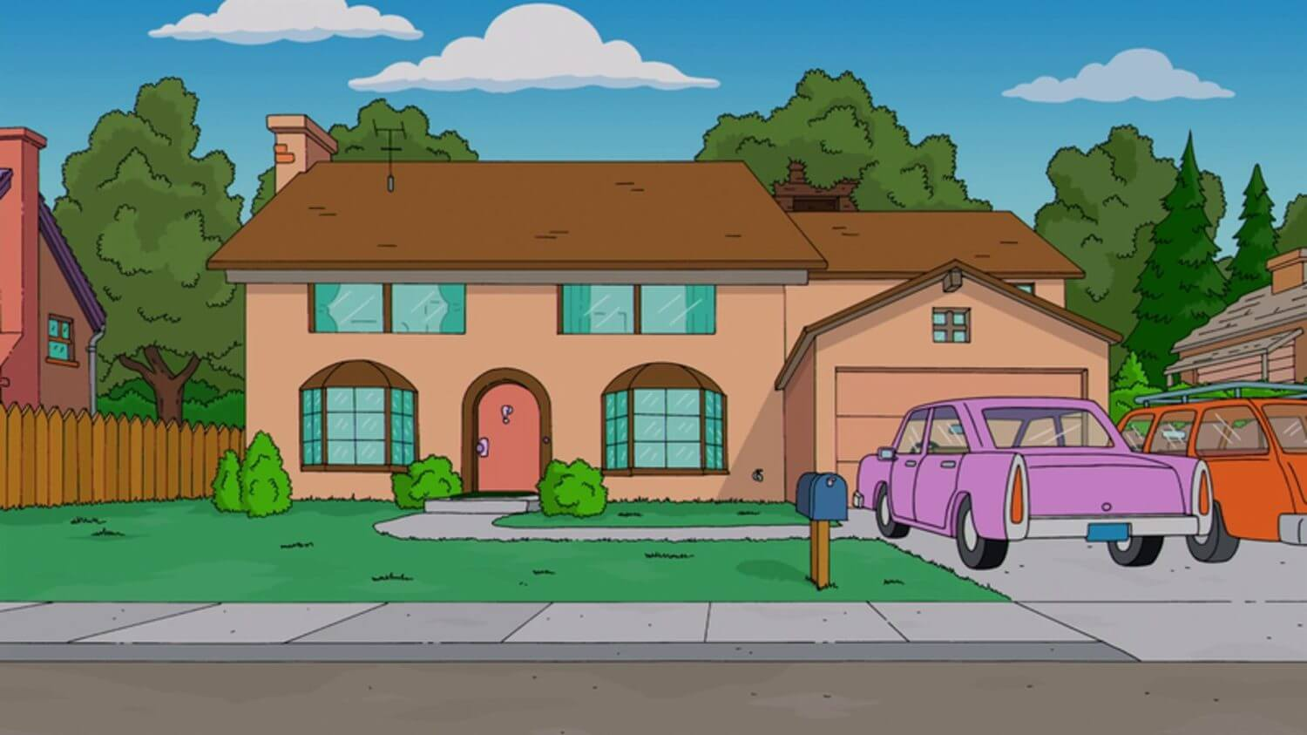
But nothing comes close

Slide 4
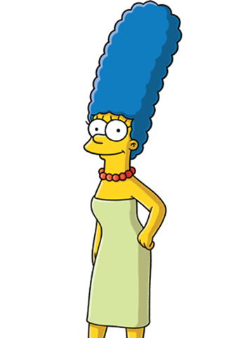
California girls

Slide 5
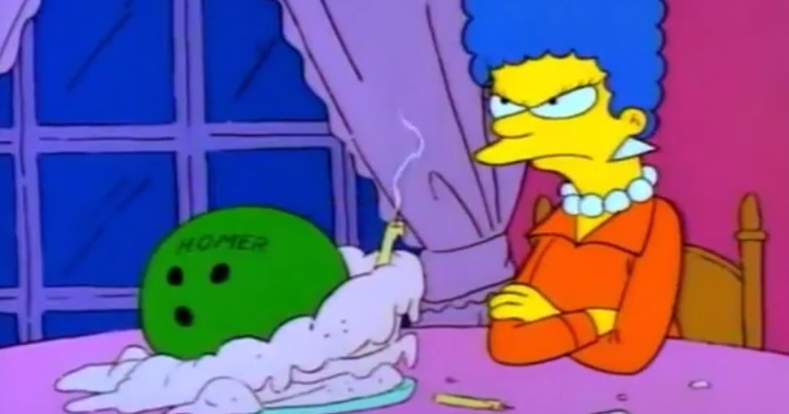
You'll be falling in love

Slide 6
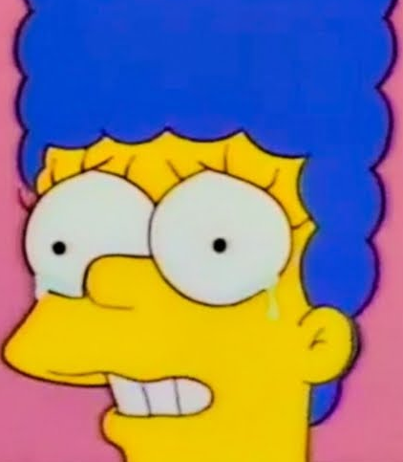
We're unforgettable

Slide 7
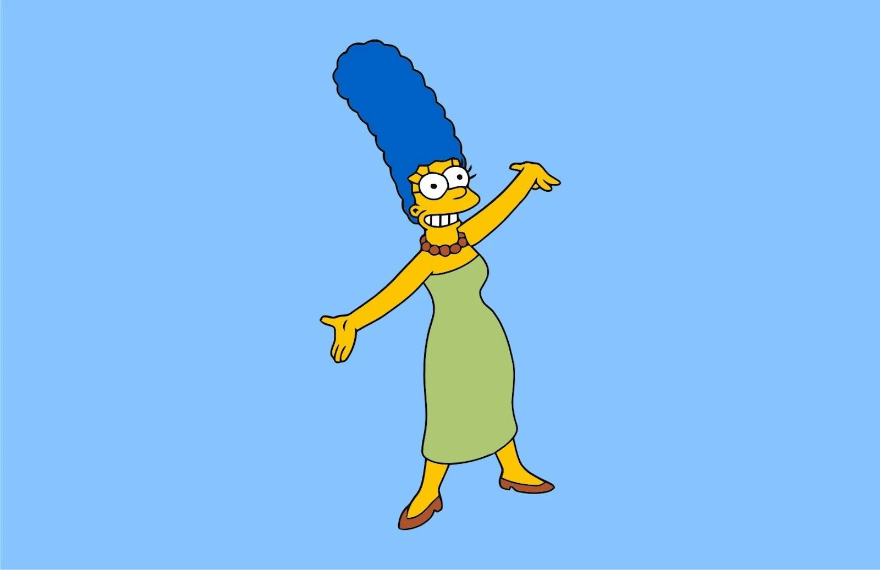
Once you party with us

Slide 8
Help
We don't mind sand in our stilettos

Slide 9
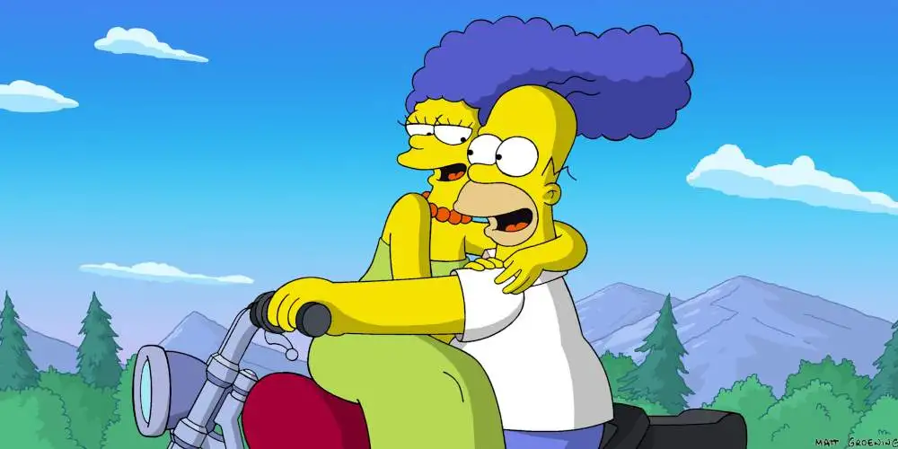
She drive a jeep

Slide 10
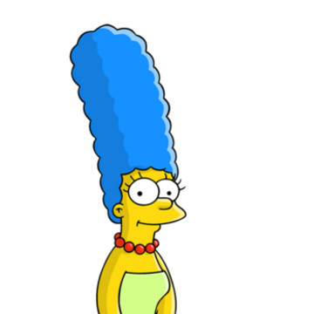
'Cause you representing California (oh yeah)

Slide 11
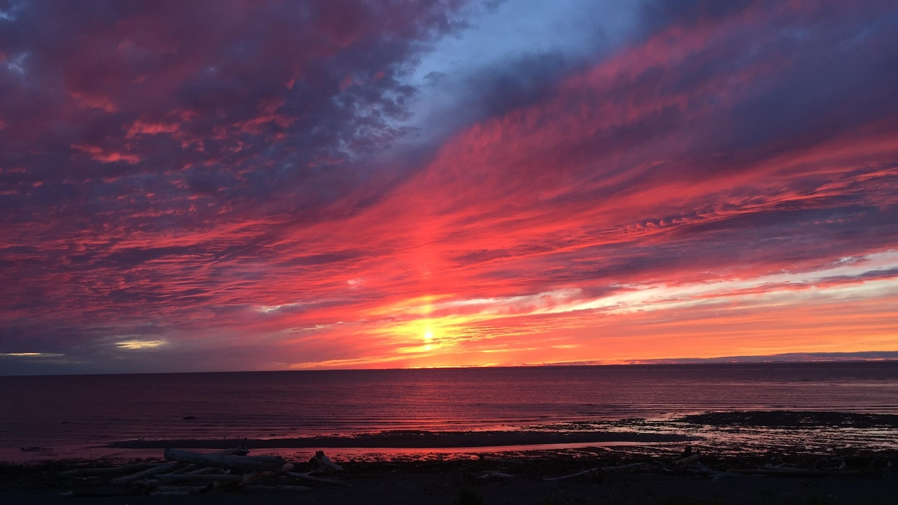
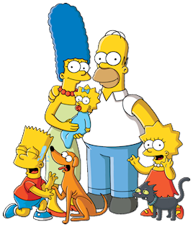
Venice Beach

