Slide 1
Story Board
Fait par anthony

Slide 2
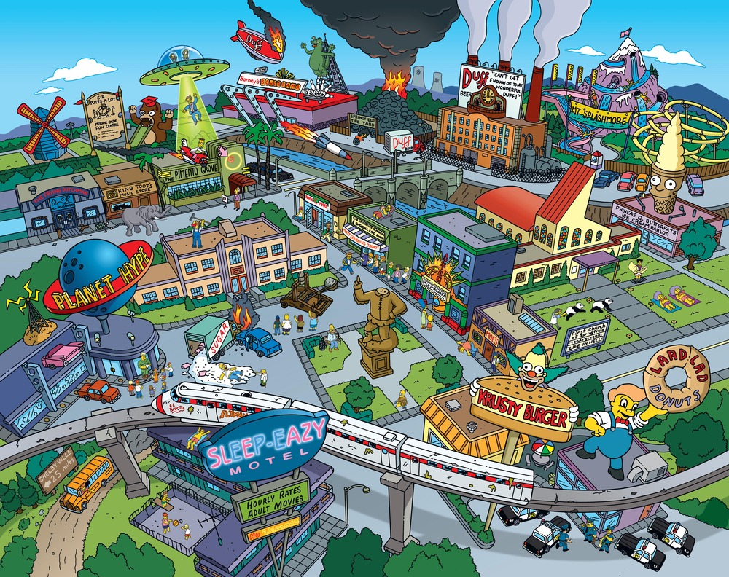
Woah, livin' on a prayer

Slide 3
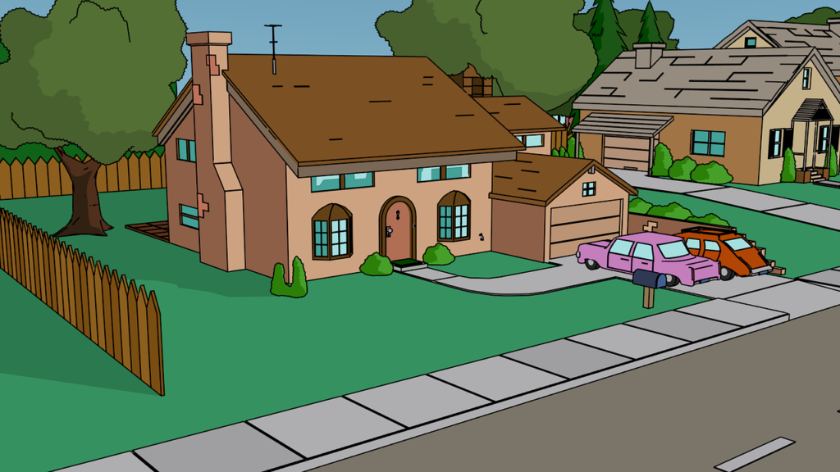
We'll give it a shot

Slide 4
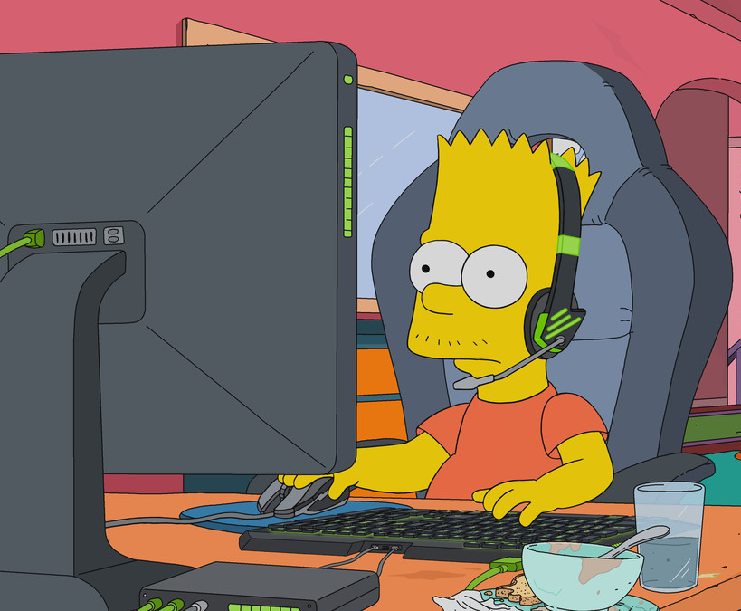
Woah, we're half way there

Slide 5
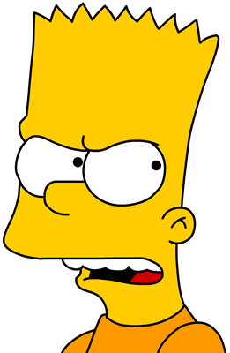
Take my hand, we'll make it I swear

Slide 6
You live for the fight when it's all that you've got

Slide 7
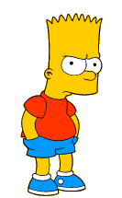
We've got each other and that's a lot for love

Slide 8
It doesn't make a difference if we make it or not

Slide 9
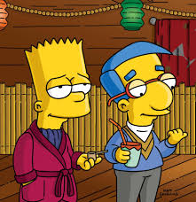
Baby, it's okay, someday

Slide 10
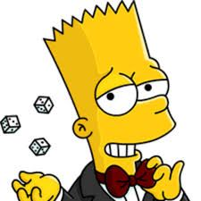
Now he's holding in what he used to make it talk

Slide 11
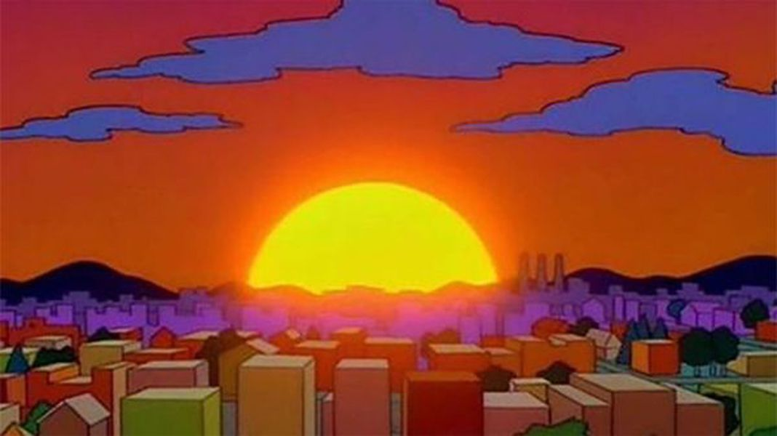
Woah, livin' on a prayer

