Slide 1
Projet G Storyboard

Slide 2
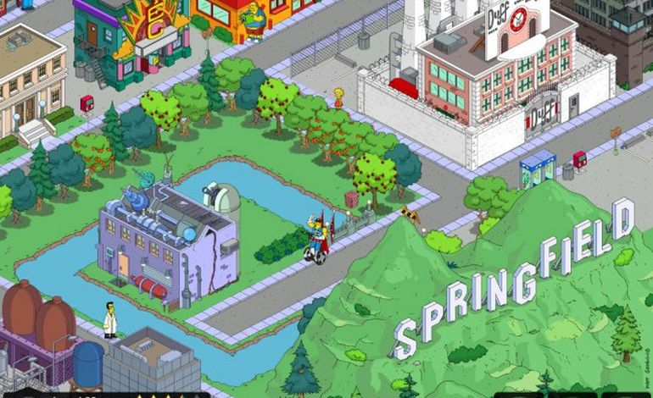
Another city goes by in the night

Slide 3
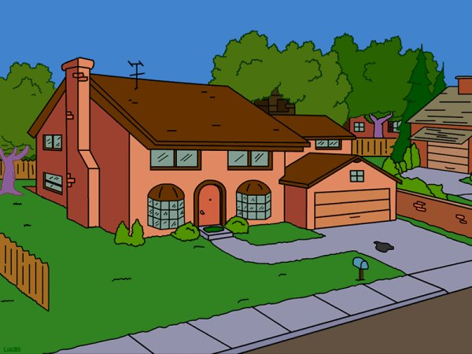
Im travellin on far and wide

Slide 4
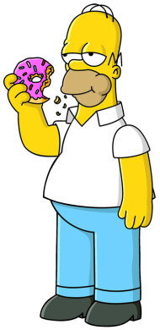
It isnt me but someone else

Slide 5
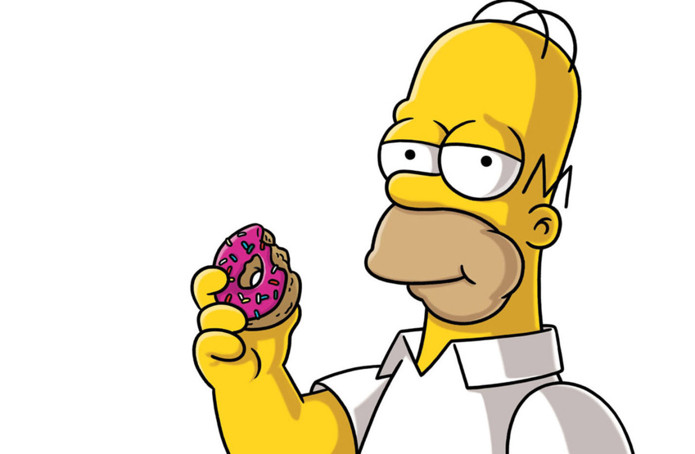
Aint it funny how it is,

Slide 6
And my heart is lying there

Slide 7
And will de til my dying day

Slide 8
Dont waste your time always

Slide 9
Face up... make your stand

Slide 10
And realise youre living in the golden years

Slide 11
Tout fini bien
Cant easy this pain so easily

