Slide 1
Projet g storyboard
Fait par Esteban Fortin
MSI2

Slide 2
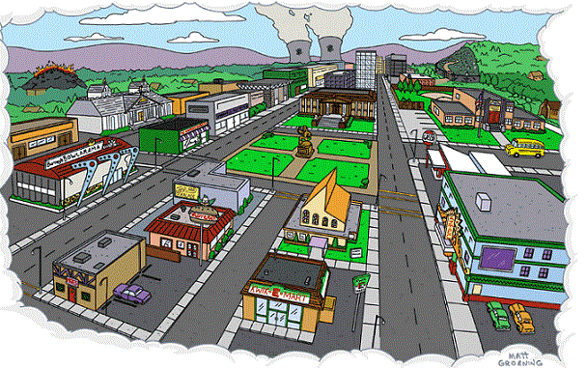
His spirit sleeping somewhere cold utile You find it there and lead it back home

Slide 3
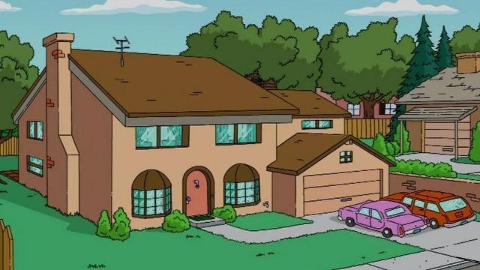
utile You find it there and lead it back home

Slide 4
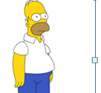
I’ve been living a lie, there’s nothing inside

Slide 5
Wake me up inside before I come undone

Slide 6
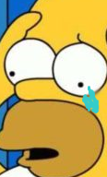
frozen inside without your touch without your love darling only you are the life among the dead

Slide 7
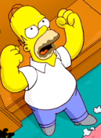
without a thought without a voice without a soul don't let me die here there must be something more

Slide 8
save me from the nothing I’ve become

Slide 9
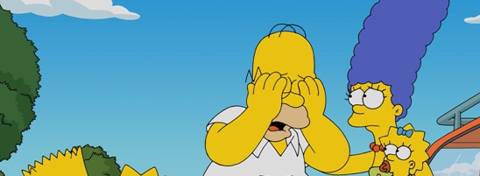
call my name and save me from the dark

Slide 10
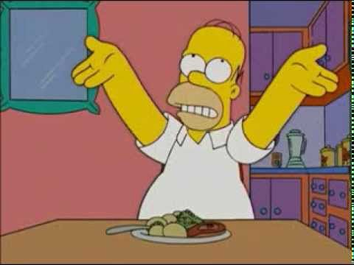
breathe into me and make me real

Slide 11
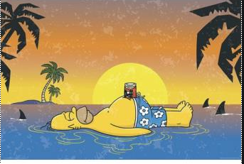
now that I know what I’m without you can't just leave me

