Slide 1
Francis Bacon
By Mathis Larivière and Marc-Olivier Drouin

Slide 2
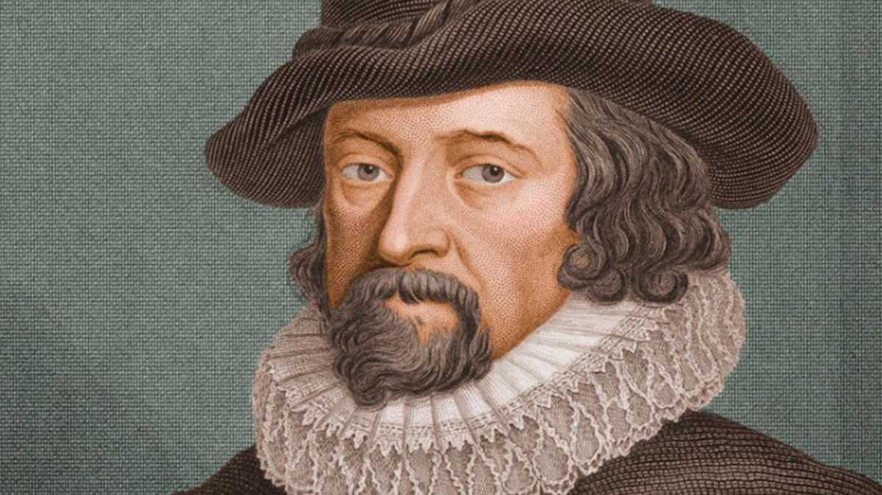
Cure the disease, and kill the patient.

Slide 3
What does he invented?
Francis Bacon discovered and popularized the scientific method, where by the laws of science are discovered by gathering and analyzing data from experiments and observations, rather than by using logic-based arguments.

Slide 4
Moment important in his life!
When Francis was 12 years old he went to Trinity College of Cambridge University with is brother Anthony Bacon.
Then,when he was a bit younger his parents have noticed that Francis was genius. After that he went back to his country because of the death of his father.
He was received as a lawyer for the queen he went to common room.

