Slide 1
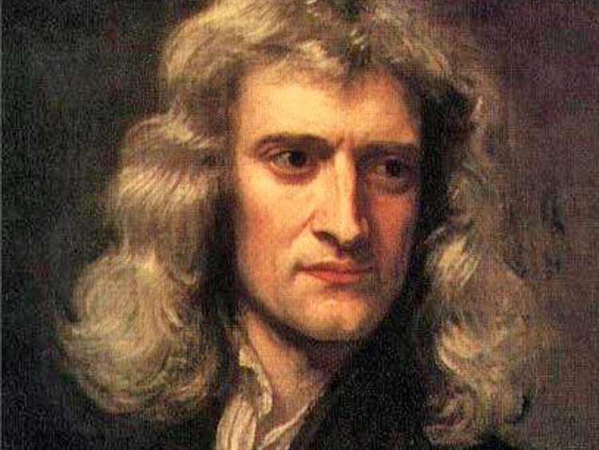
Isaac Newton

Slide 2
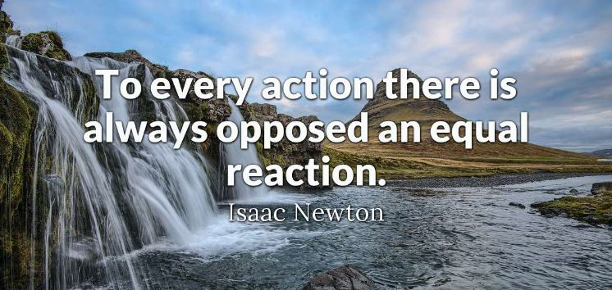

Slide 3
His search and a part of his life
His Invention: Well, Newton has shown that the motion of objects on Earth and celestial bodies are governed by the same natural laws based on Kepler's laws on the motion of planets, he developed the universal law of gravitation. In addition, to tuning the operation of the first reflection telescope with a concave primary mirror. Then, Newton discovered the universal law of gravitation that as the cause of planetary motion. Furthermore, in 1684 Newton informed in a letter to his friend Edmond Halley that he had solved the problem of force inversely proportional to the square of distances and that of elliptical orbits introduced by Kepler. Homever, gravitation is not only a force exerted by the Sun on the planets, according to the law of gravitation of Newton; all the objects of the cosmos attract each other. Indeed, the moon has an attraction. There for, he has the high tide and the low tide as cause of the moon. Moreover, Newton realized that the movements of the celestial bodies could not be constant thus opening the way to the relativistic mechanics and the elaboration of the principle of relativity by Albert Einstein. Finally, Newton said that the planets do not pass twice in the same orbit. To conclude, like Newton said: The celestial mechanics, which rests on Kepler’s three laws and Newton’s universal law of gravitation, suffices, even today, to explain by calculation the movements of the stars in a local universe, such as the solar system.
About him: He was born the 25th December 1642 and he die the 20 march 1727 at 84 years’ old. He is an English guy because he’s from England.
Areas: Astronomy, mathematics, physical, alchemy, theology and philosophy of nature
His sign:

Slide 4
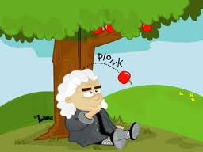
The impact of this creator nowaday
This scientist prove that all the object in the space attract other object. Without this theory, we will thank that the gravity is generate with gods. Indeed, in the XVII and the XVIII the church was very important and this monument did’nt like scientist theory because there was a threat for the religion. To sum up, if the universal gravitation laws would not be elaborated, we will have a scare life and we will thank that they had creature and this creature attract our sea, rivier and all water that have tide.

