Slide 1
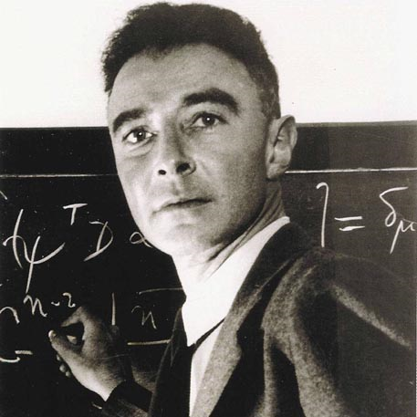
Julius Robert oppenheimer
« I need physics more than friends. »
« Oppenheimer's one and only revolutionary contribution to science »
BY: Aymrik Rodrigue and William Latulippe

Slide 2
PRIMARY INFORMATION
22 April 1904 - 18 february 1967
haRVARD
Profession : THEORICAL PHYSICAL

Slide 3
invention
Atomic bomb

Slide 4
Part of is life
December 1925
Paris

Slide 5
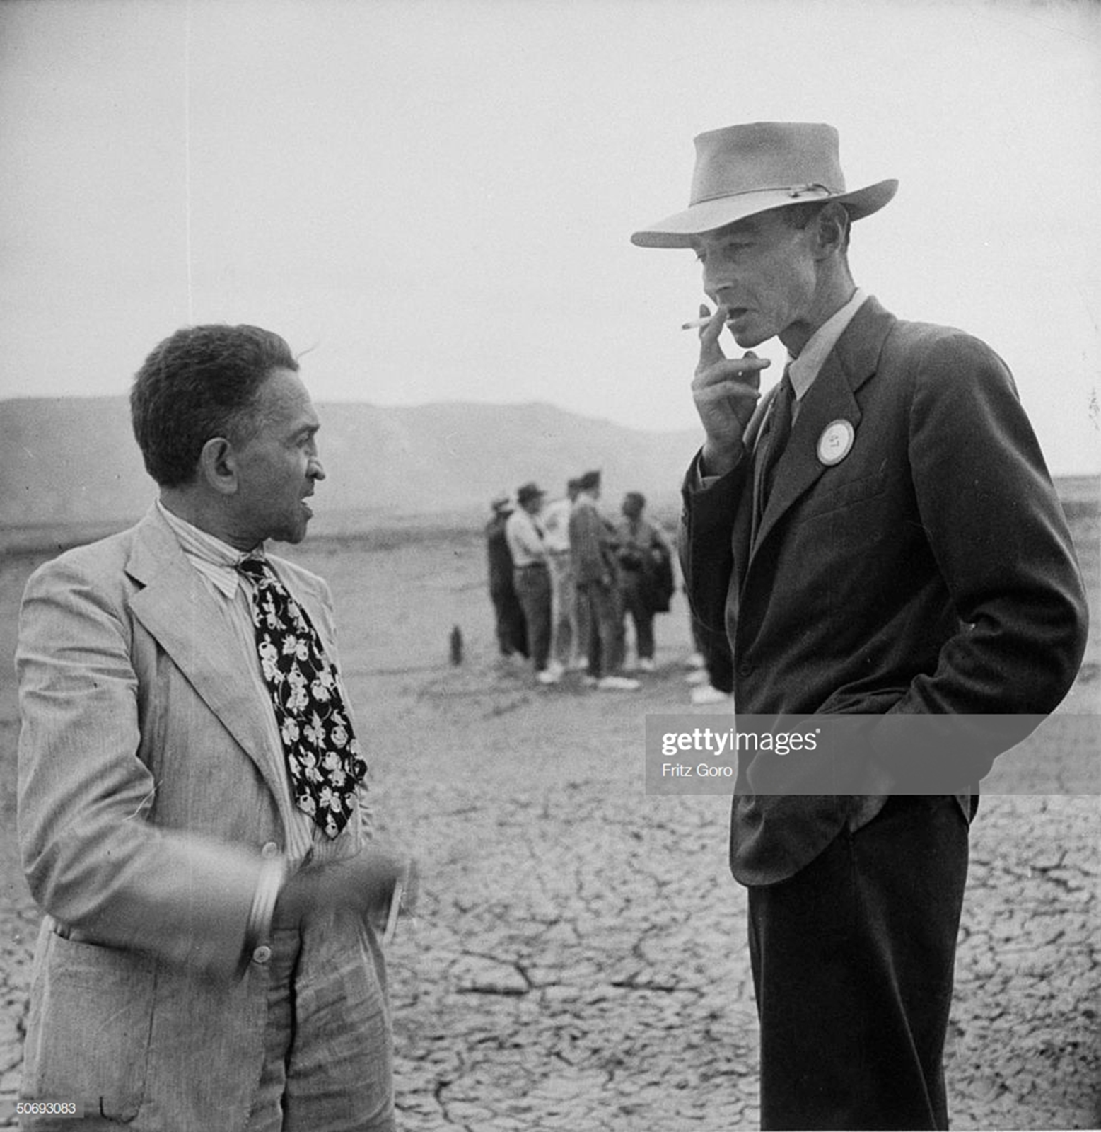
The Impact of this creator
Atomic bomb and war

