Slide 1
storyboard
1: grand plan d’ensemble
2: plan d’ensemble
3: plan général
4: plan moyen
5: plan pied
6: plan américain
7: Plan ceinture
8: plan buste
9: plan épaule
10: plan tète
11: extrême gros plan

Slide 2
storyboard
Informatique
Fait par: Simon-Olivier
Présenté à: Daniel Blais
Msi2
13 nov 2017

Slide 3
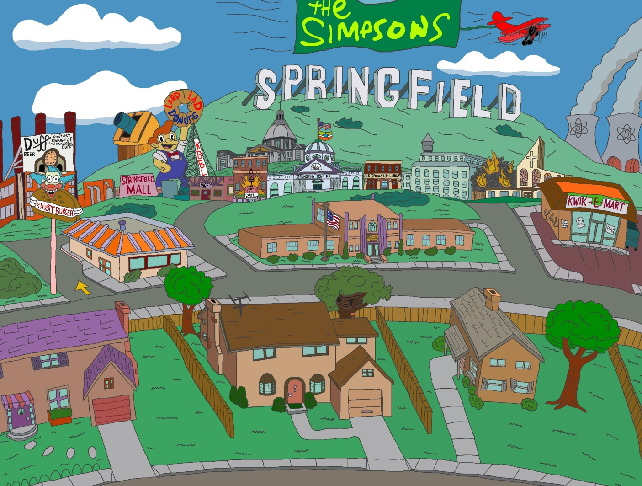
Once upon a time

Slide 4
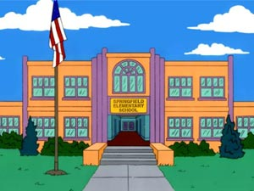
Not so long ago

Slide 5
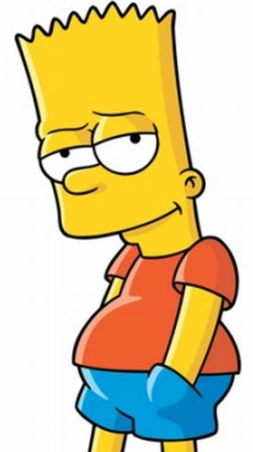
He's down on his luck

Slide 6
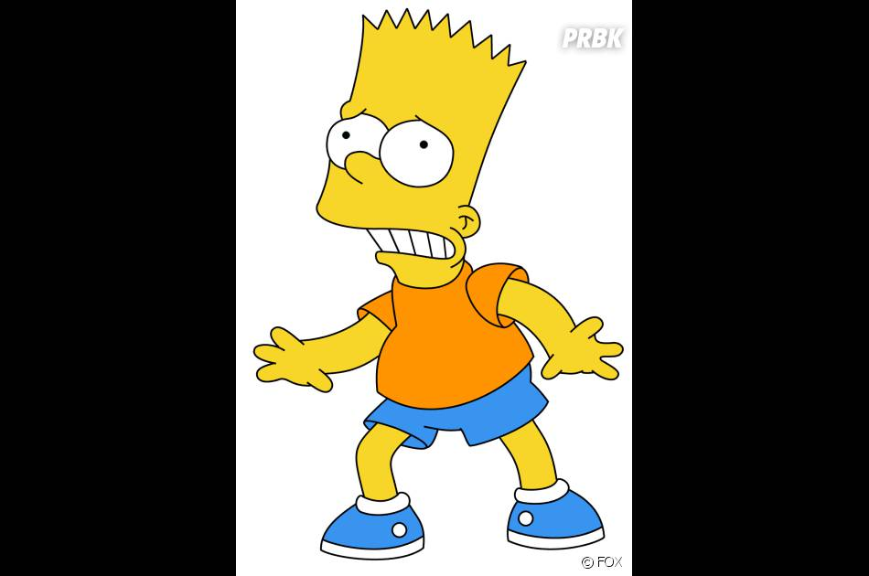
So tough, it's tough

Slide 7
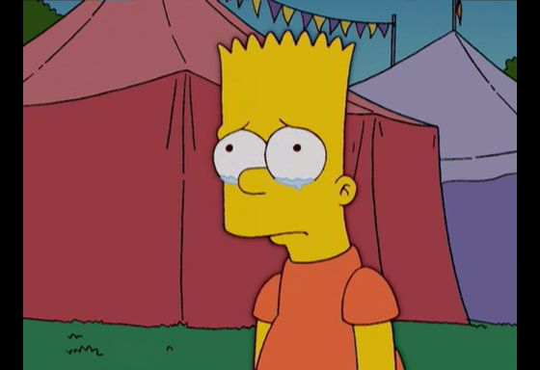
When he cries in the night

Slide 8
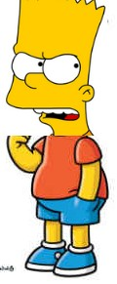
Now he's holding in what he used to make it talk

Slide 9
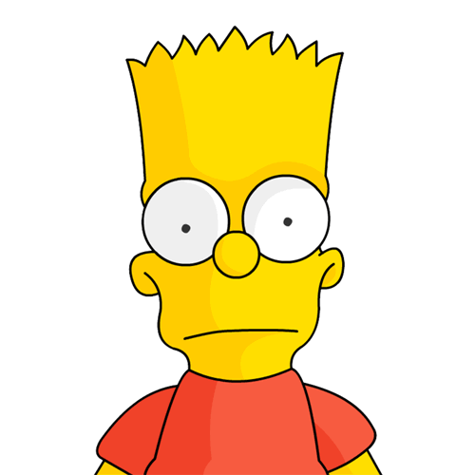
It doesn't make a difference if we make it or not

Slide 10
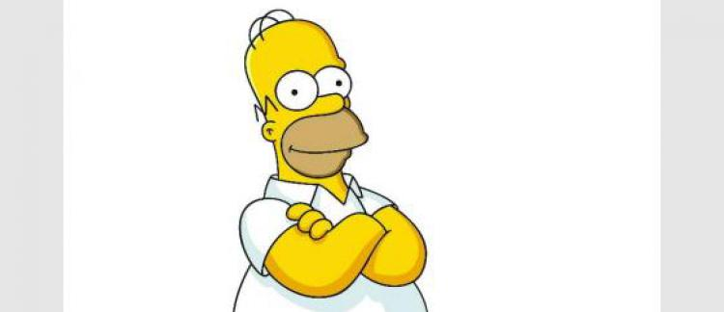
Tommy whispers : Baby it's okay, someday

Slide 11
Livin' on a prayer

Slide 12
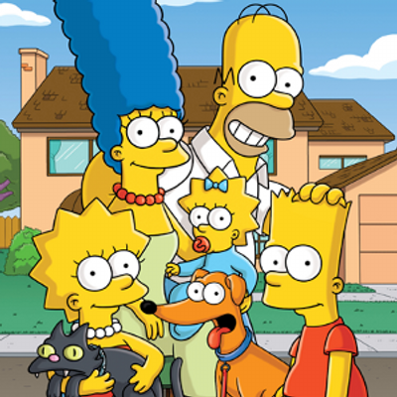
We've got each other and that's a lot for love, for love

