Slide 1
Storyboard Fait par: Marc-Antoine Huot Date: 13 novembre 2017

Slide 2
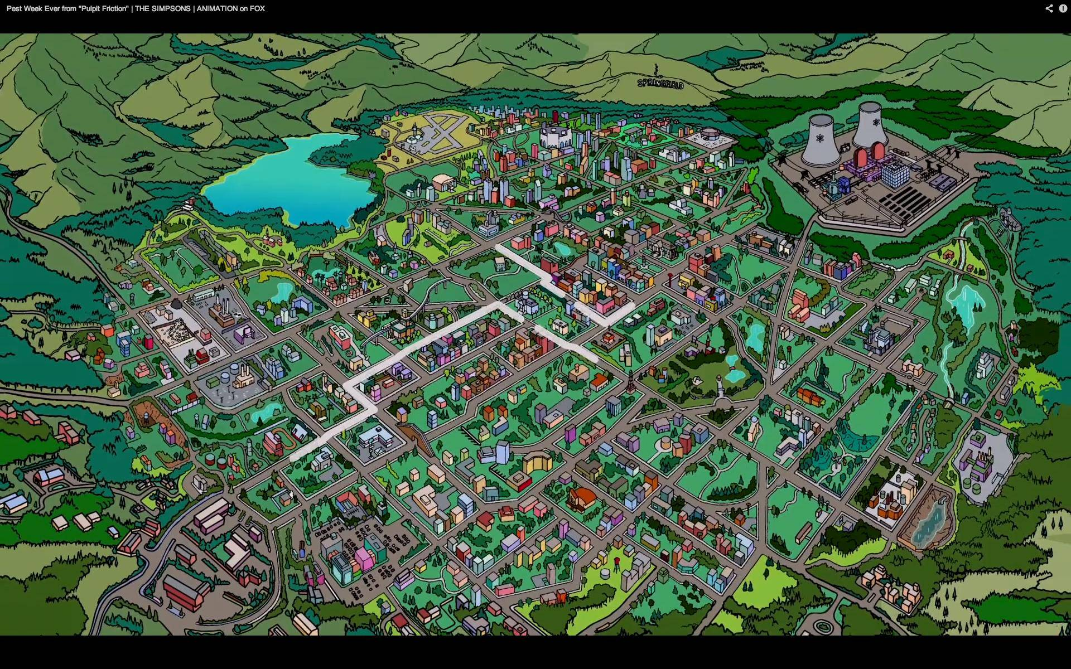
Worlds apart

Slide 3
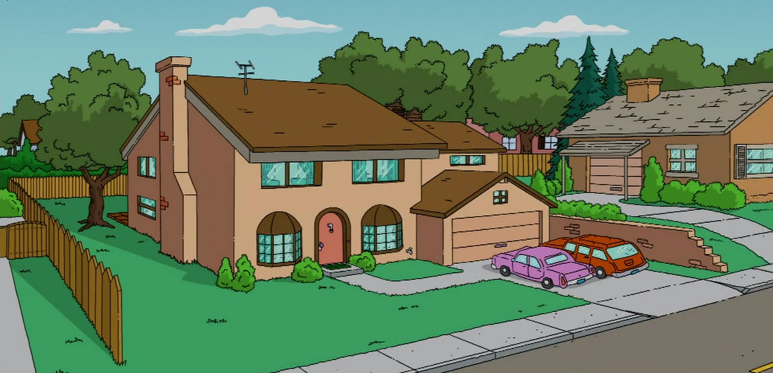
I'm reaching for you, you, you

Slide 4
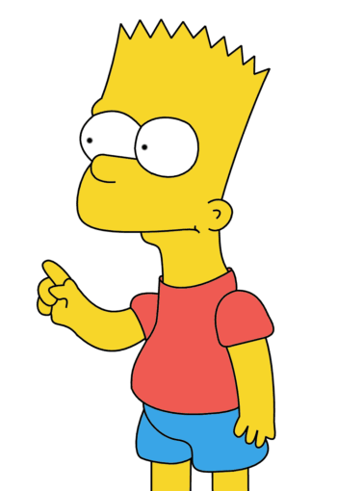
Break those chains that bind you

Slide 5
Caught between confusions and pain, pain, pain

Slide 6
Promises we made were in vain

Slide 7
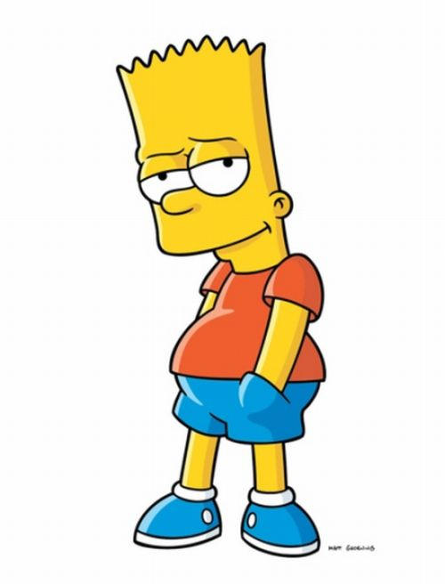
True love won't desert you

Slide 8
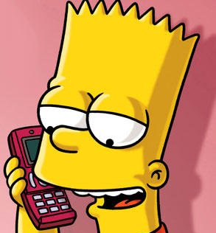
I still love you, girl

Slide 9
One night will remind you

Slide 10
You'll never walk alone

Slide 11
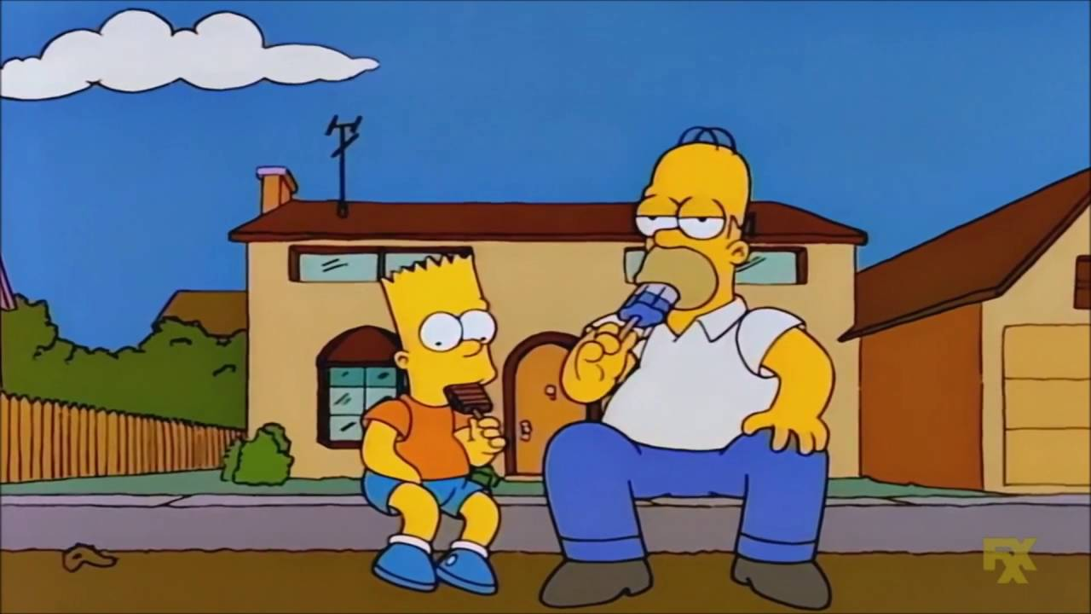
Though we touched

