Slide 1
Play the guitar

Slide 2
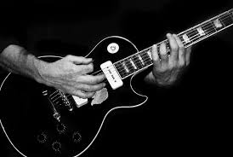
Jacob try to play the guitar but Is was not good.
But they was persevered

Slide 3
Jacob call Jeremy because is was very good at the guitar
and he want Jeremy for her guitar teacher.

Slide 4
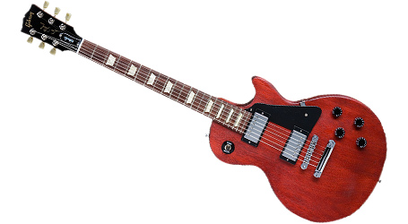
Jacob listen rapidly the guitar and they
are more and more good at all class.

Slide 5
He practice and practice during two years
and after he was good as jeremy for play
the guitar. He was very happy.

Slide 6
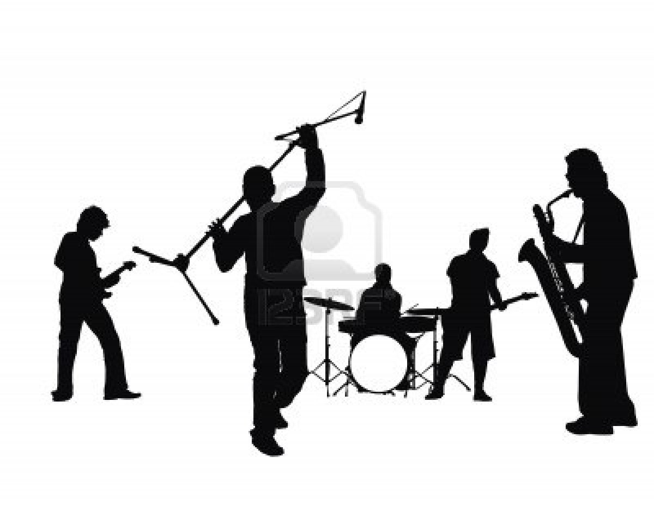
Jeremy think that Jacob was pretty good
so Jeremy would create a group with Jacob and the name was jéjack

